Slide 1
The Church at Ephesus

Slide 2
The Church of Ephesus
Revelation 2:1-7 –
To the angel of the church of Ephesus write, ‘These things says He who holds the seven stars in His right hand, who walks in the midst of the seven golden lampstands:

Slide 3
“I know your works, your labor, your patience, and that you cannot bear those who are evil. And you have tested those who say they are apostles and are not, and have found them liars; and you have persevered and have patience, and have labored for My name’s sake and have not become weary.

Slide 4
Nevertheless I have this against you, that you have left your first love. Remember therefore from where you have fallen; repent and do the first works, or else I will come to you quickly and remove your lampstand from its place—unless you repent.

Slide 5
But this you have, that you hate the deeds of the Nicolaitans, which I also hate. “He who has an ear, let him hear what the Spirit says to the churches. To him who overcomes I will give to eat from the tree of life, which is in the midst of the Paradise of God.”

Slide 6
Note Revelation 1:19
Things which you have seen:
Revelation Chapter 1
Things which are:
Revelation Chapters 2 and 3
Things which will take place:
Revelation Chapters 4 – 22

Slide 7
The pattern in the seven letters:
1) Commendations & Condemnations
2) Special rewards for overcomers
3) Closing – “He who has an ear to hear, let him hear what the Spirit says unto the churches”

Slide 8
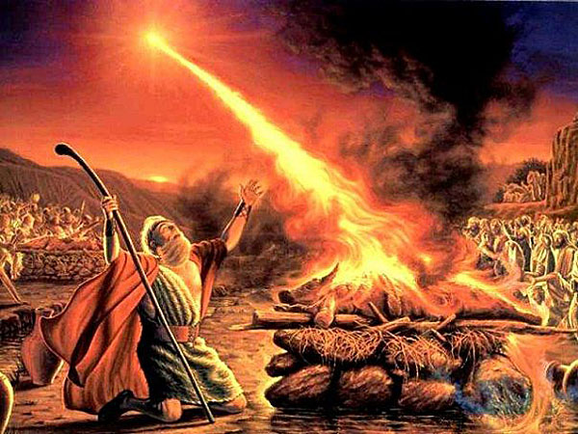
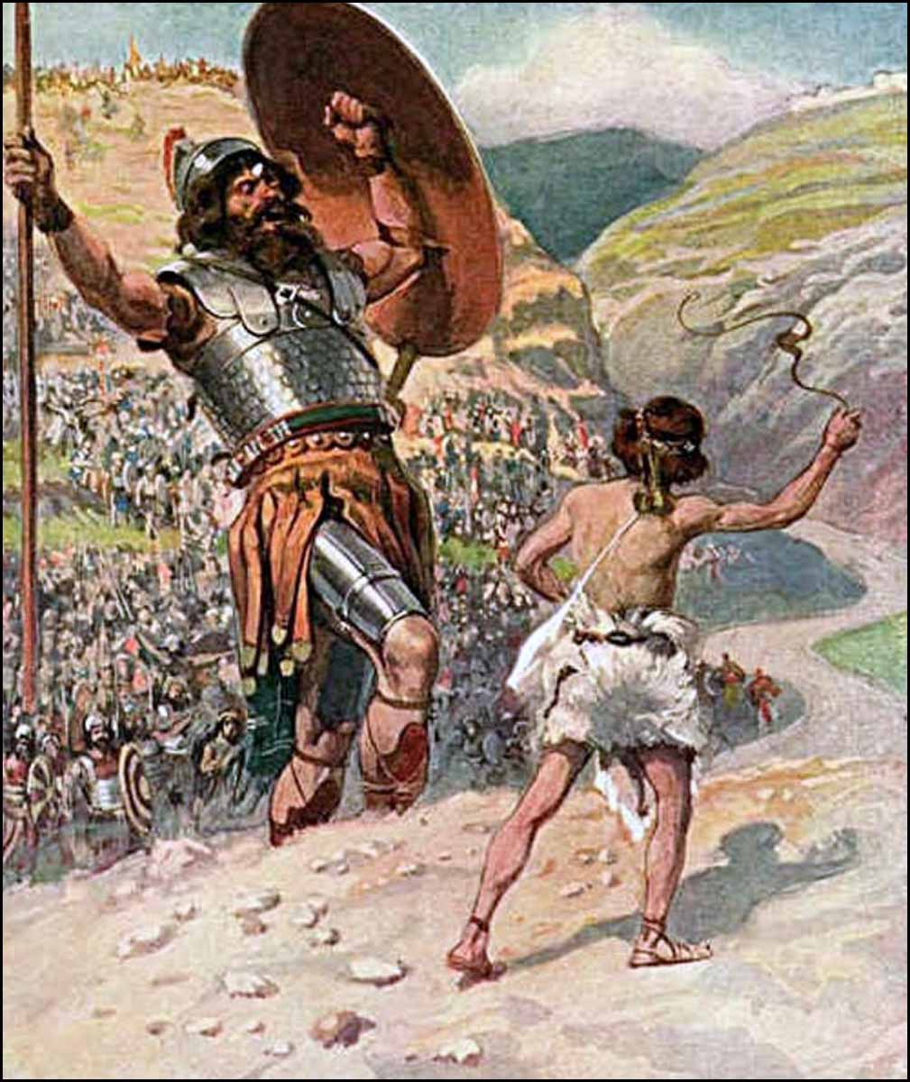
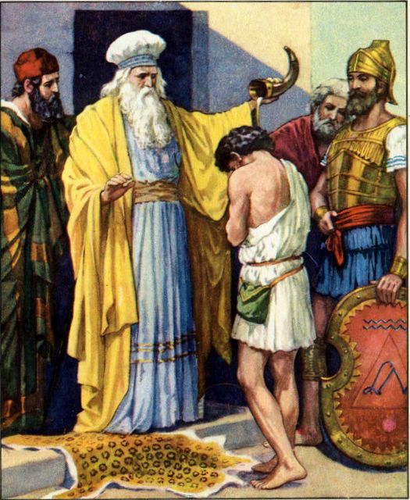
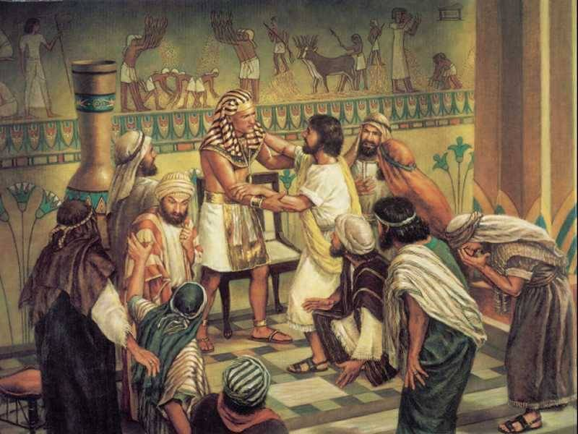
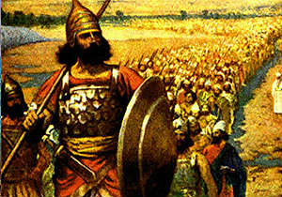
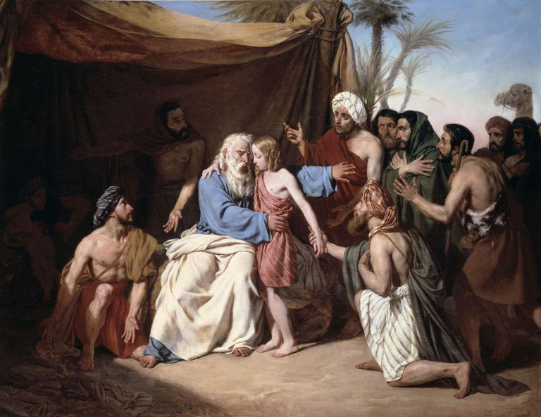
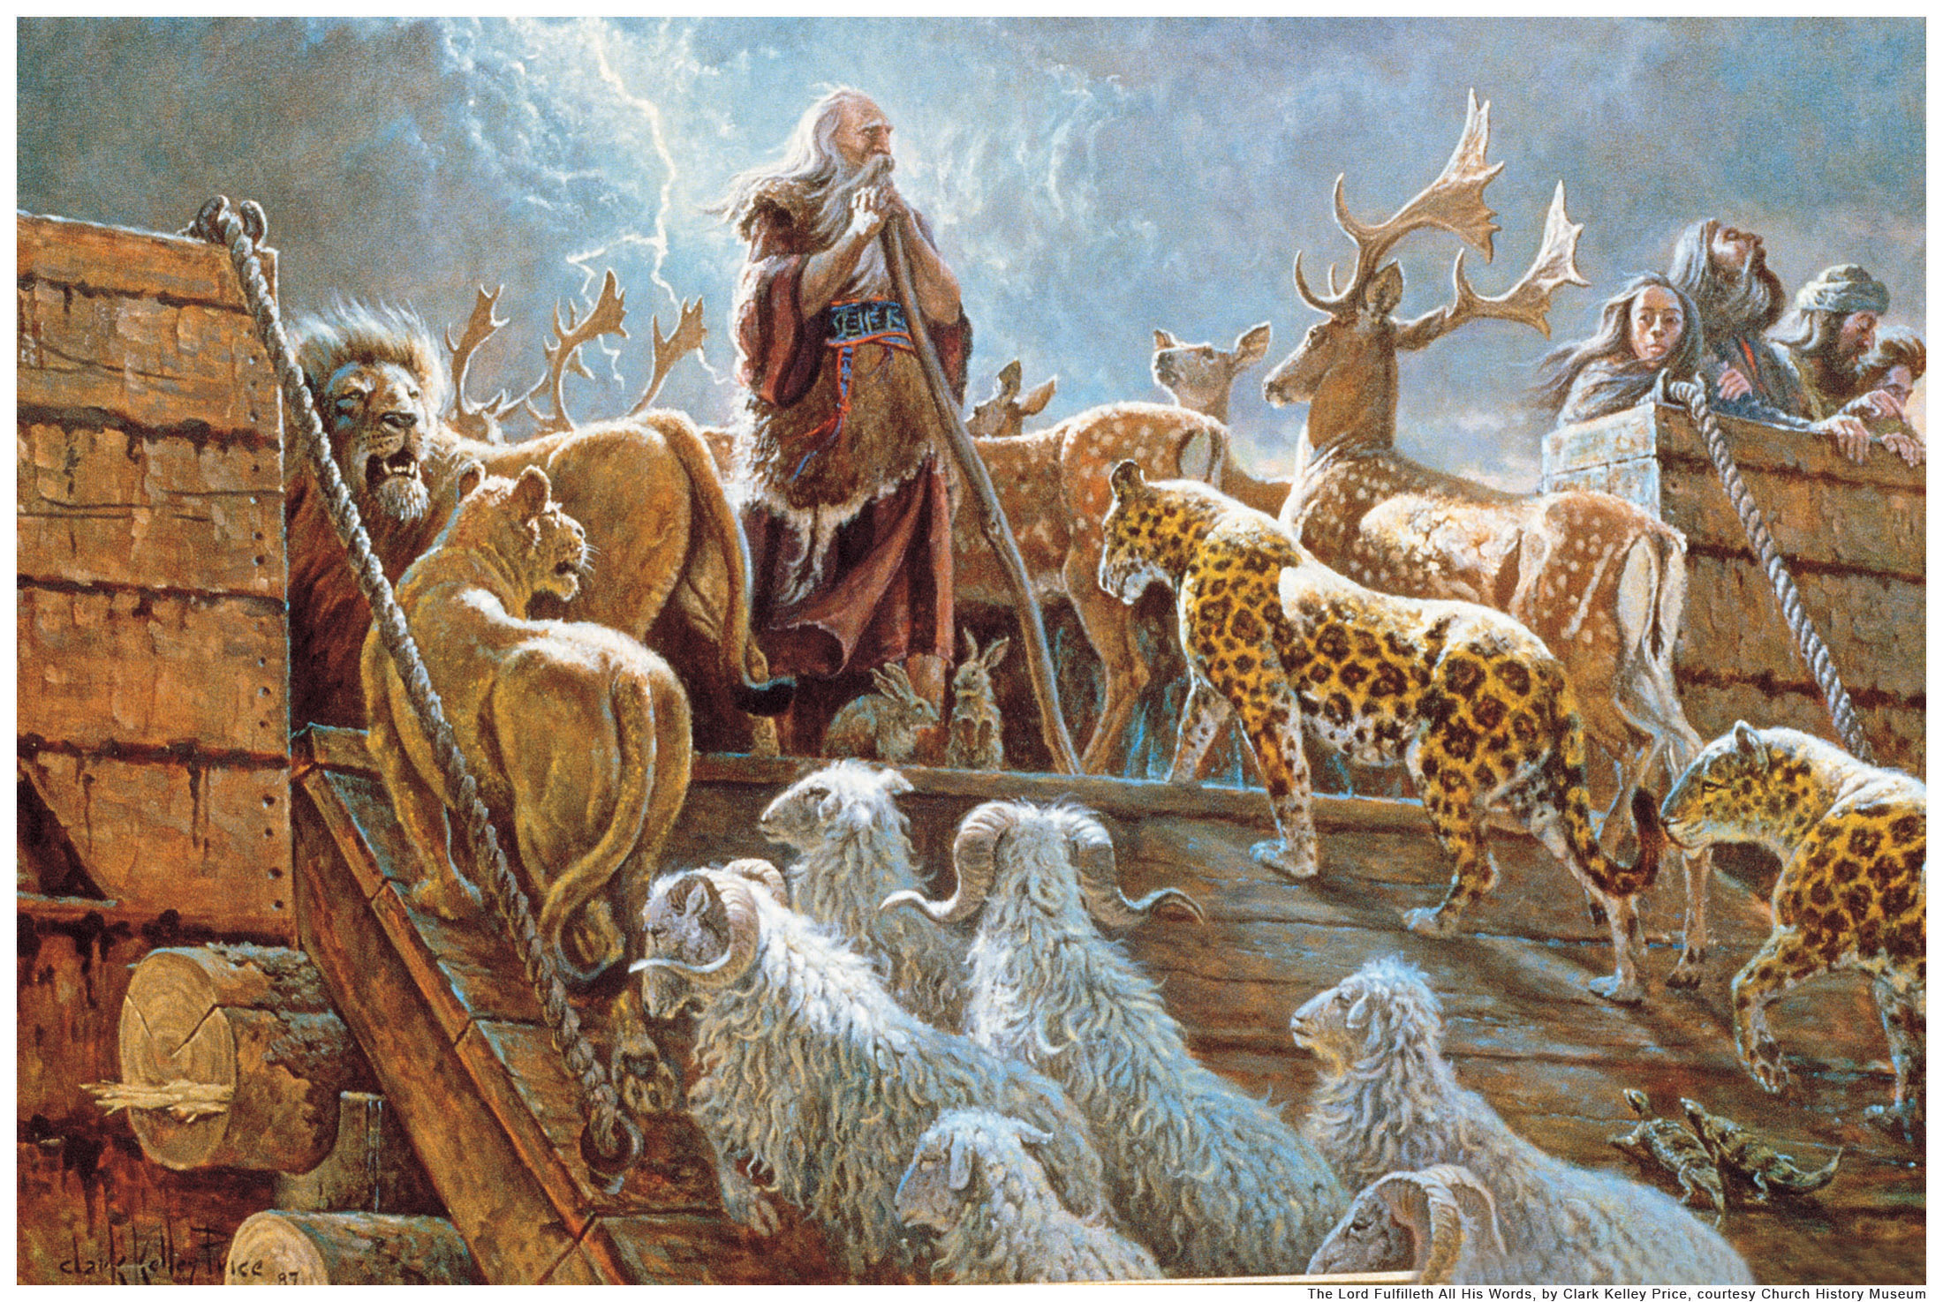
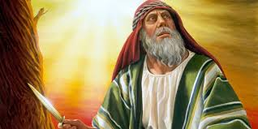
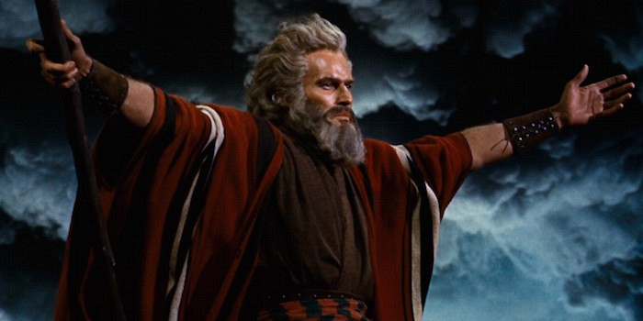
To the angel of the church of Ephesus
one “angel” (angelos = messenger)
God has always dealt with one man

Slide 9
We must be sure we are following a true man of God – one whom God is obviously leading – and get behind him.

Slide 10
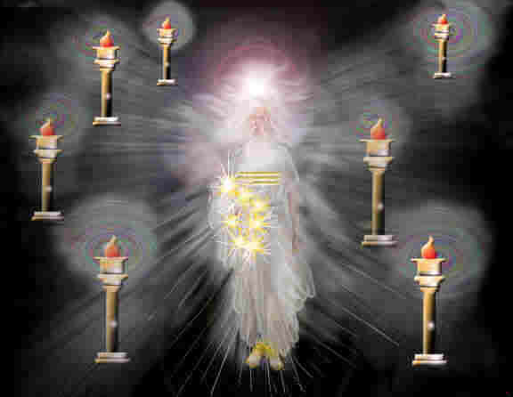
7 golden lampstands = 7 churches
Our High Priest:
Trims the church
Cleans the church
Replenishes the oil
Hebrew Priests:
Trimmed the lamps
Cleaned the lamps
Replenished the oil
Brass = Judgment

Slide 11
The City of Ephesus

Slide 12
Gateway in Ephesus

Slide 13
Gateway in Ephesus

Slide 14
The Temple of Diana (Artemis)

Slide 15
The Temple of Diana (Artemis)

Slide 16
Diana (Artemis)

Slide 17
Diana (Artemis)

Slide 18
Highway in Ephesus

Slide 19
Inscription on Mazeus-Mithridates

Slide 20
Great Theatre in Ephesus

Slide 21
View from the Great Theatre

Slide 22
View of Highway from the Great Theatre

Slide 23
Toilets in Ephesus

Slide 24
Nike in Ephesus

Slide 25
The Commendation – verses 2 and 3
I know your works… God knows. Works = ergon (energy) The church of Ephesus had energetic works!
I know your labor… The members went the distance! They kept at it when it wasn’t convenient – they sacrificed to keep the work going.
I know your patience… They did not get discouraged. They were not popcorn members – they loved their church.

Slide 26
The Commendation – verses 2 and 3
You cannot bear those who are evil. They hadn’t gotten used to the dark!
(Think of a dark room on a sunny day)
We’ve gotten used to the dark!!
We turn our eyes away from blatant sin
“That’s just the way things are today.”
We’ve decided to live with it – sometimes even to embrace it!

Slide 27
The Commendation – verses 2 and 3
You have tested those who say they are apostles and are not, and have found them liars.
The Ephesians knew their doctrines well. They were not easily fooled.
There were no printing presses. Copies of the Word of God were few, and kept in synagogues.

Slide 28
The Commendation – verses 2 and 3
They had the teachings of the apostles that they continued to teach.
When Paul wrote his letter to the Ephesians, he filled it with doctrine.
The book of Ephesians is stocked full of truths including:

Slide 29
Ephesian Doctrines…
…just as He chose us in Him before the foundation of the world…
…having predestined us to adoption as sons by Jesus Christ to Himself, according to the good pleasure of His will…
…in Him we have redemption through His blood, the forgiveness of sins…

Slide 30
Ephesian Doctrines…
…in whom also, having believed, you were sealed with the Holy Spirit of promise…
…and He put all things under His feet, and gave Him to be head over all things to the church, which is His body, the fullness of Him who fills all in all…
…and you He made alive, who were dead in trespasses and sins…

Slide 31
Ephesian Doctrines…
…for by grace you have been saved through faith, and that not of yourselves: it is a gift of God, not of works, lest anyone should boast…
…for we are His workmanship, created in Christ Jesus for good works, which God prepared beforehand that we should walk in them…

Slide 32
Ephesian Doctrines…
…to make all see what is the fellowship of the mystery, which from the beginning of the ages has been hidden in God who created all things through Jesus Christ…
…He who descended [into the lower parts of the earth] is also the One who ascended far above all the heavens, that He might fill all things…

Slide 33
Ephesian Doctrines…
…and He Himself gave some to be apostles, some prophets, some evangelists, and some pastors and teachers, for the equipping of the saints…
…that we should no longer be children, tossed to and fro and carried about by every wind of doctrine, by the trickery of men…

Slide 34
Ephesian Doctrines…
…that you should no longer walk as the rest of the Gentiles walk, in the futility of their mind, having their understanding darkened…
…and be renewed in the spirit of your mind, and that you put on the new man which was created according to God, in righteousness and true holiness…
…do not grieve the Holy Spirit of God, by whom you were sealed for the day of redemption…

Slide 35
Ephesian Doctrines…
…let no one deceive you with empty words…
…have no fellowship with the unfruitful works of darkness, but rather expose them…
…wives, submit to your own husbands…
…husbands, love your wives...
…children, obey your parents in the Lord

Slide 36
Ephesian Doctrines…
…put on the whole armor of God…
…praying always…
…being watchful to this end with all perseverance…

Slide 37
The Condemnation (Complaint) – verse 4
I have somewhat against you – you have left your first love.
Their service had become mechanical.
The preaching had become robotic.
The singing had become mundane.
The teaching had become tedious.
Their devotion had become routine.
Their enthusiasm had become molded.
It was all monotonous – cut & dried – without emotion or excitement.

Slide 38
The Condemnation (Complaint) – verse 4
We need to be careful to keep our relationship with Christ fresh and new each day.
always in an attitude of prayer
reading God’s Word with fervency
expecting the Lord’s intervention at all times
coming to worship & give praise to the Lord rather than to be entertained

Slide 39
The Counsel – “Remember…” – verse 5
Remember your sin and where you were headed before the Lord saved you
Remember when you first came to know the Lord
Remember when you didn’t have to be coaxed out of bed on Sunday morning
Remember the love you had for the Lord, the Lord’s work, and for His people

Slide 40
The Counsel – “Remember…” – verse 5
Remember the flame that burned in your heart to read His Word, to sing songs of praise to His name, to be taught His truths, and to tell others about Him
Remember the sweet fellowship you had with the Lord in prayer each night and every morning
Spend some time remembering.

Slide 41
The Counsel – “…then Repent” – verse 5
Then… repent and do the first works. Ask the Lord for forgiveness for neglecting your relationship.
Begin to watch for God’s hand in your life. As you take each step, expect Him to intervene.
Be ready at all times to sing praises to His name or to pick up His Word for guidance and comfort.

Slide 42
The Counsel – “…then Repent” – verse 5
Do the first works – go, preach the gospel to all the world…
Your family needs your witness
Your neighbors need your influence
…or else I will come to you quickly and remove your lampstand from its place—unless you repent.

Slide 43
In 268 AD, the Temple was destroyed or damaged in a raid by the Goths, an East Germanic tribe. “[They] took ship and sailed across the strait of the Hellespont to Asia. There they laid waste many populous cities and set fire to the renowned temple of Diana at Ephesus.”
Jordanes, Getica xx.107.

Slide 44
Ephesus never recovered its glory.
The coastline changed drastically until the famous port was no longer functional.
Now there is only a small village that tourists can visit.
There is no church in Ephesus today.

Slide 45
God can remove our lampstand.
Even if we get all the doctrine right and have all the programs going, if we have left our first love, it is in vain.
Don’t leave your first love. Nothing else is so important.

Slide 46
Additional Commendation: – verse 6
But this you have, that you hate the deeds of the Nicolaitans, which I also hate.
The Lord is so good!! Even though the Church in Ephesus had lost their first love and had become stale in their worship, the Lord loved them and had not given up on them. He did not want to leave them with a harsh complaint. Instead, He again commended them for their adherence to the truth.

Slide 47
Additional Commendation: – verse 6
"Nicolaitans" is from the compound Greek word nikolaos
nikos = to conquer or to subdue
laos = the people (root of our word laity)
nikos + laos = also the name Nicolas, literally: one who conquers and subdues the people.

Slide 48
Ireneus and Hippolytus recorded many events in the earliest recorded days of Church history.
They said the Nicolaitans = spiritual descendants of Nicolas of Antioch, a deacon in Acts 6:5.
This Nicolas seeded corruption in his teaching.

Slide 49
Nicolas taught compromise: that total separation between Christianity and the practice of occult paganism was not essential.
The Ephesian church, like our Lord, hated false teachings, and kept to the pure gospel of Christ!

Slide 50
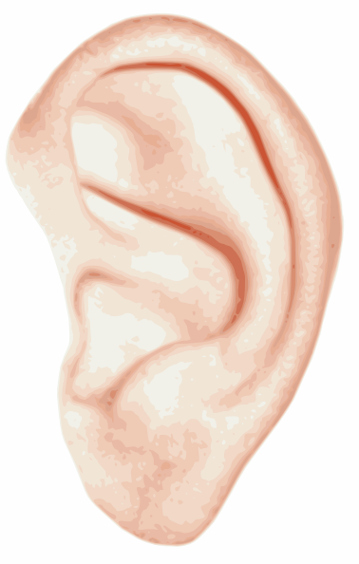
The Closing – He who has an ear, let him hear what the Spirit says to the churches.
Not everyone has an ear!
In John 10:27, Jesus said, “My sheep hear my voice, and I know them, and they follow Me.”
Only those who are born again have a spiritual ear to hear the Spirit.

Slide 51
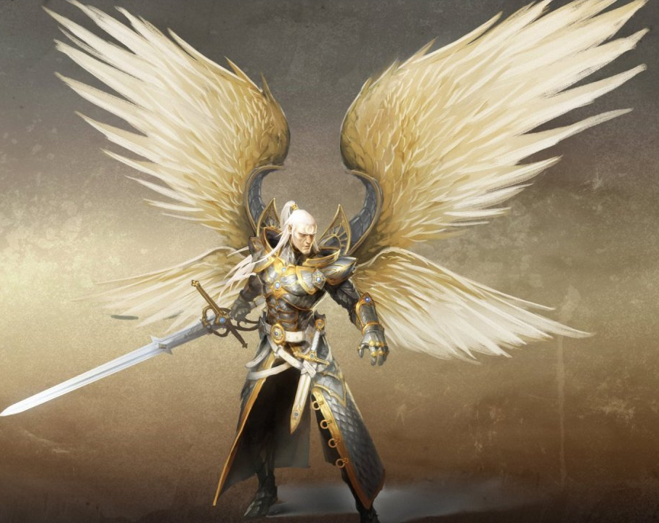
The Reward – To him who overcomes I will give to eat from the tree of life, which is in the midst of the Paradise of God.
Genesis 2:9 the tree of life was created
Genesis 3:22-24 God drove out Adam and Eve after they had sinned to protect them from eating of the tree of life in their sinful condition.
Warrior Angels (cherubim) and a flaming sword keep man away from the tree of life

Slide 52
To be offered the tree of life:
You must be born-again and
Have the blood of Christ applied and
The day of redemption has come
Revelation 22:2 = pictures the tree of life: bears twelve different fruits, each one yields its fruit every month.
The leaves of the tree will heal the nations so that all will live in peace forevermore.

Slide 53
Representation of the Church of Ephesus in Church History
It is believed that the Church of Ephesus represents the first century church.
As a refresher, let’s look at the major events of the first century church.

Slide 54
29 AD Jesus crucified; the church established–Rome sees the church as competition for authority
35 AD Stephen stoned; Saul meets Jesus going to Damascus – converts and becomes Paul
49-51 AD Jews expelled from Rome for persecuting Christians until it became disruptive to the Roman citizens

Slide 55
During this time, the church was working – they were spreading the gospel. Jesus said, “I know your works, your labor…” – the first century church wasted no time in spreading the gospel.
They added thousands to the church daily. The word was spreading rapidly. That didn’t just happen accidentally.

Slide 56
Christians were talking about Jesus and the sacrifice He made to pay for the sins of anyone who believed wherever they went.
They purposely went to other cities (Missions) to make sure everyone knew God’s plan for mankind’s salvation.

Slide 57
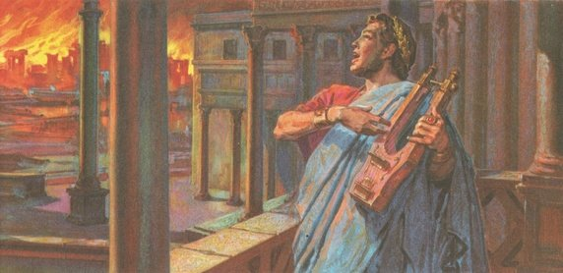
64 AD Nero set fire to Rome, blamed the Christians, then launched severe Christian persecution
And the first century church was longsuffering. Jesus said, “…I know your… patience…” They didn’t give up. Their faith was strong, and they were willing to sacrifice their freedoms, their pride and prominence – everything they possessed to let the world know what Jesus had done.

Slide 58
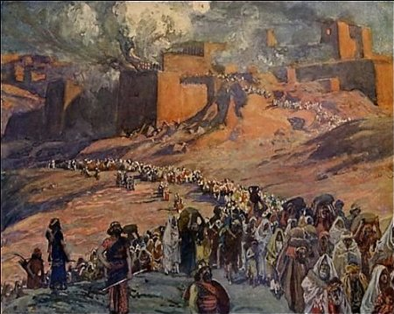
70 AD Titus destroys Jerusalem, the temple, and expels the Jews, hoping to destroy the church – Christians dispersed throughout the world
Although the Christians were on their way to spread the gospel even further than they had dreamed, they were discouraged.
Feeling almost abandoned by the Lord, they continued to spread the word, but eventually lost their first love.

Slide 59
98 AD John dies on the Isle of Patmos; Trajan becomes emperor and institutes the policy not to seek out Christians, only if they were brought before authorities, would they be punished – usually executed.

Slide 60
Happy Note for the Church of Ephesus:
Sometime between 105-115 AD, Ignatius wrote in his first epistle to the Church at Ephesus:

Slide 61
I have become acquainted with your name, much-beloved in God, which ye have acquired by the habit of righteousness, according to the faith and love in Jesus Christ our Saviour.

Slide 62
Being the followers of God, and stirring up yourselves by the blood of God, ye have perfectly accomplished the work which was beseeming to you. For, on hearing that I came bound from Syria

Slide 63
for the common
name and hope, trusting through your prayers to be permitted to fight with beasts at Rome, that so by martyrdom I may indeed become the disciple of Him

Slide 64
“who gave Himself for us, an offering and sacrifice to God. I received, therefore, your whole multitude in the name of God, through Onesimus, a man of inexpressible love, and your bishop

Slide 65
in the flesh, whom I pray you by Jesus Christ to love, and that you would all seek to be like him. And blessed be He who has granted unto you, being worthy, to obtain such an excellent bishop.

Slide 66
Happy Note for the Church of Ephesus:
That was written ten to twenty years after John’s letter. Apparently, the church took the Lord’s counsel and became vibrant in their love for the Lord – at least for a while.

