Slide 1
The Church of Laodicea The Fashionable Church Luke warmness, Materialism
Lesson 11 in When Are We Now?
The first of three studies of
The Revelation of Jesus Christ
by Paige Ramsey

Slide 2
Revelation 3:14-22
And to the angel of the church of the Laodiceans write, ‘These things says the Amen, the Faithful and True Witness, the Beginning of the creation of God: “I know your works, that you are neither cold nor hot. I could wish you were cold or hot.

Slide 3
Revelation 3:14-22
So then, because you are lukewarm, and neither cold nor hot, I will vomit you out of My mouth
Because you say, ‘I am rich, have become wealthy, and have need of nothing…’

Slide 4
Revelation 3:14-22
“…and do not know that you are wretched, miserable, poor, blind, and naked—I counsel you to buy from Me gold refined in the fire, that you may be rich; and white garments, that you may be clothed, that the shame of your nakedness may not be revealed; and anoint your eyes with eye salve, that you may see.

Slide 5
Revelation 3:14-22
“‘As many as I love, I rebuke and chasten. Therefore be zealous and repent.
“Behold, I stand at the door and knock. If anyone hears My voice and opens the door, I will come in to him and dine with him, and he with Me.

Slide 6
Revelation 3:14-22
“To him who overcomes I will grant to sit with Me on My throne, as I also overcame and sat down with My Father on His throne.
“He who has an ear, let him hear what the Spirit says to the churches.”

Slide 7
Laodicea
The Church of the Laodiceans is mentioned in Colossians 4:12-17:“Epaphras…has a great zeal for…those who are in Laodicea,… Greet the brethren…in Laodicea… see that it is read also in the church of the Laodiceans… likewise read the epistle from Laodicea.”
We apparently no longer have this letter to the Laodiceans… at least I couldn’t find it listed on the Early Christian Writings website, which is tragic.

Slide 8
Laodicea
Colossae is located just nine miles west of Laodicea. The Church of Colossae, though well-known and respected at the time, was not included in the seven churches in Revelation.
I believe this may be because the attributes of the Church of Colossae did not provide an adequate rendering for any of the conditions that would shape the Church Age to come.

Slide 9
Laodicea
Laodicea was located at the crossroads of major trade routes. It was very prosperous and busy, famous for its black wool, banking services, & medical achievements. Originally named Dispolis (city of Zeus), then Rhodas, before Antiochus named it after his wife, Laodice.
Pergamos
Thyatira
Sardis
Smyrna
Philadelphia
Laodicea
Ephesus

Slide 10
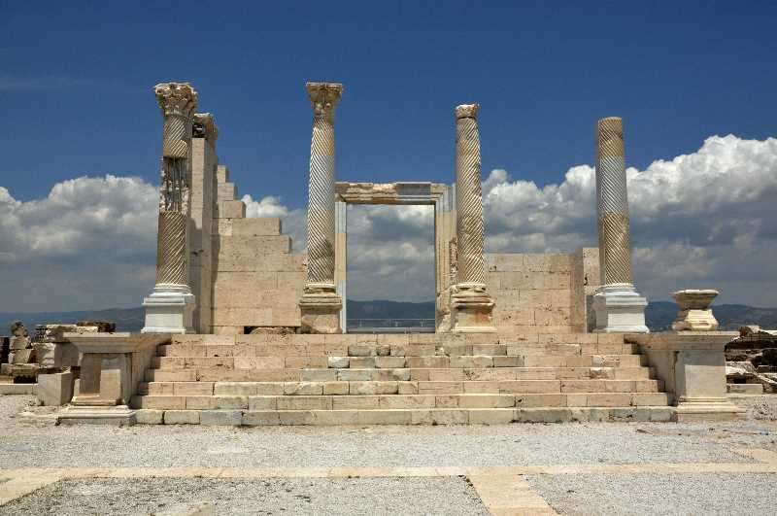
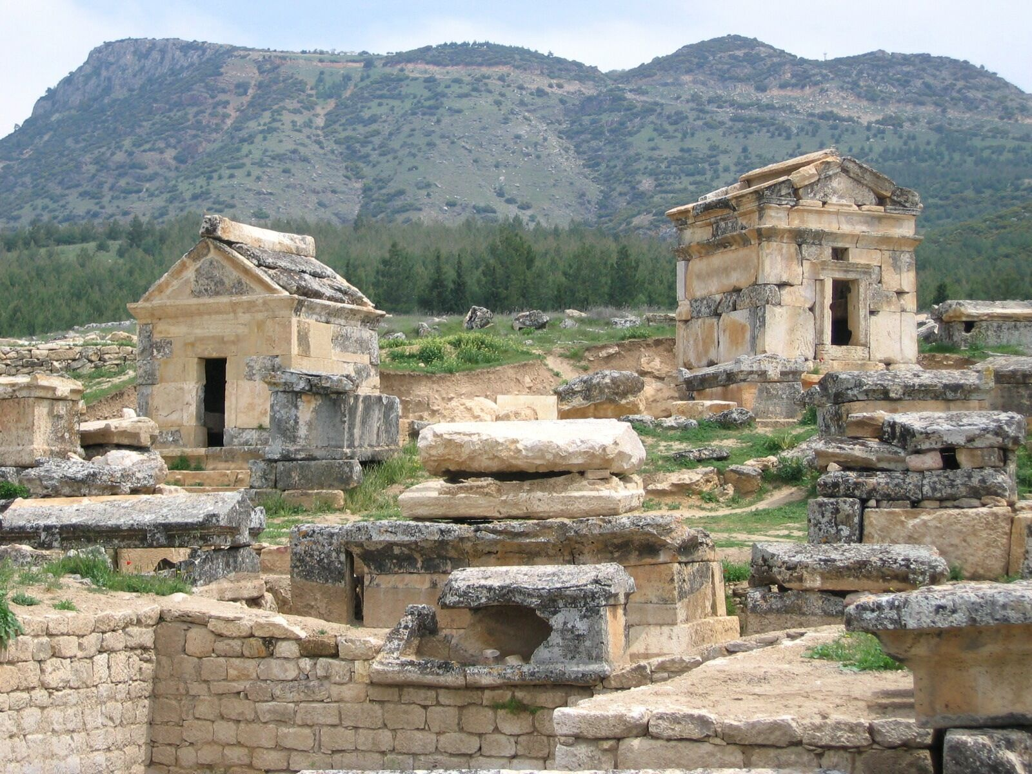
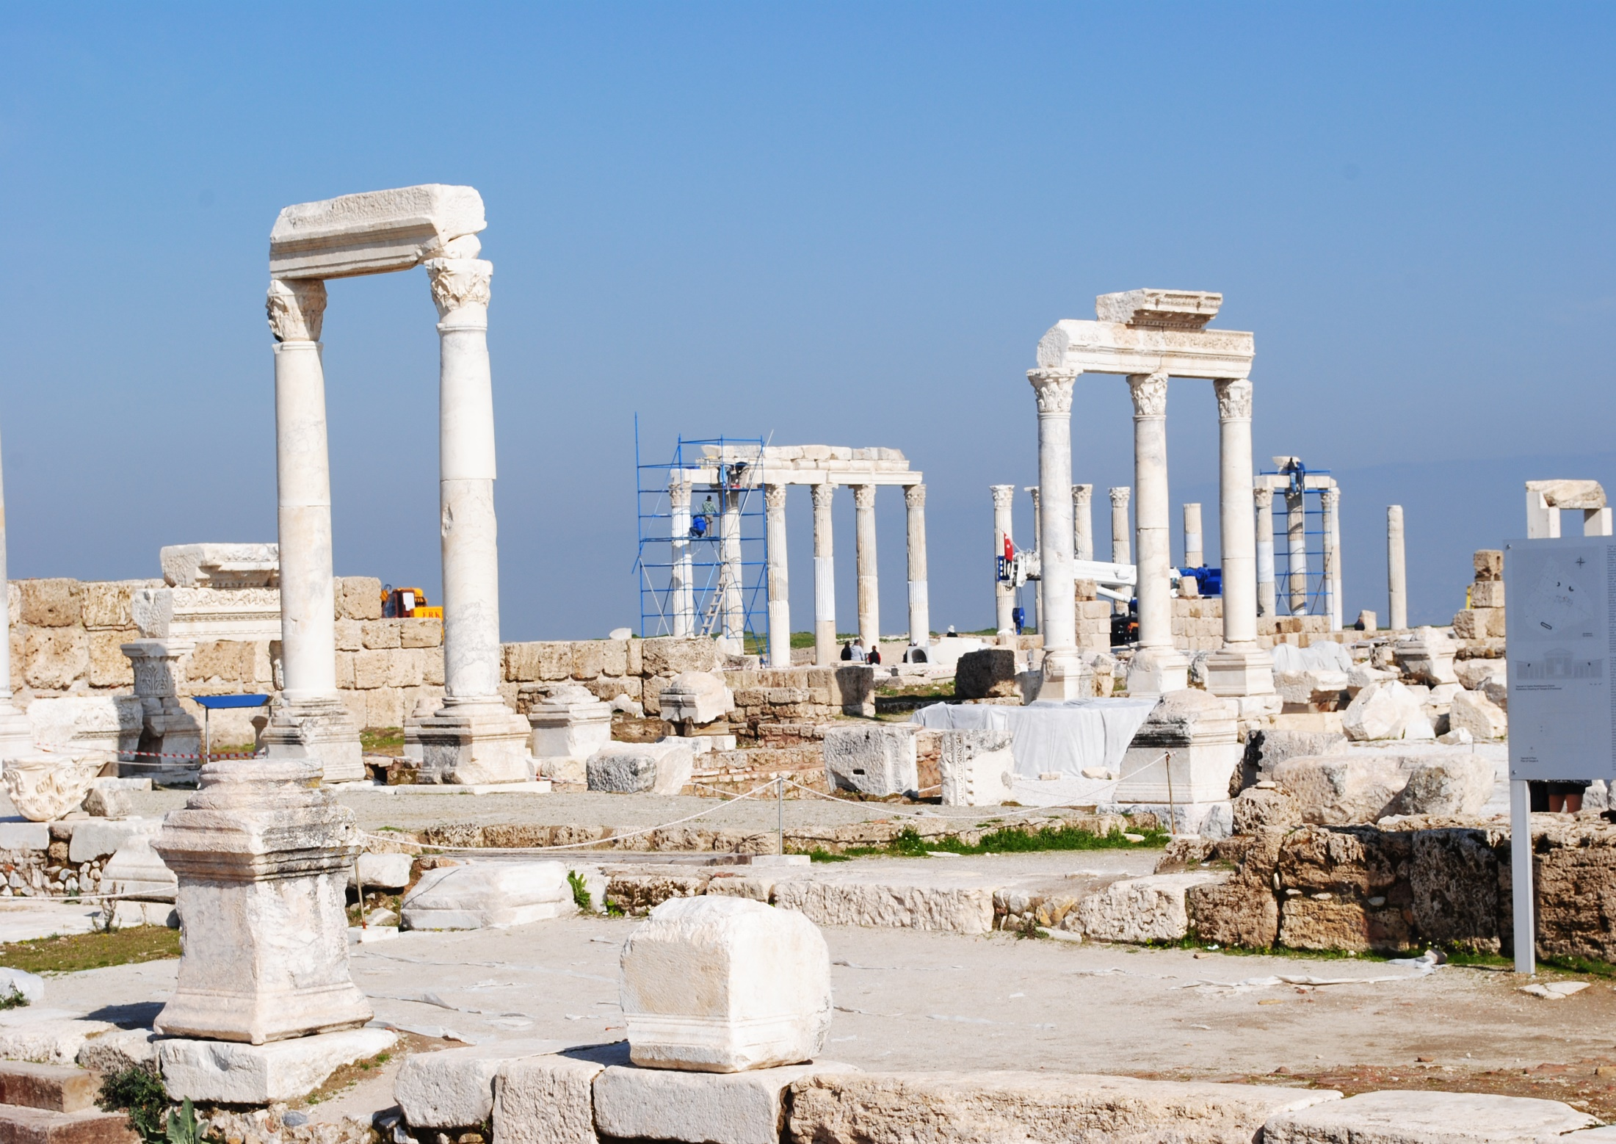
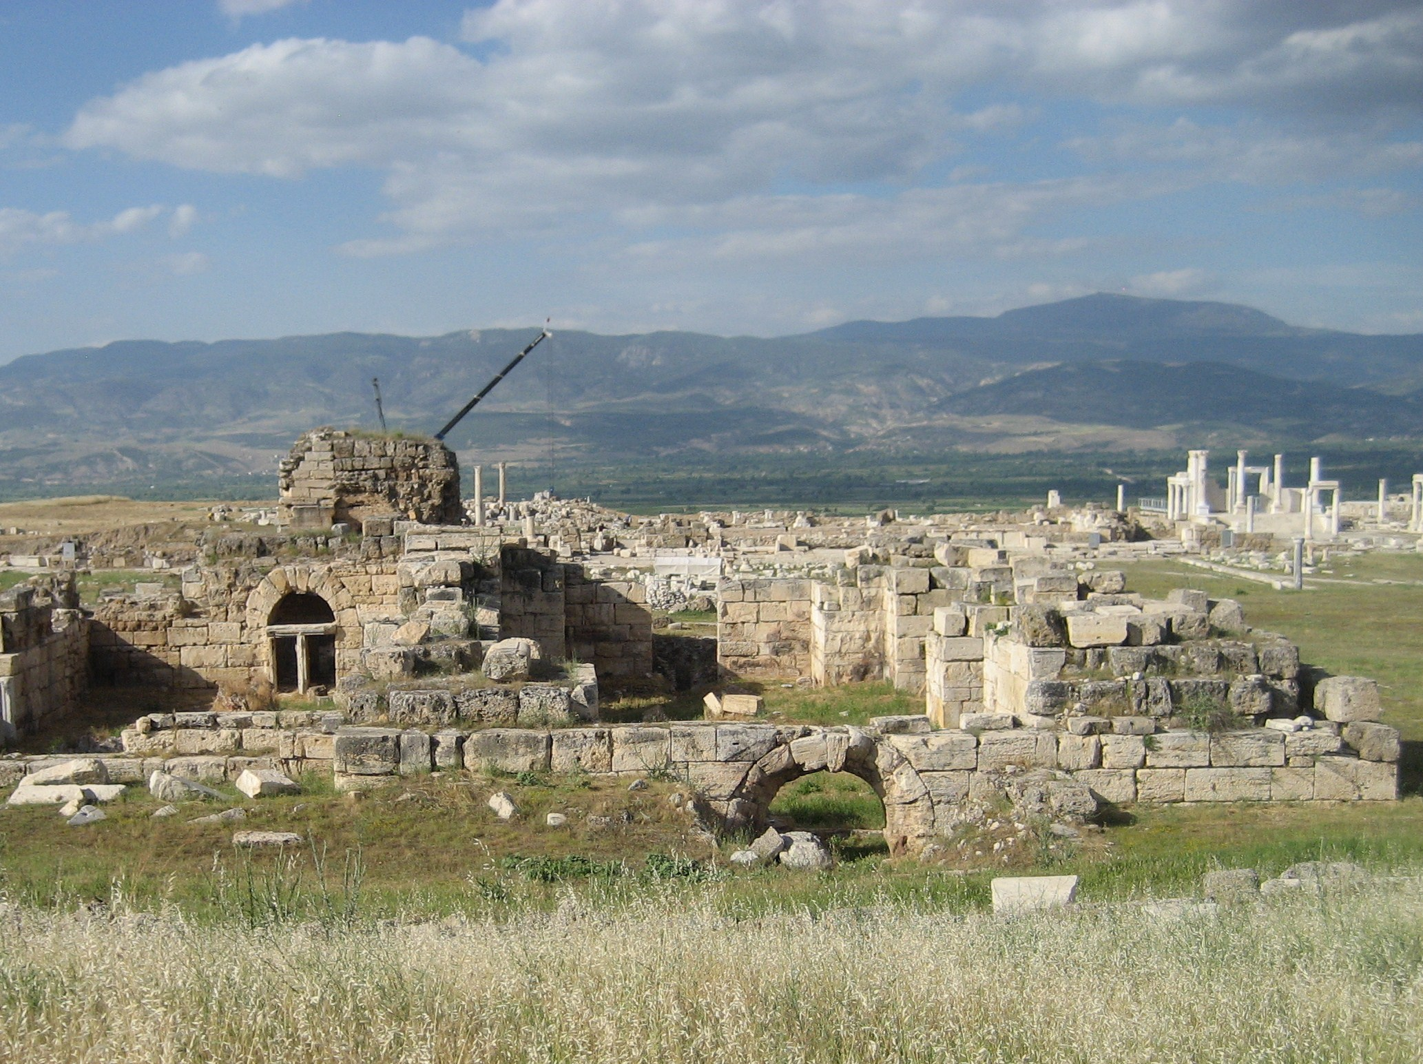
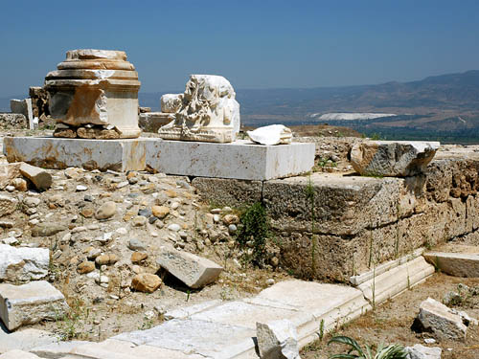
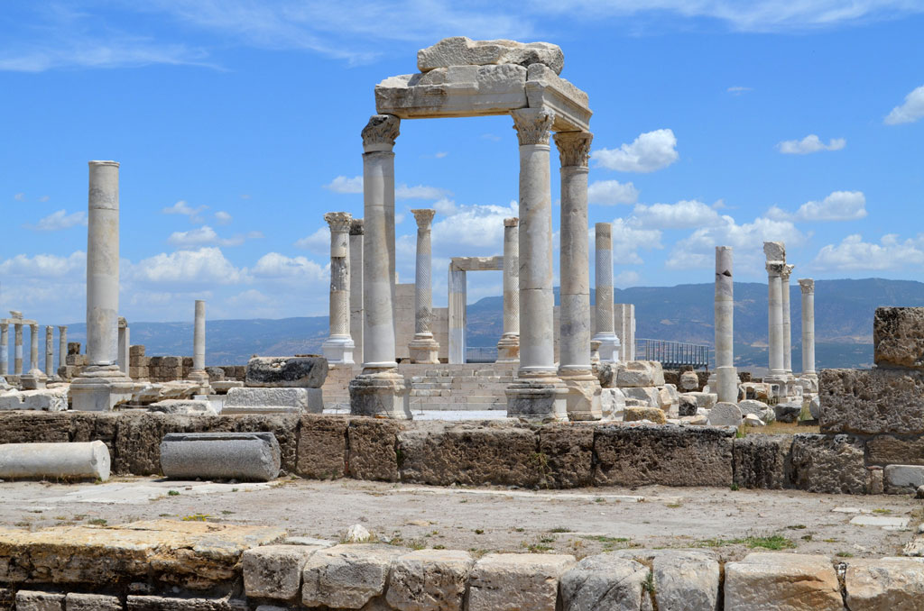
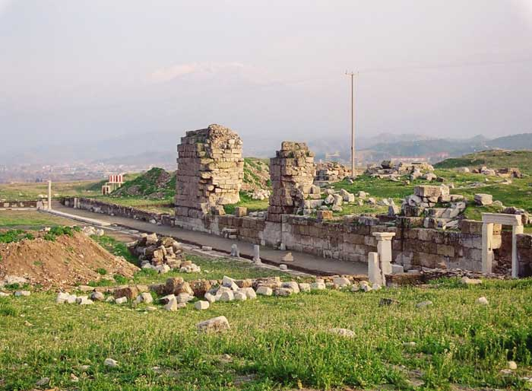
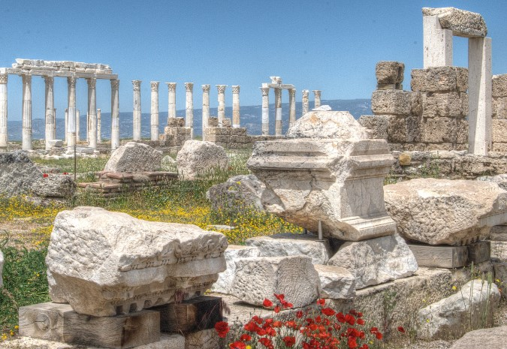
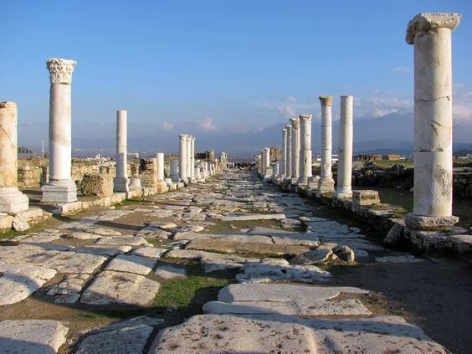
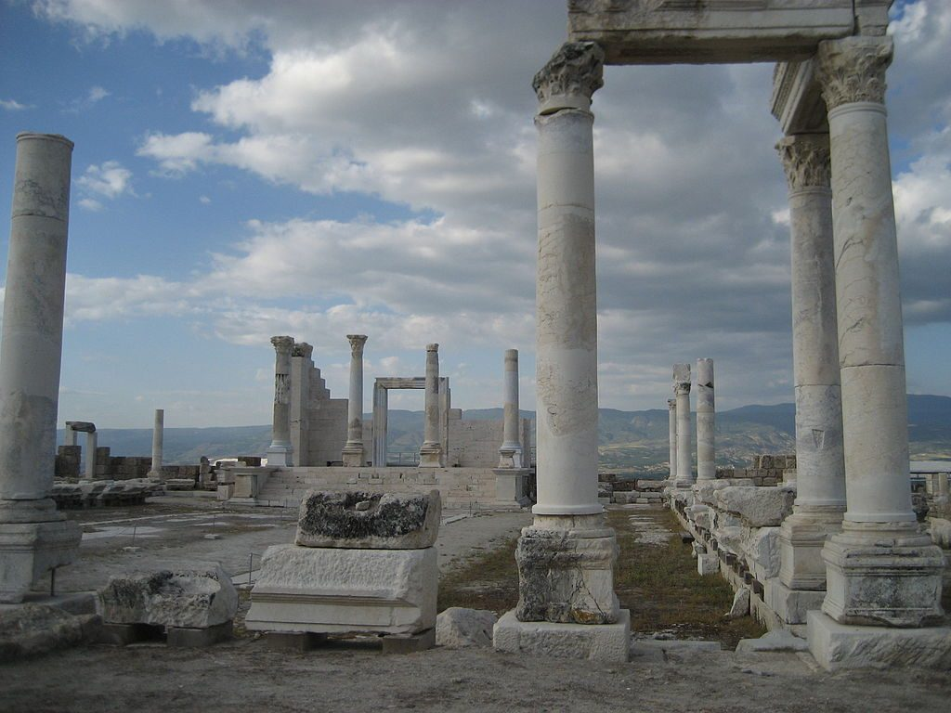
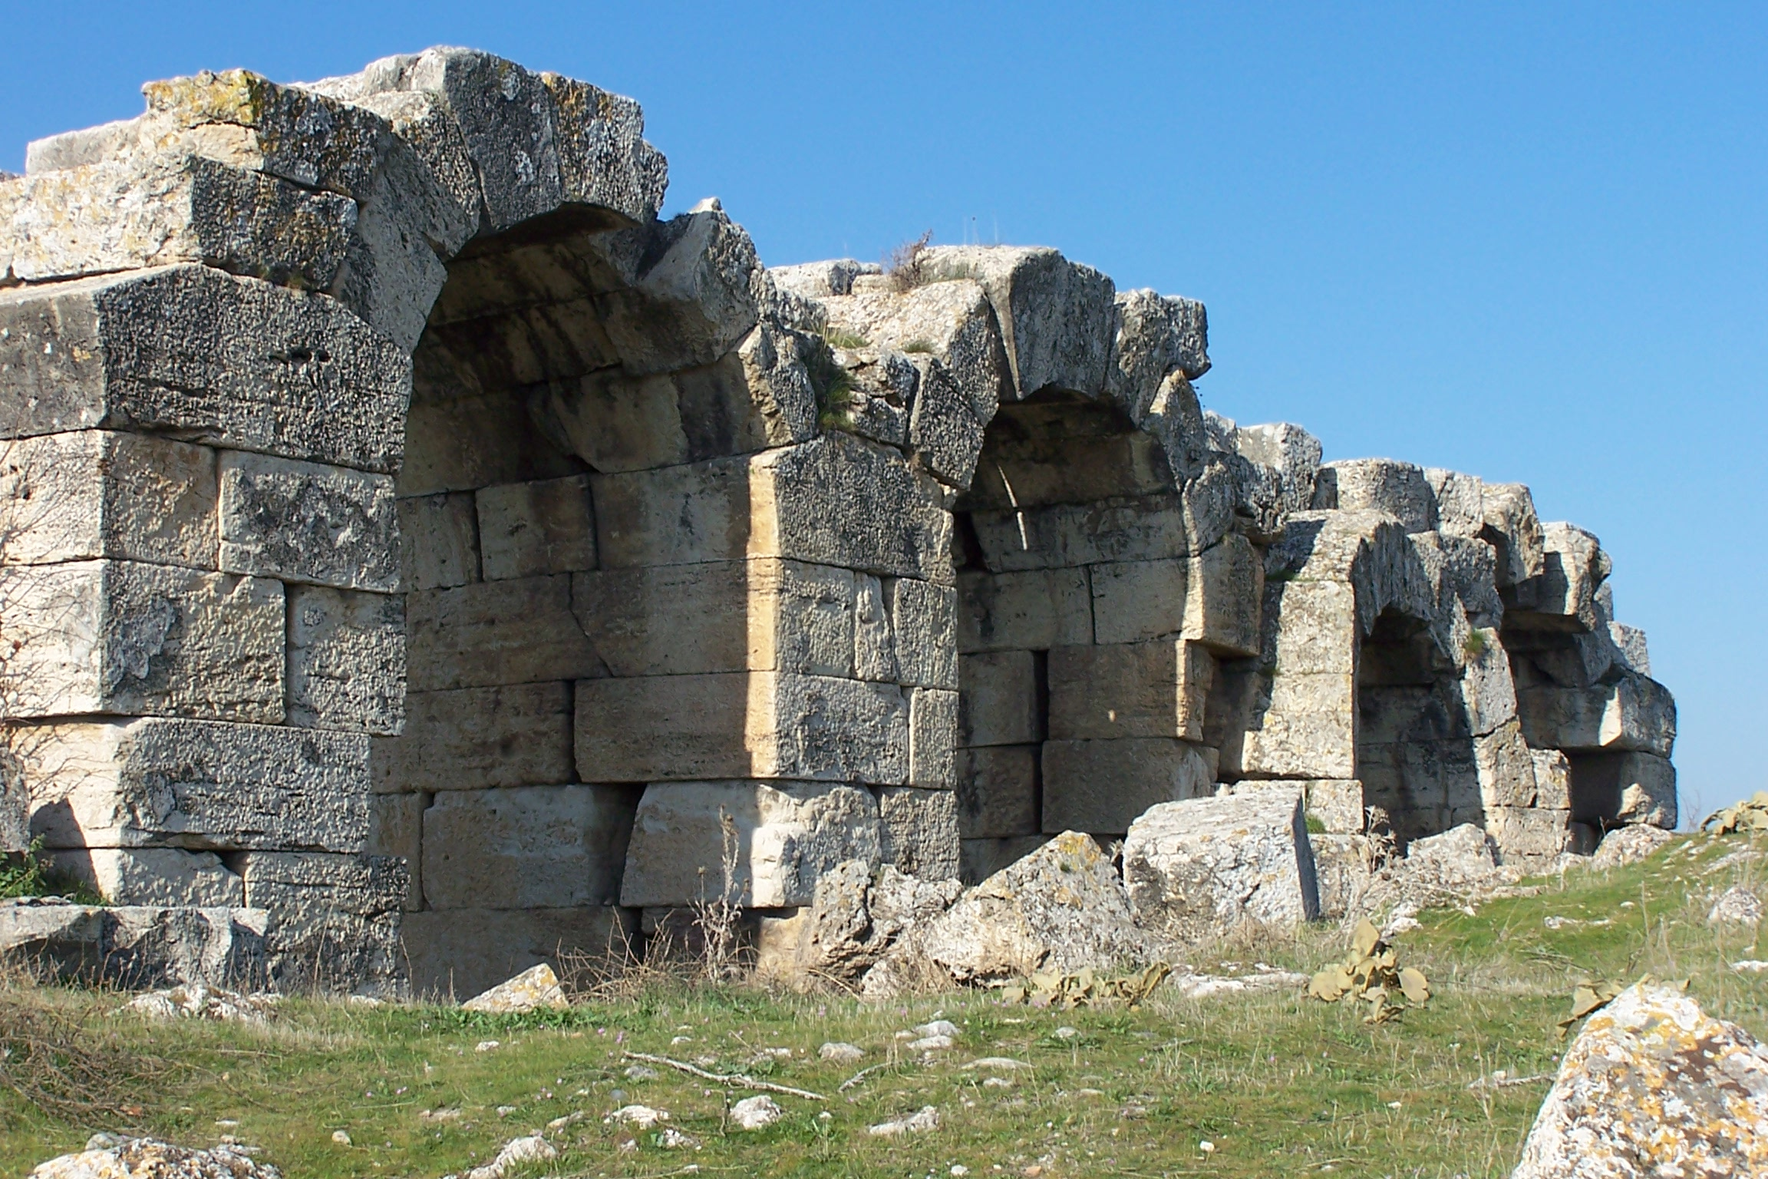
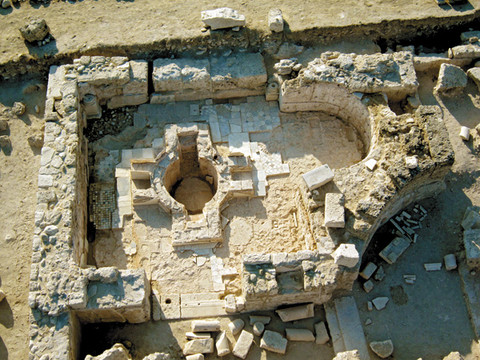
Laodicea
The ordained bishop of Laodicea was Archippus, according to the Apostolical Constitutions, and mentioned in Col. 4:17. However, Dr. John Gill says the pastor (angel) could have been Epaphras, at the time of the writing of the letter to the Colossians, mentioned in Col. 1:7, 4:12.

Slide 11
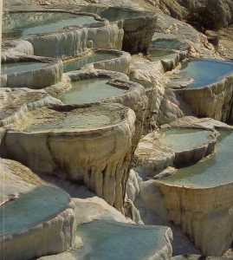
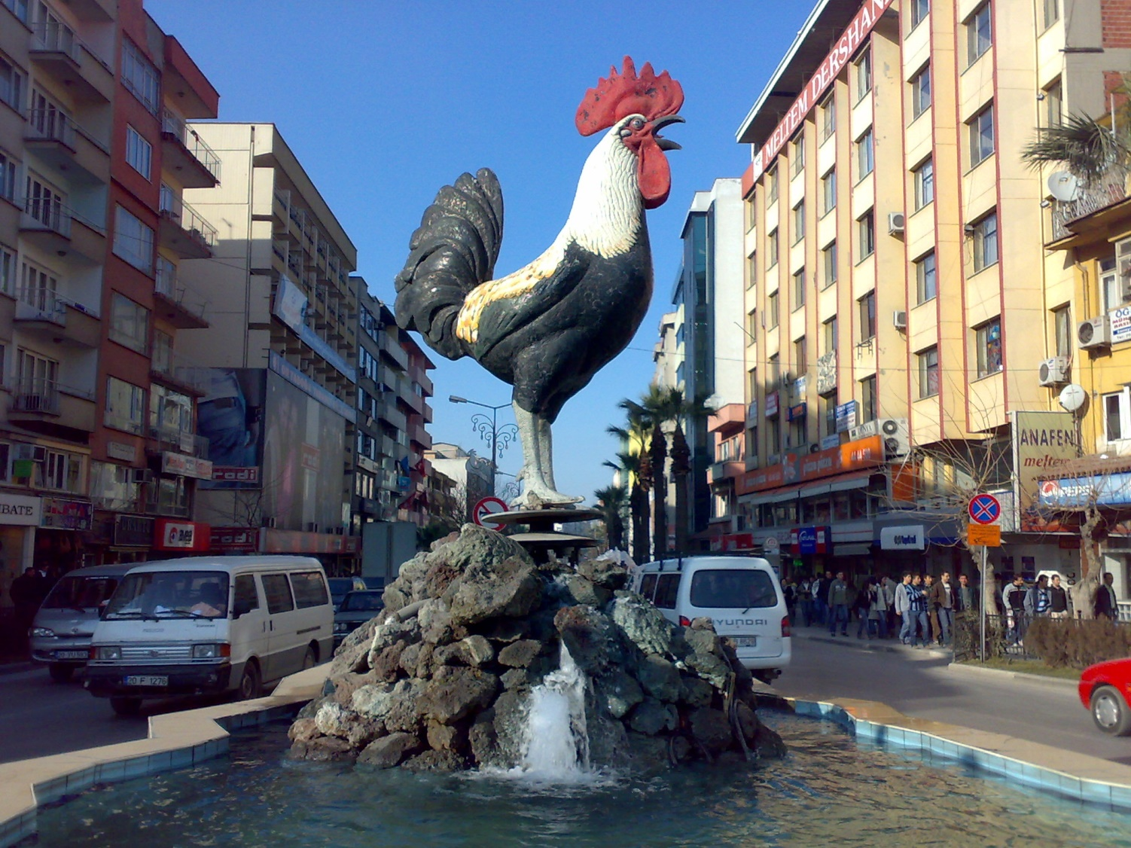
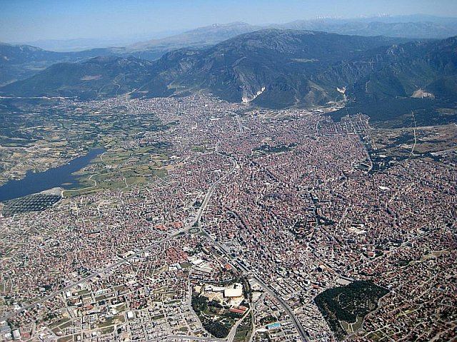
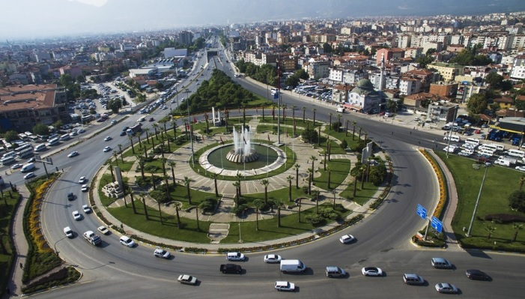
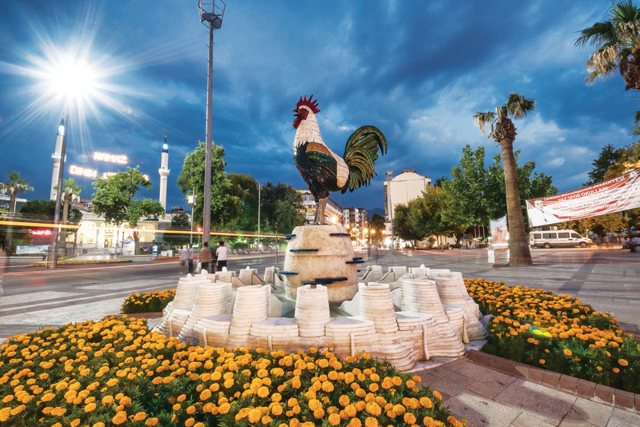
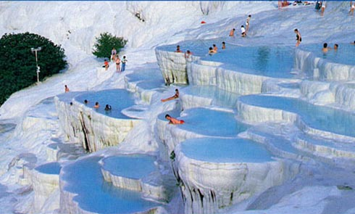
Laodicea
The ruins of Laodicea are located near the modern city of Denizli.

Slide 12
The Letter
These things says the Amen, the Faithful and True Witness, the Beginning of the creation of God – The Amen is a name given to Christ. Isaiah 65:16 says, “So that he who blesses himself in the earth shall bless himself in the God of truth; and he who swears in the earth shall swear by the God of truth; because the former troubles are forgotten, and because they are hidden from My eyes.”
“Truth” in
Is 65:16 is the Hebrew word
“Amen”
(So be it! Truth! Amen!)

Slide 13
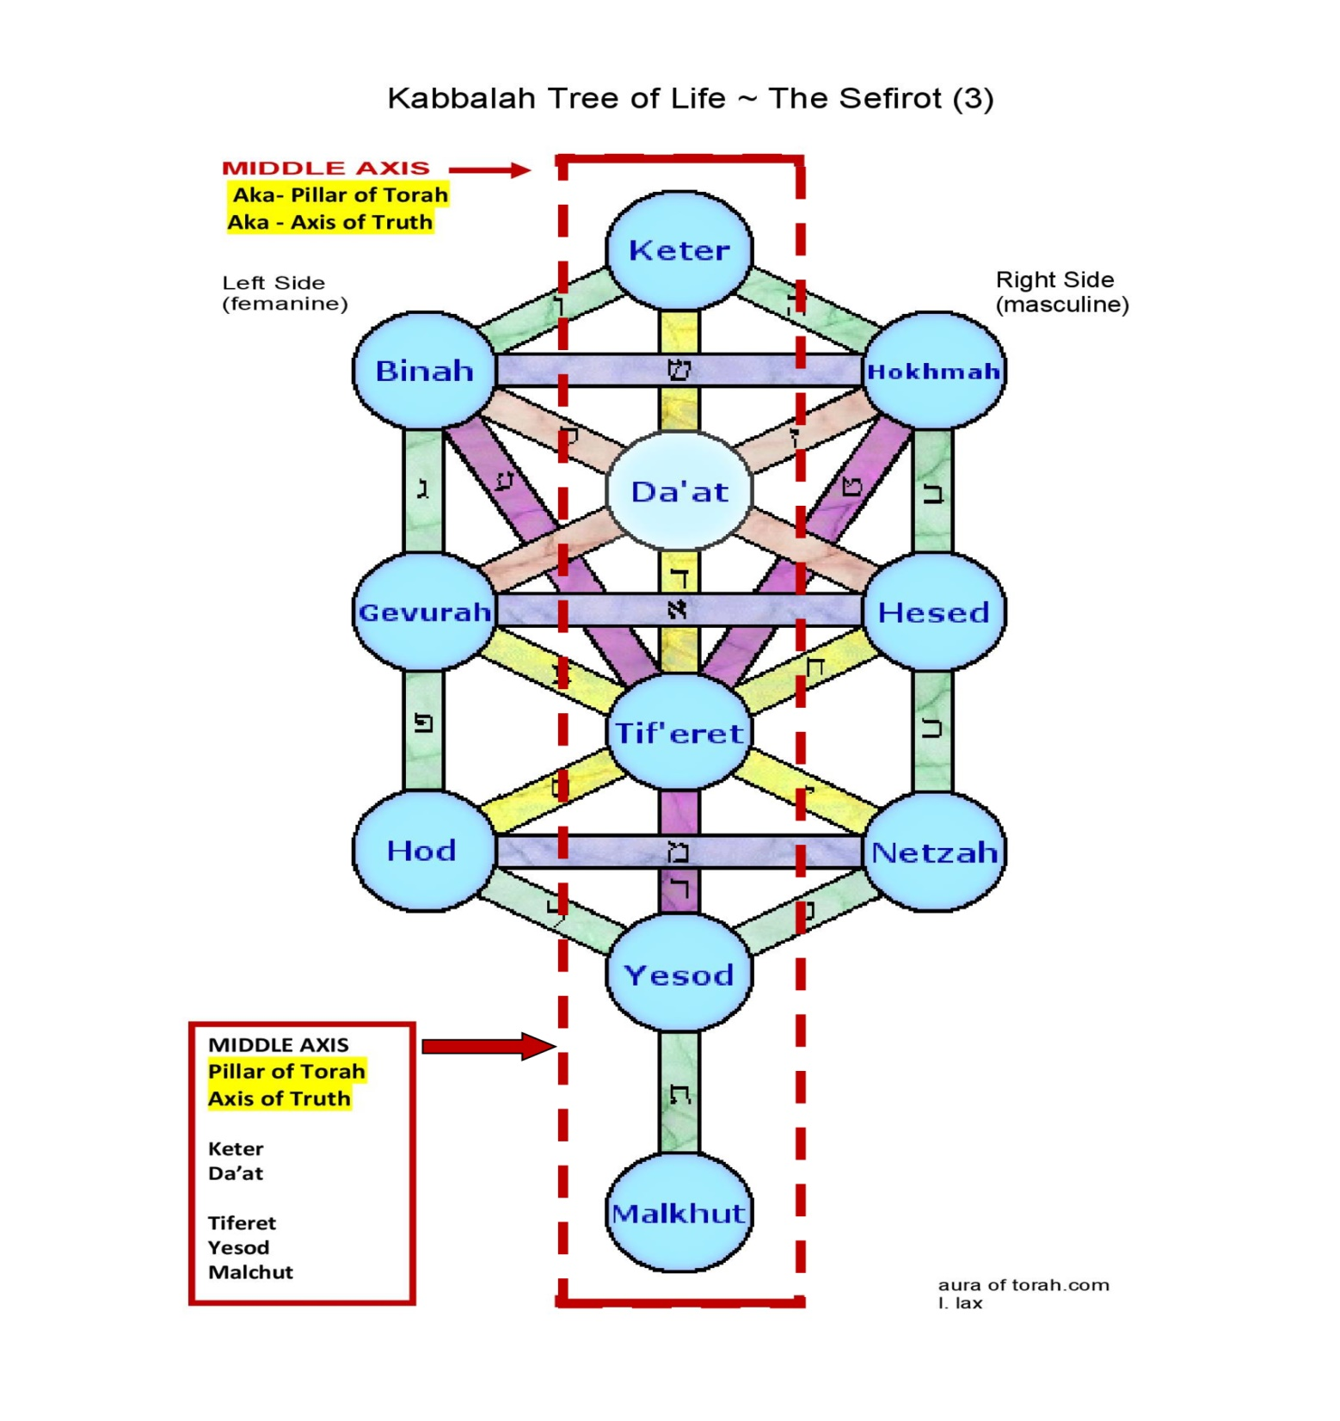
The Letter
They make "Amen" to be one of the names of the second "Sephira", or number in the Cabalistic tree, by whom the second Person in the Godhead seems to be designed: and they say, that the word "Amen", by gematry (or numerically) answers to the two names "Jehovah, Adonai".
[Gill, John, Dr., (1690-1771),
John Gill’s Exposition of the Entire Bible,
(public domain), Rev. 3:14]
The word "Amen" is the name of a divine Person with the Jews, and it seems the second Person; for so on those words in Pro. 8:30; "then was I by him as one brought up with him", they observe, do not read "Amon", the word there used, but "Amen"; and, a little after, "Amen", they say, is the "notaricon", or sign of אל מלך נאמן,"” – God the faithful King"
Christ is also called The Amen, because He is the God of Truth & it speaks to His faithfulness!

Slide 14
The Letter
2 Cor. 1:20 says, “For all the promises of God in Him are Yes, and in Him Amen, to the glory of God through us.” Jesus is The Amen! So be it in Christ Jesus! Jesus said, “I am the Way, the Truth, and the Life!” What God has said will be done. It must be done. There is no other way. In Him is the way… so be it!

Slide 15
The Letter
Jesus also reminds them He is the Faithful and True Witness. He wants them to understand what He is about to say is just. He is faithful and true, and they can believe what He is about to say. It is hard to accept negative criticism about ourselves. Yet, it’s imperative that we listen to truth no matter how hard it is to hear. Jesus is preparing them for a blast of hard truth.
Are you ready for the Lord to give you a blast of hard truth?
Will you be able to accept it and do what He asks?

Slide 16
The Letter
Then, He also reminds them that He is the Beginning of the creation of God. This is not saying that Jesus is a creation of God. It is saying that Jesus is the Beginning! He is the Creator! John 1:1-3 says, “In the beginning was the Word and the Word was with God and the Word was God. He was in the beginning with God. All things were made through Him, and without Him nothing was made that was made.”
“the beginning of the creation of God” is a Jewish phrase and title given to Metatron, by whom they sometimes mean the Messiah.

Slide 17
Commendations
The Letter
NONE!!
Like the dead church of Sardis, they are not given any praise for their works.

Slide 18
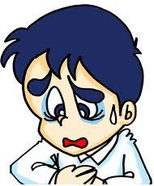
Complaint
The Letter
I know your works, that you are neither cold nor hot. I could wish you were cold or hot. So then, because you are lukewarm, and neither cold nor hot, I will vomit you out of My mouth.

Slide 19
Complaint
The Letter
Here, again… Jesus knows. He knows emphatically and completely down to the intents and desires behind the actions… He knows they are neither cold nor hot.
they did not oppose it, did not fight it, did not speak against it, did not shun it.
In fact, they acknowledged it, accepted it, and even agreed with it.
They were not cold toward the gospel

Slide 20
Complaint
The Letter
they weren’t excited about it, nor fervently embracing it, not on fire to spread its message to others
They nodded their heads during the preaching in agreement, but the Holy Spirit did not abide within
Why?
Because they had never allowed the gospel into their lives!
! They had the head knowledge, but their hearts were not changed!
They were not hot toward the gospel

Slide 21
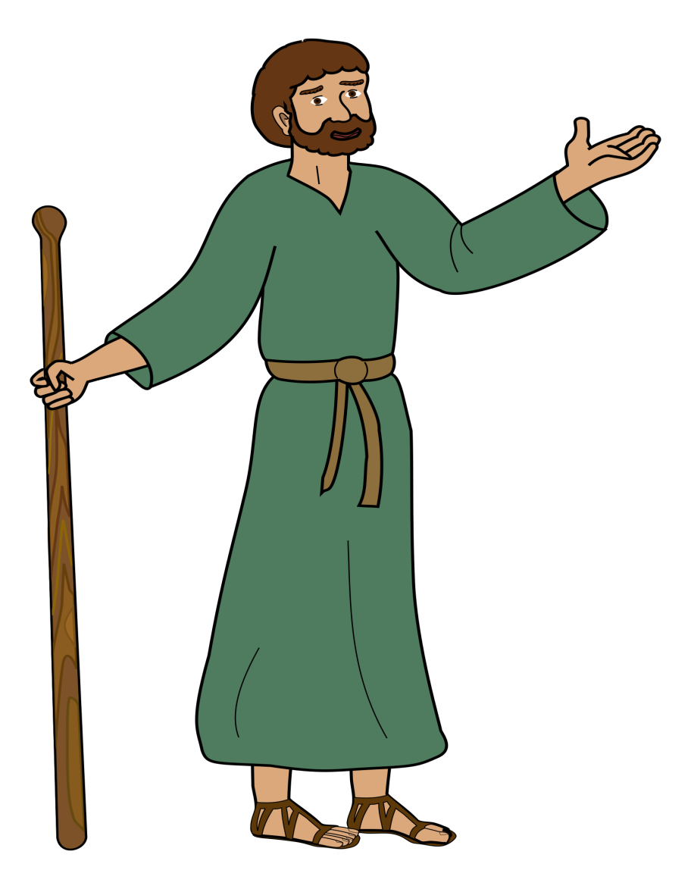
Complaint
Saul was a person who vehemently opposed the gospel. He went on missions to seek out those who followed Christ and killed their leaders. He was at the stoning of Stephen, one of the first seven deacons.
was. When the Voice identified Himself as Jesus, Saul immediately asked what the Lord wanted him to do. From that time until his death, Saul –Paul – applied just as much vigor and fervency to spreading the gospel as he had fighting it.
The Letter
He went from COLD
While on his way to find more Christians in Damascus, the Lord struck him with a bright light from heaven. He fell to the ground and clearly heard a Voice speak to him. Saul acknowledged that the Voice was the Lord, but asked who He
To HOT in minutes!

Slide 22
Complaint
Do you know anyone who is cold – vehemently fighting against the Lord?
The Letter
Do you know anyone who is hot – fervently fighting for the Lord?

Slide 23
Complaint
The Letter
When other things take precedence over the things of the Lord in our lives, we are indifferent. We are lukewarm.
Love acts. You see love in action. When a church no longer acts in love by zealously spreading the gospel, teaching, discipling, sending missionaries, publishing the message, writing, playing, and singing music to glorify the Lord, producing enactments that depict the gospel, etc., it is indifferent.
The opposite of love is:
NOT hate…
Indifference! Apathy!
God is Love –
Love is a verb – not a passive verb, but an action verb
Laodicea was lukewarm and it was making the Lord sick to His stomach until He would vomit them out of His mouth!
is, are, has, was, etc.
Run! Jump! Fight! etc.

Slide 24
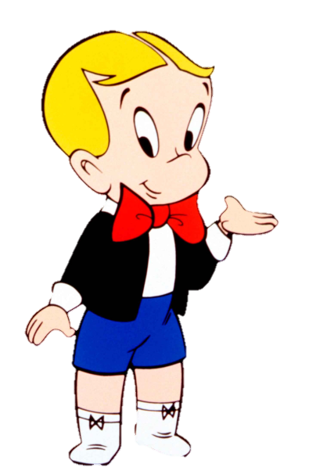
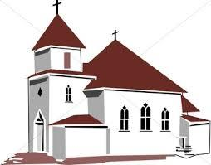
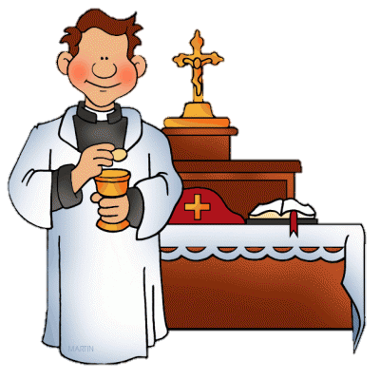
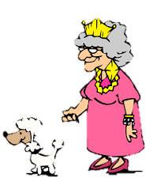
Complaint
The Letter
They could have easily paid the pastor a good salary so that he would look good in the community.
They may have even had a church building to be proud of.
The Laodicean church was wealthy with money.
They enjoyed their social club where they talked about the Lord, and didn’t have any real needs.
Because you say, ‘I am rich, have become wealthy, and have need of nothing’—and do not know that you are wretched, miserable, poor, blind, and naked —
They looked good when they gathered together – they all had nice clothes, and wore perfumes to smell nice.

Slide 25
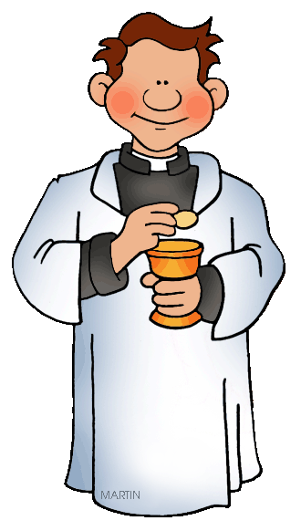
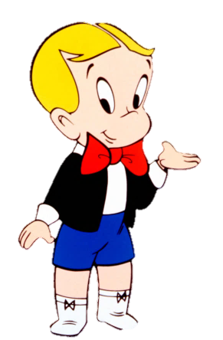
Complaint
The biggest thing that came up in the business meetings wasn’t how to support the missions of Paul (that was covered – they gave more than any of the other churches).
No, the biggest thing that came up in the Laodicean business meeting was a needed change in color for the church house, so someone needed to send off to Thyatira to get some madder root paint to spruce up the place.
Nor was it how to reach other citizens of Laodicea (after all, the town knew they came every Sunday morning to worship, and if anyone else wanted to come, they were welcome).
Nor was it how to train for mission work or teaching positions (their pastor taught everyone quite well, and no one was called to the mission field anyway).
The Letter
They were indifferent to their spiritual needs or the spiritual needs of others. They were lukewarm Christians.
Does this describe any church you know today?

Slide 26
Complaint
This church didn’t have a clue…
The Letter
the Lord was not leading them!
wretched in God’s sight!
miserable in their social lifestyles
carnal - limited!
literally made Him sick!
blind!
Insensitive to God’s calling!
honestly thought they had it pretty good!
missing mighty works of the Lord!
naked before the Lord!
happily going about their own way
missing excitement and blessings
spiritually poor!

Slide 27
The Letter
I counsel you to buy from Me gold refined in the fire, that you may be rich; and white garments, that you may be clothed, that the shame of your nakedness may not be revealed; and anoint your eyes with eye salve, that you may see.
God’s Counsel

Slide 28
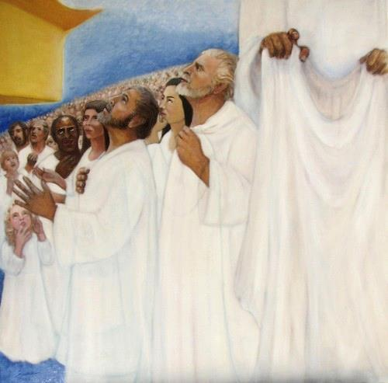
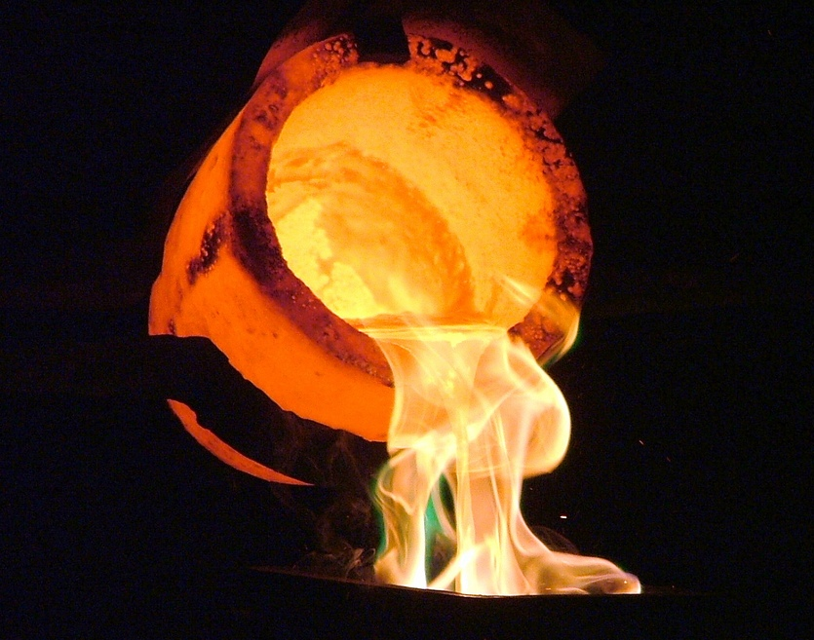
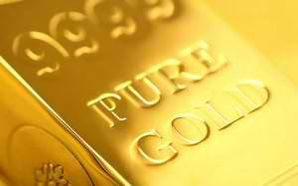
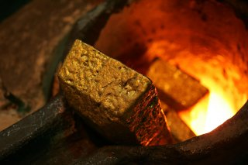
This fire-refined gold was only bought by completely trusting in the Lord and not in their own endeavors!
Only then could they discover the riches of His grace in their lives!
The Letter
They needed to buy white garments by repenting of the sin in their lives – only then could they be clothed in His righteousness so that their shameful, prideful hearts could not be seen.
They needed eye salve to see. They needed to ask for God’s wisdom, the mind of Christ, and not their own limited understanding. Only then could they truly comprehend the ways of the Lord.
God’s Counsel
The Laodiceans loved to buy. And so, the Lord counsels them to buy from Him!

Slide 29
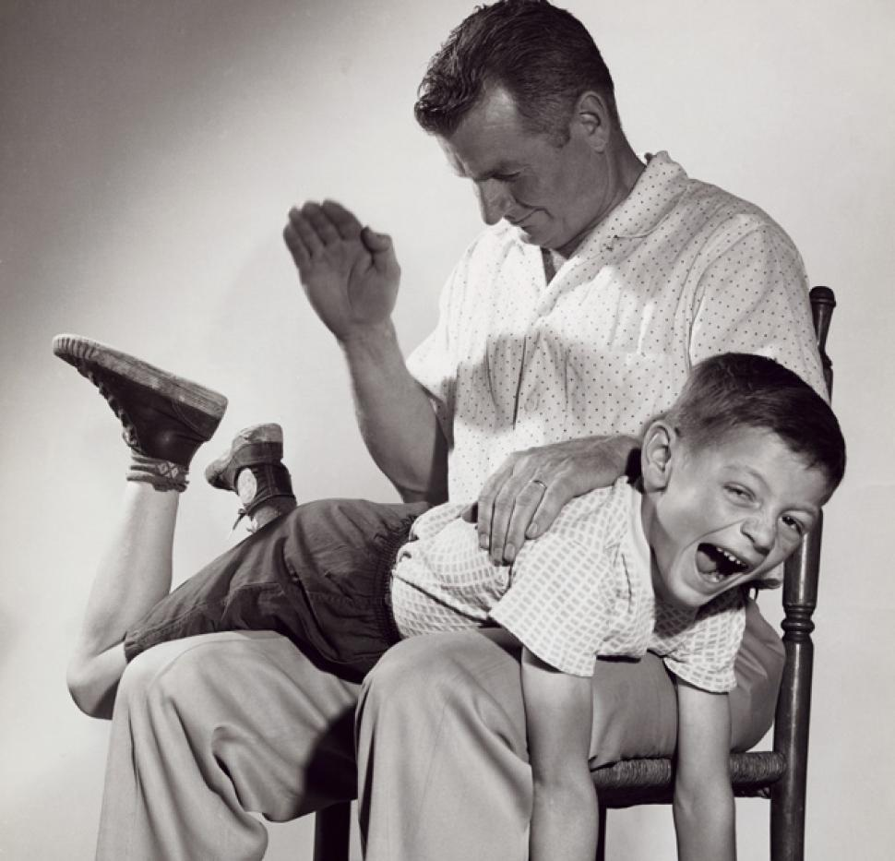
Counsel
As many as I love, I rebuke and chasten. Therefore be zealous and repent.
The Lord is reminding them of His great love for them, even in their unrepentant, miserable state.
He is rebuking them; chastening them so that they will repent and share in the abundant life He has waiting for them.
The Letter

Slide 30
Christ’s Invitation
Behold, I stand at the door and knock. If anyone hears My voice and opens the door, I will come in to him and dine with him, and he with Me.
Here is the pitiful state of the Laodicean Church:
Christ is not inside the church – He is on the outside, and finds the door shut in front of Him so that He must knock!
The Letter

Slide 31
Christ’s invitation
NOTICE: He speaks to the individual – not to the church as a group. He knocks at the door of each individual heart.
Opening the door – simply saying, “Yes, Lord, what will you have me do?” – God comes in – the Holy Spirit takes up residence in your heart – your very will, and begins to lead you into wonders and blessings of the spiritual life that are endless!
The Letter

Slide 32
Christ’s invitation
He promises to dine with us!
Dining is an intimate pastime. It is hard to digest food when we are bothered, upset, or disgusted.
The Lord Jesus, who said this church has made Him sick, now says He wants to dine with them!! If they will only open the door!
We dine with people we enjoy – people we love to be with – people we are close to. We enjoy good food and good conversation with those we cherish.
The Letter

Slide 33
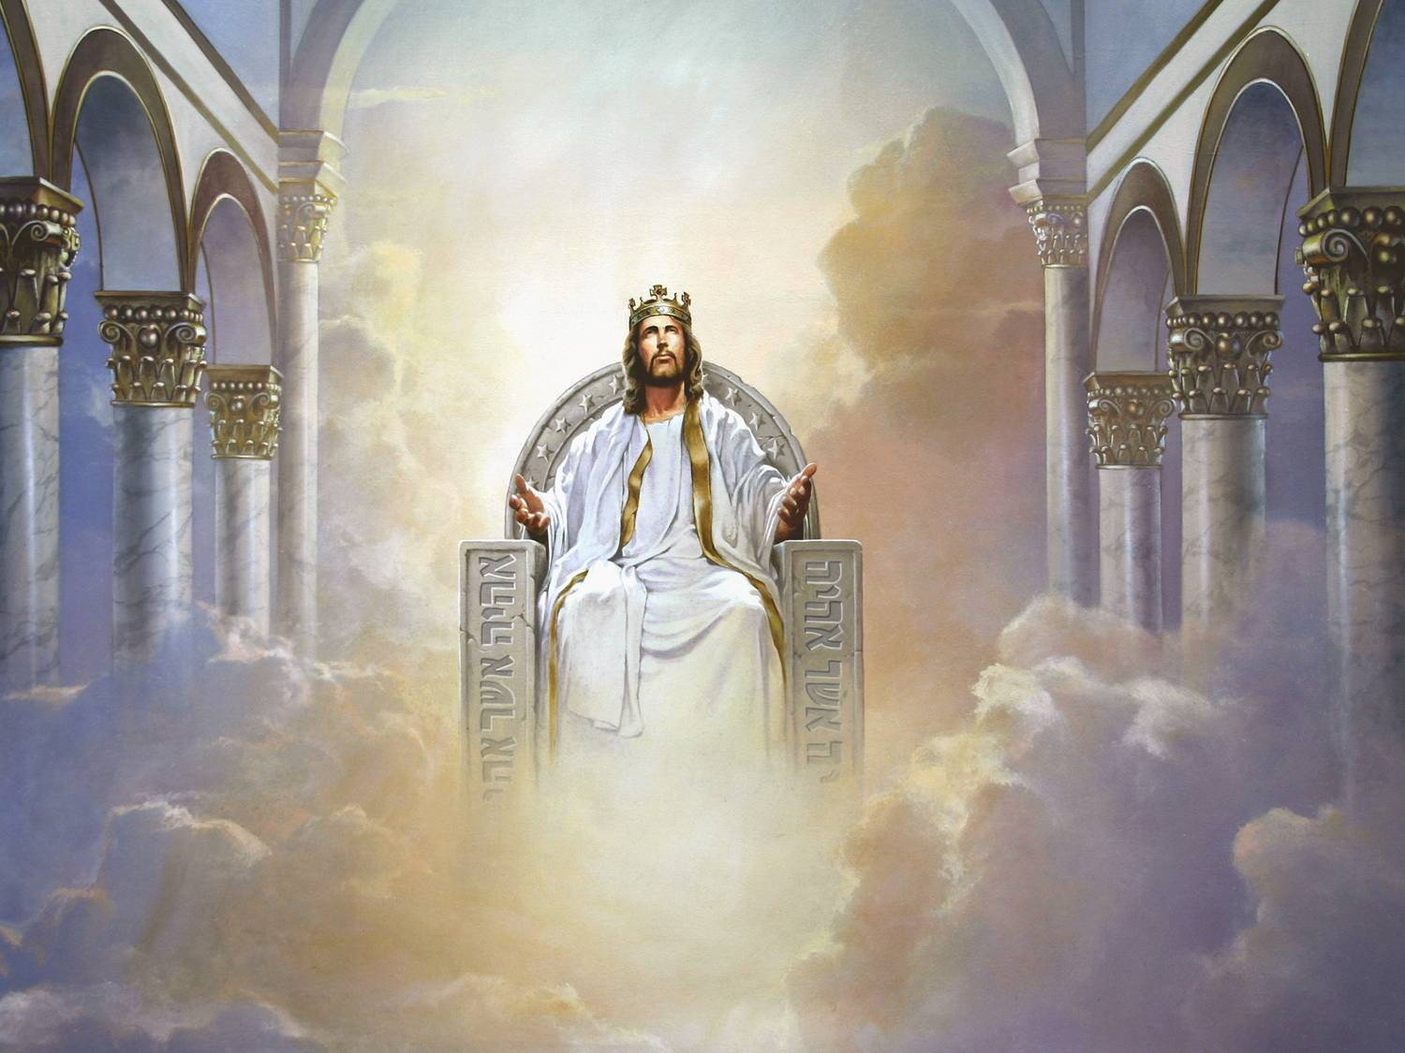
The Letter
To him who overcomes I will grant to sit with Me on My throne, as I also overcame and sat down with My Father on His throne.
They will sit with Him on His throne!
2 Peter 1:10 tells us it is best to make certain of our calling and election – we don’t want to miss out on the blessings of the Lord in this life or all the marvels in the life to come!
The Greatest of Rewards!
Given to those
who overcome their
self-centered pride
and open the door!
The Reward
We will rule with Christ! He said we would call Him our Brother and be joint heirs with Him of all the riches of the universe!!

Slide 34
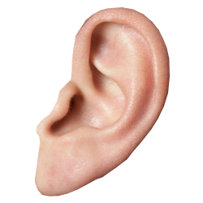
The Letter
He who has an ear, let him hear what the Spirit says to the churches.
LISTEN!
HEAR!
RESPOND!
Is your spiritual ear hearing the message that Christ gave to the church of Laodicea?
Closing
Does your heart beat with knocking as the Lord calls you?

Slide 35
The Church of Laodicea The Fashionable Church Luke warmness, Materialism
Lesson 11 in When Are We Now?
The first of three studies of
The Revelation of Jesus Christ
by Paige Ramsey

