Slide 1
The Church of Pergamos
Lesson 7 in “When Are We Now?”
The first of three studies in
The Revelation of Jesus Christ
by Paige Ramsey

Slide 2
Revelation 2:12-17
“And to the angel of the church in Pergamos write,
‘These things says He who has the sharp two-edged sword: “I know your works, and where you dwell, where Satan’s throne is. And you hold fast to My name, and did not deny My faith even in the days in which Antipas was My faithful martyr, who was killed among you, where Satan dwells.

Slide 3
Revelation 2:12-17
But I have a few things against you, because you have there those who hold the doctrine of Balaam, who taught Balak to put a stumbling block before the children of Israel, to eat things sacrificed to idols, and to commit sexual immorality. Thus you also have those who hold the doctrine of the Nicolaitans, which thing I hate.

Slide 4
Revelation 2:12-17
Repent, or else I will come to you quickly and will fight against them with the sword of My mouth.
“He who has an ear, let him hear what the Spirit says to the churches. To him who overcomes I will give some of the hidden manna to eat. And I will give him a white stone, and on the stone a new name written which no one knows except him who receives it.”’

Slide 5
The Revelation & its Author
A REVIEW
The Revelation - of Jesus Christ
John – Pastor of Ephesus
Domitian – Ruler
Domitian took vengeance against the Church and began to take action against the pastors.

Slide 6
Domitian exiled John to the Isle of Patmos, and took away everything familiar to him
He could not prevent the Lord from coming to John
He could not prevent the revealing from taking place
This revelation completed God’s Word

Slide 7
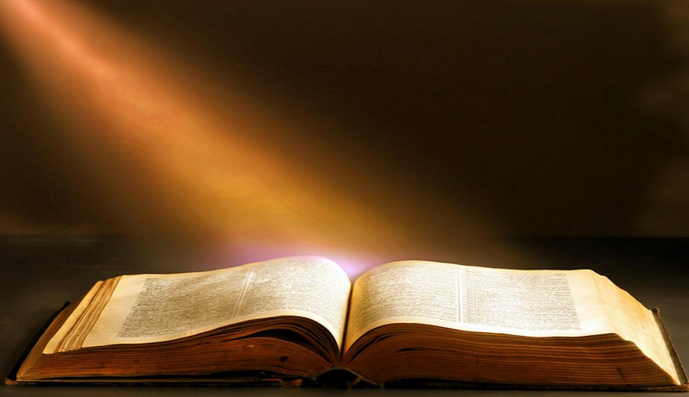
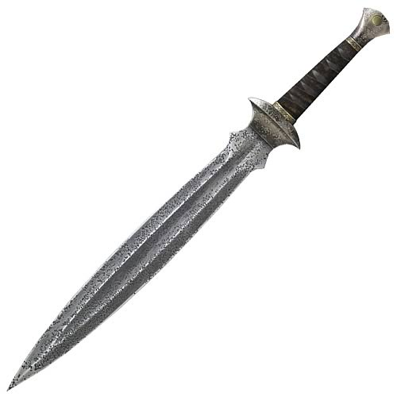
In studying this comprehensive conclusion to the Word of God, the whole of God’s Word becomes clear, with purpose and direction.
In persecuting John, Domitian paved the way for us to have our Sword perfected, sharpened, and polished.

Slide 8
Earmarks of the
Church at Pergamos
Keyword “L” – Laxity
Type of Church “F” – Faltering
Issue “ism” – Concedism
Represents Church Age – 314 AD - 560 AD

Slide 9
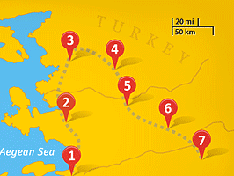
Pergamos is located north of Smyrna, 15 miles inland from the Agean Sea.
There was little trade from the outside world in Pergamos.
Pergamos was known for education in science & medicine. Hippocrates is thought to have studied at Cos and Galen at Pergamum.
Pergamos
Pergamos
Thyatira
Sardis
Smyrna
Philadelphia
Laodicea
Ephesus

Slide 10
4 Magnificent Greek Temples in Pergamos
Zeus – the “head god,” referred to as the “sovereign of all sovereigns”
Dionesius – the god of wine & drama
Athena – the goddess of wisdom in art & war
Asclepius – the god of healing, symbolized by serpents

Slide 11
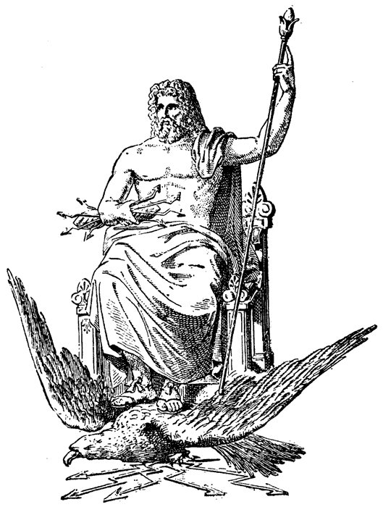
4 Magnificent Greek Temples in Pergamos
Zeus - Zeus overthrew his Father Cronus, drew lots with his brothers Poseidon & Hades and won to become supreme ruler of Olympian gods. He is lord of the sky, the rain god, god of justice and mercy, protector of the weak, and punisher of the wicked. His weapon is a thunderbolt which he hurls at those who displease him.

Slide 12
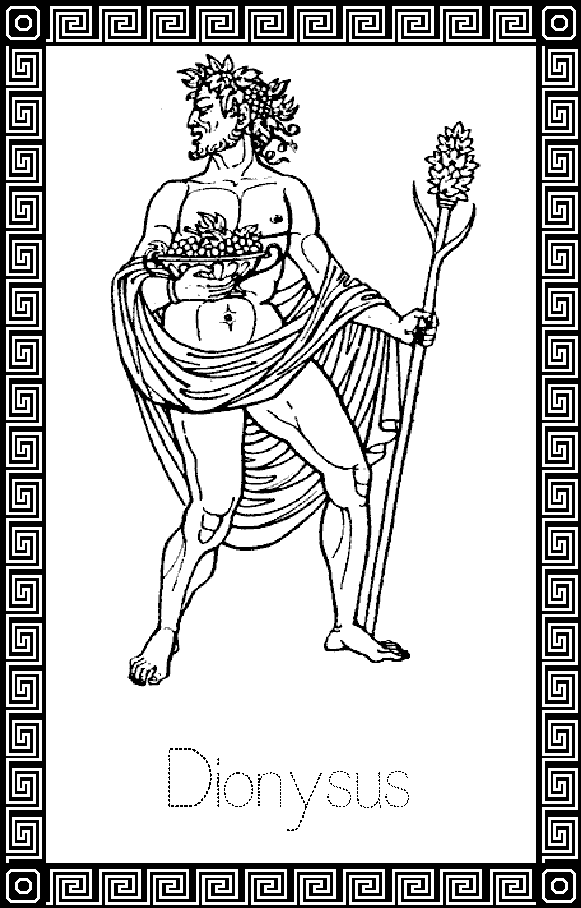
4 Magnificent Greek Temples in Pergamos
Dionysus – invented wine and spread the art of tending grapes. He has a dual nature. On the one hand, bringing joy and divine ecstasy. On the other, brutal, unthinking, rage. Thus, reflecting both sides of wine’s nature. If he chooses, Dionysus can drive a man mad. No normal fetters can hold him or his followers.

Slide 13
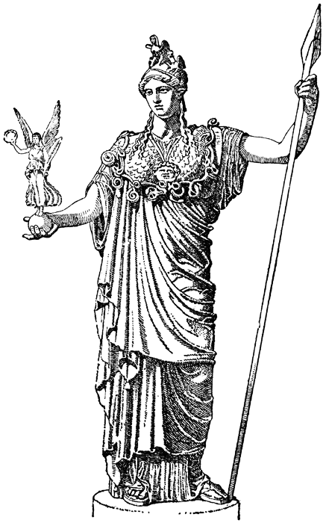
4 Magnificent Greek Temples in Pergamos
Athena - the Greek virgin goddess of reason, intelligent activity, arts and literature. Athena is the daughter of Zeus. She sprang full grown in armour from his forehead, thus has no mother. … Her tree is the olive. The owl is her bird.

Slide 14
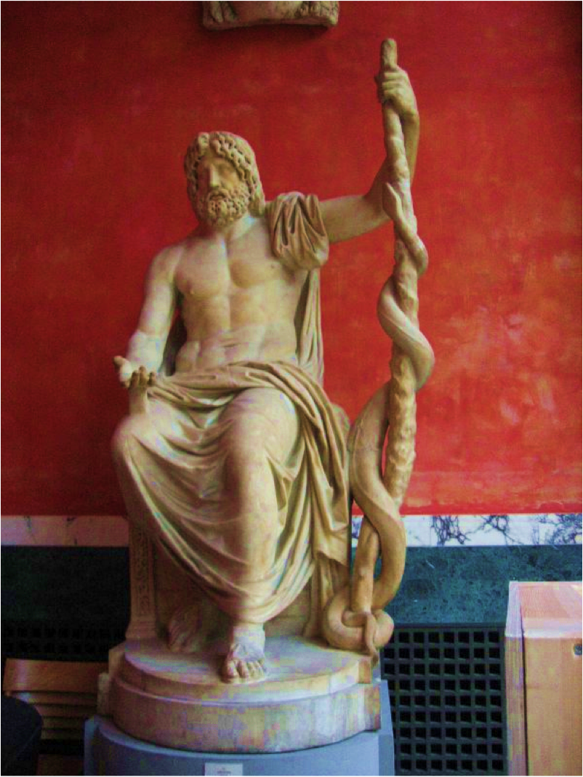
4 Magnificent Greek Temples in Pergamos
Asclepius – most probably a skilled physician who practiced in Greece around 1200 BC (described in Homer's Iliad).
Eventually he came to be worshipped as Asclepius, the Greek god of Healing.

Slide 15
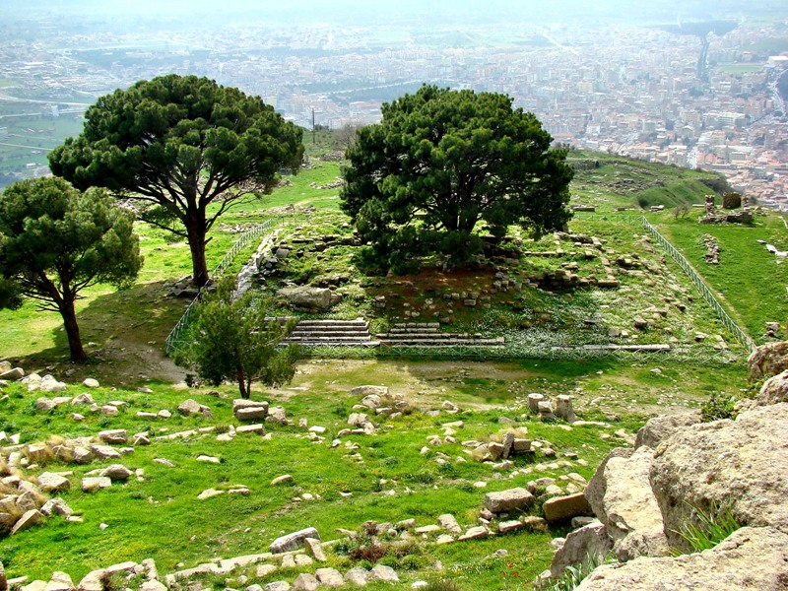
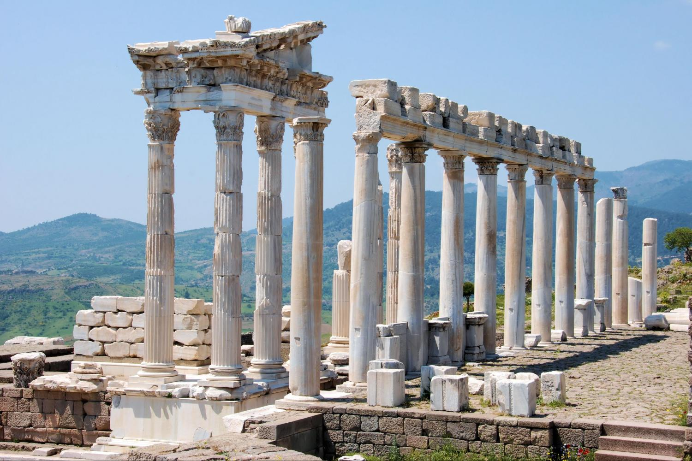
The City of Pergamum
Temple of Zeus
Pergamos
Trajan Temple
Pergamos

Slide 16
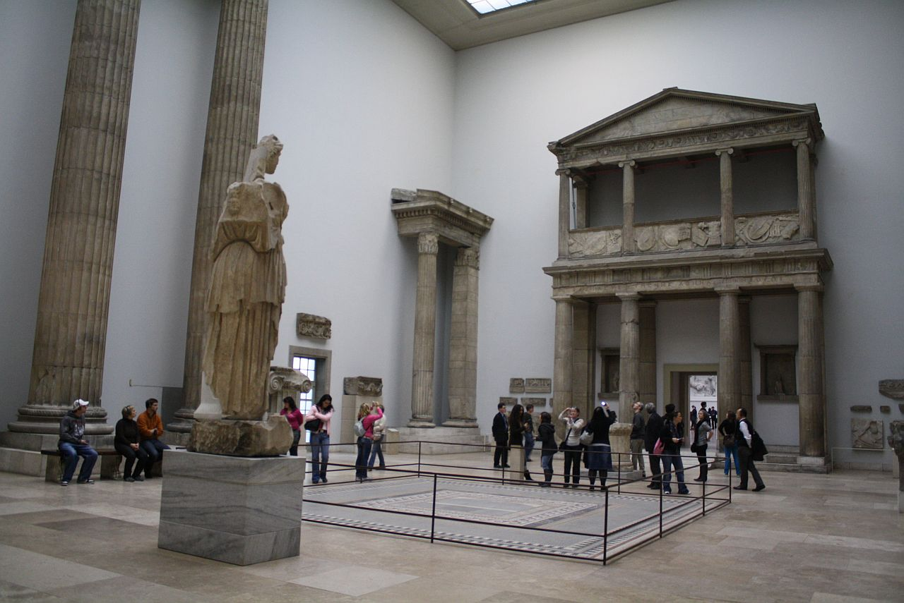
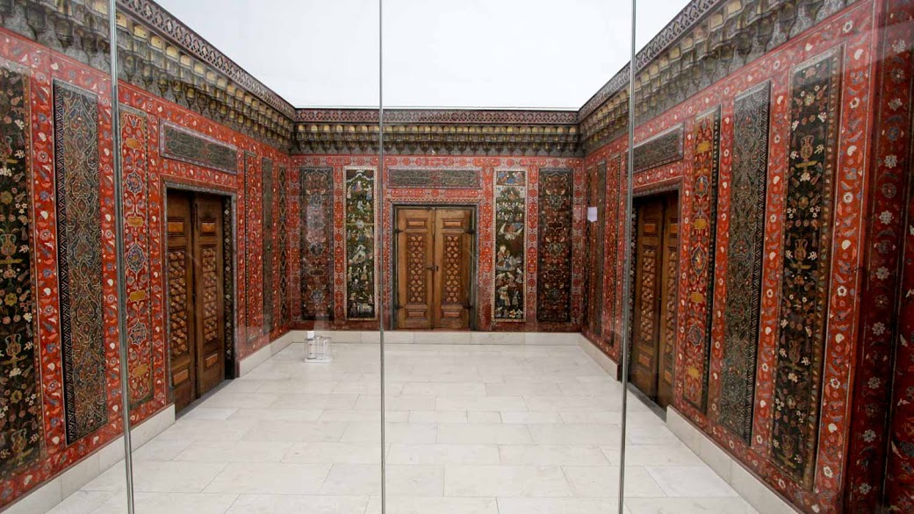
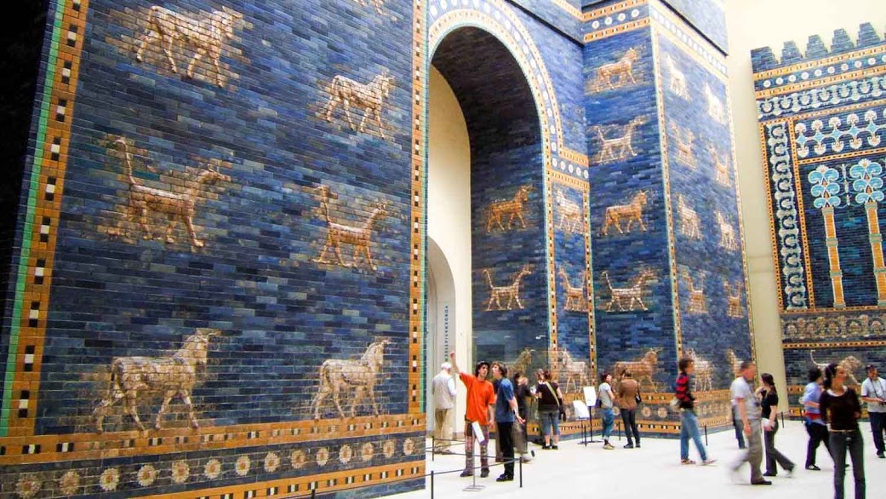
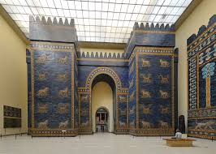
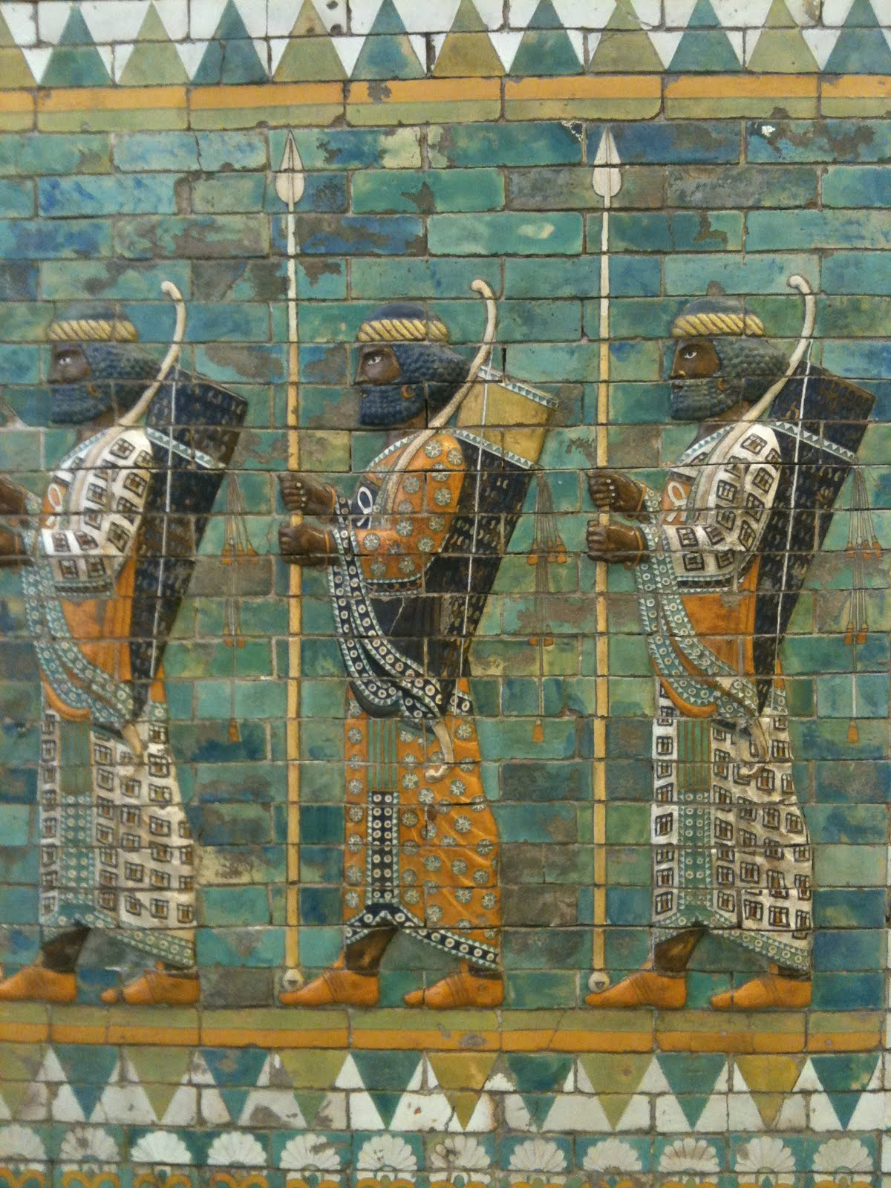
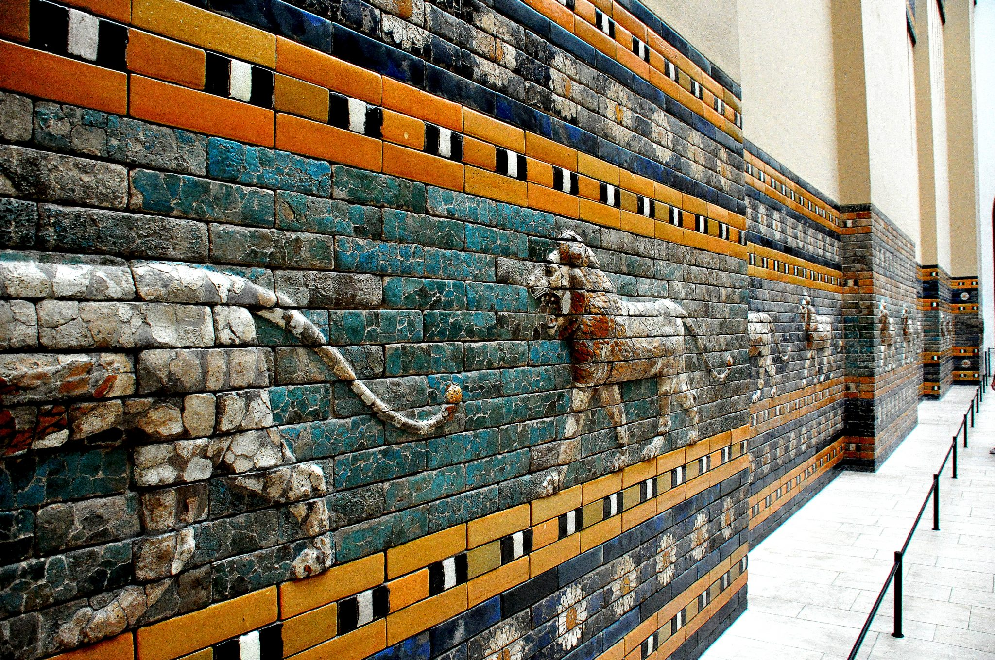
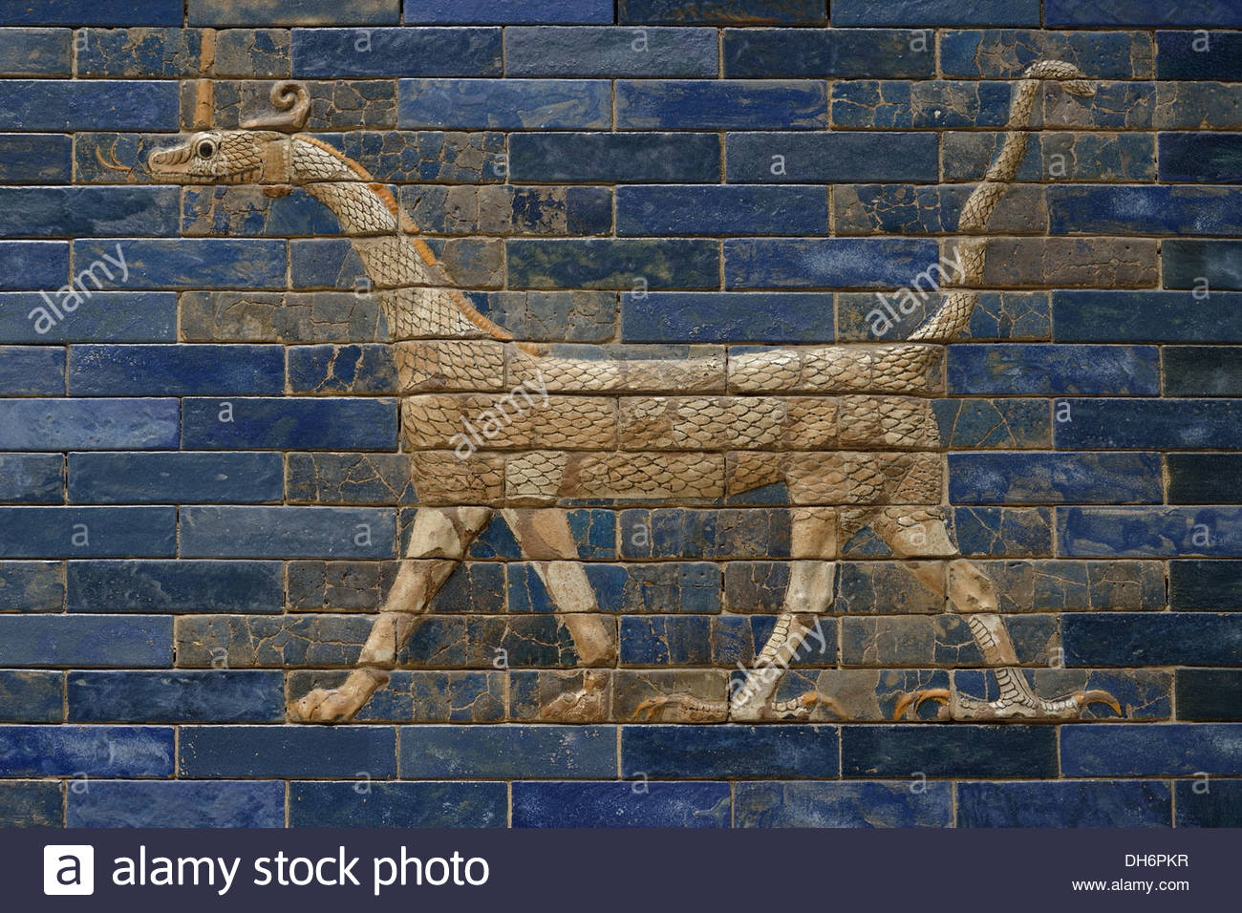
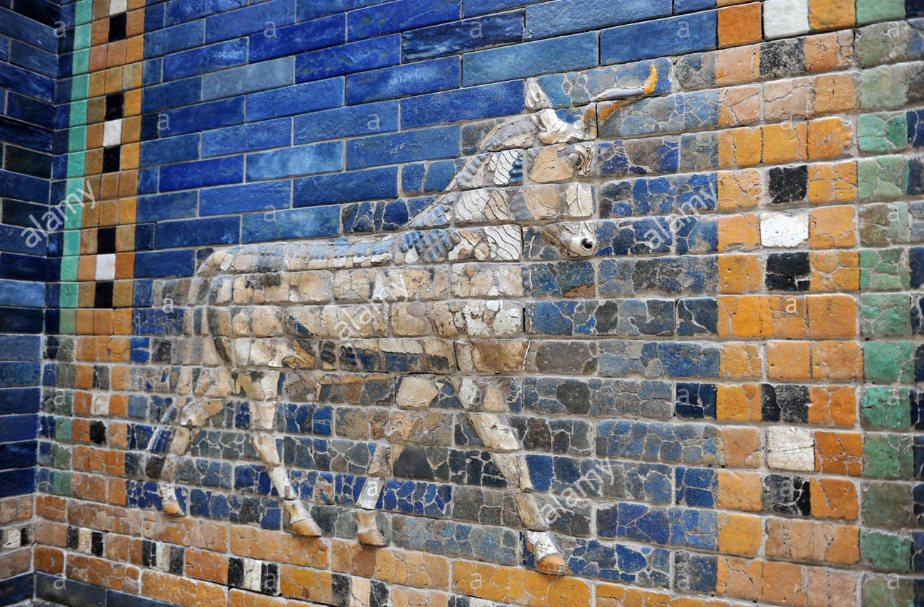
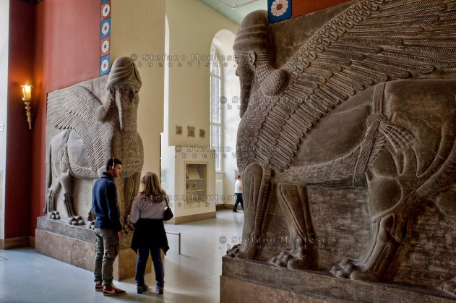
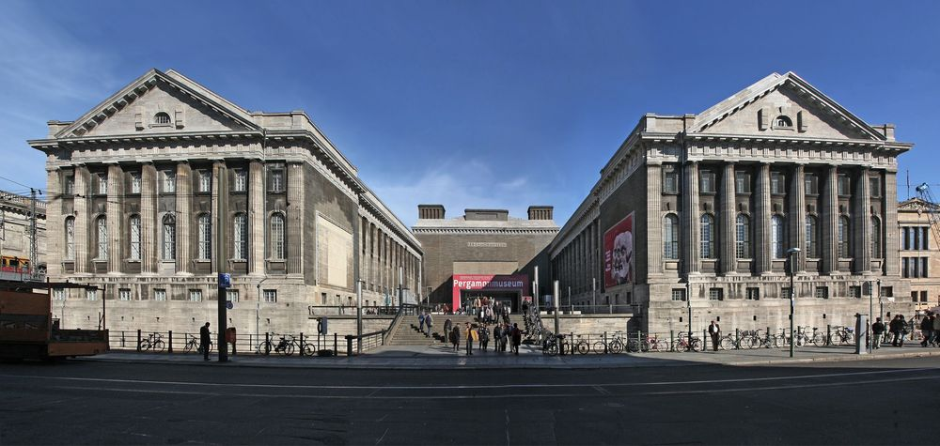
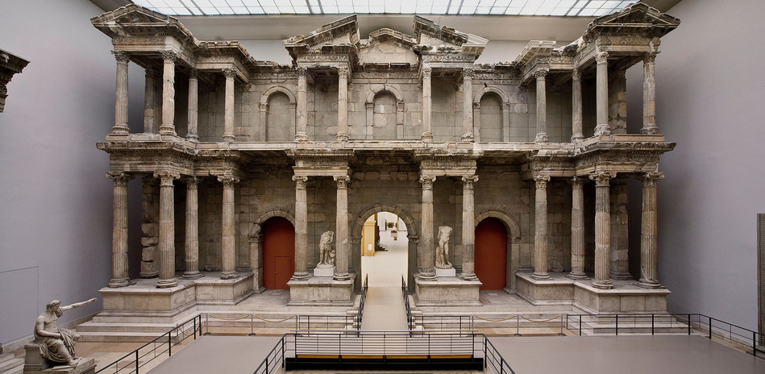
The Pergamon Museum
Pergamon Museum
In Berlin

Slide 17
The word pergamos or pergamum means “married”. The church at Pergamos was married to the world. It held those who were teaching heretical doctrines, either not realizing it, or not seeing the importance of keeping the doctrine pure. It marketed the gospel by making it appealing to the world, promoting: “Christianity really isn’t that different.”

Slide 18
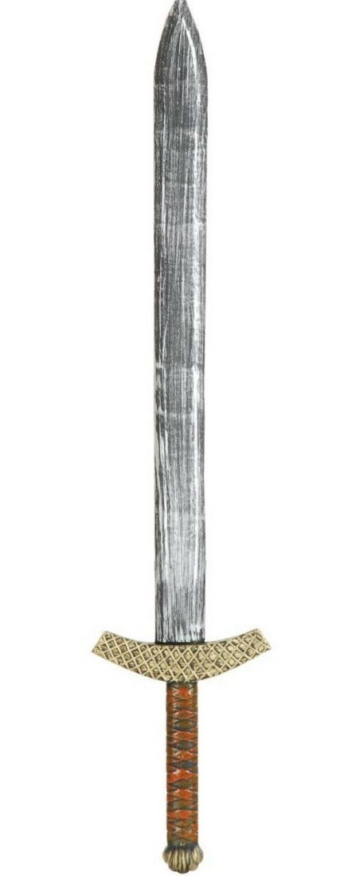
The Introduction – verse 12
He who has the sharp two edged sword–
Ephesians 6:17 (the armor of God), the Sword is the Word of God
Hebrews 4:12 (the Word of God is sharper than any two edged sword) The sword needed to have two sharpened sides to take care of the heresy in the church at Pergamos. Truth exposes error.

Slide 19
The Commendation – verse 13
Daniel 10:12-14 – Then he said to me, “Do not fear, Daniel, for from the first day that you set your heart to understand, and to humble yourself before your God, your words were heard; and I have come because of your words. But the prince of the kingdom of Persia withstood me twenty-one days;
Some cities are notorious for the amount of evil they produce.
Satan is the god of this world, a roaring lion seeking whom he may devour. Satan is very real.
Satan is not God.
He is not omniscient.
He cannot do whatever he wants to do.
and behold, Michael, one of the chief princes, came to help me, for I had been left alone there with the kings of Persia.
Now I have come to make you understand what will happen to your people in the latter days, for the vision refers to many days yet to come.”
I know your works, and where you dwell, even where Satan's seat is:

Slide 20
The Commendation – verse 13
We enjoy living in an area inhabited by a number of Christians, in whom the Holy Spirit dwells. But, in Pergamos, where pagan science and medicine education was flourishing, the number of Christians were few. Satan sat upon his throne in Pergamos.
Can you think of cities where Satan has a throne?
Satan had a throne in Pergamos – when you went into Pergamos, you could feel the presence of Satan.
Houston
Calcutta, India

Slide 21
The Commendation – verse 13
…you hold fast to My name, and did not deny My faith even in the days in which Antipas was My faithful martyr, who was killed among you, where Satan dwells
The Lord Jesus acknowledges their faithfulness. No information about Antipas, a Christian in Pergamos who was martyred.

Slide 22
The Condemnation – verse 14
…you have there those who hold the doctrine of Balaam, who taught Balak to put a stumbling block before the children of Israel, to eat things sacrificed to idols, and to commit sexual immorality.
Some Christians find doctrine tedious and boring, and sometimes qualify their lack of interest in it by saying they prefer more spiritual things than doctrine… that doctrine tends to divide, and they prefer to unite.
Differing Opinions
One Belief
Opinions we can discuss, ponder, & still enjoy fellowship
Doctrinal Beliefs become a Point of Fellowship & we must part

Slide 23
The Condemnation – verse 14
What is the doctrine of Balaam?
Balaam was a false prophet hired to curse Israel. But, Balaam could not curse them – every time he opened his mouth to curse the Hebrews, blessings came out.
found in Numbers 22-24
2 Peter 2:15 –
“following the way of Balaam the son of Bosor, who loved the wages of unrighteousness”
Jude 1:11 –
“Woe unto them! for they have gone in the way of Cain, and ran greedily after the error of Balaam for reward”
People sometimes think because they have to make a living, that if they make their money doing something that isn’t Godly, it’s “just business” and doesn’t count in the realm of their Christian obligations.
It seems that the doctrine of Balaam is that it is perfectly alright to make a living or to get gain from something that is unrighteous.
They promote ungodly video games, movies, music, even teaching falsehoods, all in the name of “livelihood”.

Slide 24
Have you ever felt like you had to do something because “it was your job” that the Lord wouldn’t normally want you to do?
What did you do?
Would you do the same thing again if the situation ever arises?

Slide 25
The Condemnation – verse 15
He taught a doctrine of compromise with the world. Joining paganism with Christianity seemed favorable to him because it made Christianity more appealing to those in paganism.
…you also have those who hold the doctrine of the Nicolaitans, which thing I hate
Nicholas was a deacon who abused his place in the church to gain authority over the church.
We should stay far away from it!
God Hates This!!

Slide 26
The Condemnation – verse 15
Valentine’s
Day?
Easter Eggs/Bunnies?
Christmas
trees?
Santa Claus?
What about the pagan festival of Halloween?
Are we so indoctrinated in paganism that we don’t even recognize it?

Slide 27
The Condemnation – verse 15
Matthew 16:18 tells us, “upon this rock I will build My church, and the gates of hell will not prevail against it”
We will never be conquered from any power coming from outside our churches, but we must carefully guard what we allow to emerge and take hold on the inside.
Differing Opinions
One Belief
Opinions we can discuss, ponder, & still enjoy fellowship
Doctrinal Beliefs become a Point of Fellowship & we must part

Slide 28
The Counsel – verse 16
Repent, or else I will come to you quickly and will fight against them with the sword of My mouth.
Turn away!!
God is fighting these idolatrous doctrines with His Truth!!
Are we listening?

Slide 29
The Closing – verse 17
Once more, the Lord used the same closing as He did with the Churches at Ephesus and Smyrna, reminding the members in Pergamum that not all have the spiritual ears to discern what the Spirit is saying.
He who has an ear let him hear what the Spirit says to the churches.

Slide 30
The Reward – verse 17
The hidden manna – When the Ark of the Covenant, was constructed three things were put into it: The Law of God (first five books of the Bible – also known as the Pentateuch), Aaron’s rod that budded, and a golden pot of manna. That manna signified ???
To him who overcomes I will give some of the hidden manna to eat.
Jesus Christ - the Bread of Life!

Slide 31
The Reward – verse 17
They gave white stones to the conquerors in the Olympic games, with their names upon them, and the value of the prize they won.
May represent the crown of life and glory given to them who are more than conquerors through Christ, with excellency and their title to it.
The White Stone
There are many symbolic references for white stones.
The Romans, in court judgments, gave their suffrages for condemnation by casting black stones into an urn, and for absolution, white stones…
In Christ, we’ve been absolved – released from our condemnation!
The Grecians used to mark good or lucky days with white stones.
The Lord will reward good days ahead.
And I will give him a white stone, and in the stone a new name written which no one knows except him who receives it.

Slide 32
The Reward – verse 17
A new name that no one knows –
God has always put significance on names. He has changed names of people so that they might reflect His purpose. Abram was changed to Abraham, Jacob was changed to Israel, etc.
This new name that God will give to us, whatever it may be, will reflect His purpose in us. It will be a name to cherish!

Slide 33
Pergamos (which means married) was married to the world.
The “Church” (led by Roman officials) marketed the gospel by allowing people to keep their pagan practices and simply rename idols & celebrations “converting” them into “Christian” ones.
During the Church Age it represents (312–500 AD),
the “Church” married into the pagan world system.

Slide 34
Pergamos (which means married) was married to the world.
Codex Theodosianus XVI 1.2.
It is Our will that all the peoples who are ruled by the administration of Our Clemency shall practice that religion which the divine Peter the Apostle transmitted to the Romans....
…The rest, whom We adjudge demented and insane, shall sustain the infamy of heretical dogmas, their meeting places shall not receive the name of churches, and they shall be smitten first by divine vengeance and secondly by the retribution of Our own initiative.
Forced conversion was a major means in the Christianization of the Roman Empire.
In 392 A.D. the emperor, Theodosius I, made Christianity the only legal religion of the empire, and forbade Pagan practices by law as a means to stabilize the declining empire.

Slide 35
Codex Theodosianus XVI 1.2.
led to the destruction of most pagan temples in the empire.
To make this massive conversion easier, the government acknowledged some of the pagan practices as “Christian.”

Slide 36
George Parsons: If You Cannot Beat Them, Join Them!
Thousands of unsaved pagans became baptized and started calling themselves "Christians." Did water baptism make them true Christians? The church gained in QUANTITY but it lost in QUALITY. There was a massive growth in numbers but no growth in purity. The church was becoming more and more worldly and corrupt.
It was just the same old paganism or heathenism under a new name!
The church had not conquered the world. THE WORLD HAD CONQUERED THE CHURCH!
Paganism had put on new clothes but it was the same old paganism.
The host of hypocrites and pretenders that was entering the church was multiplying beyond control.
As you can well imagine, many heathen customs and practices crept into the church.
The pagan images and statues were still honored, but they were given "Christian" names such as Peter or Mary. Artemis (Diana) worship was changed to Mary worship. Also Isis, the Egyptian goddess was easily transformed into Mary. Worshippers of Isis called her "the Great Virgin" and "Mother of the God".
Some surviving images of Isis holding the child Horus are in a pose very similar to that of some early Christian Madonnas (showing Mary holding the infant Jesus). Heathen temples were consecrated and changed into churches. Heathen feasts were given Christian names.

Slide 37
Do we see paganism in our world today?
Do we see it in our churches?
Name some pagan practices that are seen in our Christian homes or churches

Slide 38
A Look at Our Timeline
312 AD Constantine defeats Maxentius (Battle of Milvian Bridge) and becomes Emperor of the West. Constantine used the letters chi and rho (first two letters in "Christ") as his symbol.
312 AD Caecilian elected bishop of Carthage. (results in Donatist Churches)
313 AD Edict of Milan gives Christians equal rights.

Slide 39
324 AD Constantine defeats Licinius and becomes Emperor of both East and West.
325 AD Council of Nicea condemns Arianism (belief that Jesus was created).
337 AD Constantine dies
340 AD Ulfilas converts to Arian Christianity, takes it to Germanic tribes, gives them an alphabet, and translates the Bible into German. Most Germanic tribes become Arian Christians

Slide 40
353 AD Emperor Constantius releases his pro-Arian campaign and drives Athanasius (bishop) from Alexandria
361-363 AD Reign of Julian the Apostate, who converts from “Christianity” to paganism and restores paganism in Rome
367 AD A letter of Athanasius names the 66 books of the canon
(Athanasius dies in 373)

Slide 41
381 AD Council of Constantinople – defeats Arianism & Appolloarianism and declares Father/Son/Holy Spirit as one God in three persons.
393 AD The Council of Hippo recognizes the canon.
To be recognized, a book had to be ¹⁾Apostolic, ²⁾fit in with the other scriptures, and ³⁾have been of fruitful use throughout the church up to that time.

Slide 42
397-401 Augustine (age 22-26) writes Confessions
411-430 Augustine's Anti-Pelagian writings. (Pelagius rejected that we all fell in Adam and have a sin nature. We could earn our salvation by works, so grace is not necessary) Augustine insisted that we all sinned in Adam, resulting in spiritual death, guilt, & our diseased nature. God's grace is necessary not only to be able to choose to obey God's commands, but to be able to choose to turn to God initially for salvation.

Slide 43
418 The Council of Carthage anathematized the teachings of Pelagius.
434 Patrick begins his mission to spread the Gospel in Ireland.
590 Gregory the Great becomes pope. He develops the idea of Purgatory.

Slide 44
Repent from Pagan beliefs!
God wants us to repent from the doctrines of Balaam – to not make our living from things that are unrighteous – but live a pure life in all things!
God wants us to repent from the doctrine of the Nicolaitans – the marriage of pagan worship into the true gospel of Christ!

Slide 45
Our Reward!
God will give us to eat of the Bread of Life – to have Jesus to permeate our life!
God will give us a white stone with a new name – all our old sins and existence will be gone, our new life is all that remains!

Slide 46
That concludes our study of
The Church of Pergamos
Lesson 7 in “When Are We Now?”
The first of three studies in
The Revelation of Jesus Christ
by Paige Ramsey

