Slide 1
The Church of Philadelphia The Feeble Church – Loyalty, Revivalism
Lesson 10 in When Are We Now?
The first of three studies of
The Revelation of Jesus Christ
by Paige Ramsey

Slide 2
Revelation 3:7-13
And to the angel of the church in Philadelphia write,
‘These things says He who is holy, He who is true, “He who has the key of David, He who opens and no one shuts, and shuts and no one opens”: “I know your works. See, I have set before you an open door, and no one can shut it;

Slide 3
Revelation 3:7-13
for you have a little strength, have kept My word, and have not denied My name. Indeed I will make those of the synagogue of Satan, who say they are Jews and are not, but lie—indeed I will make them come and worship before your feet, and to know that I have loved you.

Slide 4
Revelation 3:7-13
Because you have kept My command to persevere, I also will keep you from the hour of trial which shall come upon the whole world, to test those who dwell on the earth. Behold, I am coming quickly! Hold fast what you have, that no one may take your crown. He who overcomes, I will make him a pillar in the temple of My God,

Slide 5
Revelation 3:7-13
and he shall go out no more. I will write on him the name of My God and the name of the city of My God, the New Jerusalem, which comes down out of heaven from My God. And I will write on him My new name.
“He who has an ear, let him hear what the Spirit says to the churches.”’

Slide 6
Philadelphia
Phileo = love, fondness, affection one for another
[Also found in the names Philemon & Philippians.]
Adelphi = brotherly Philadelphia = brotherly love

Slide 7
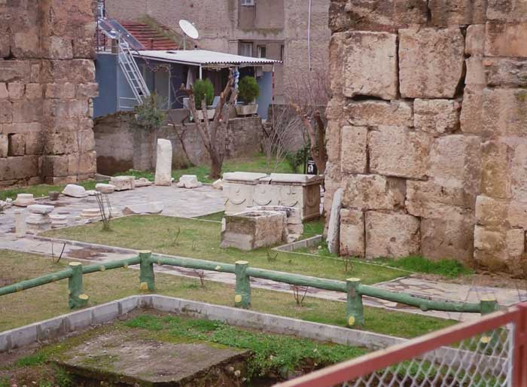
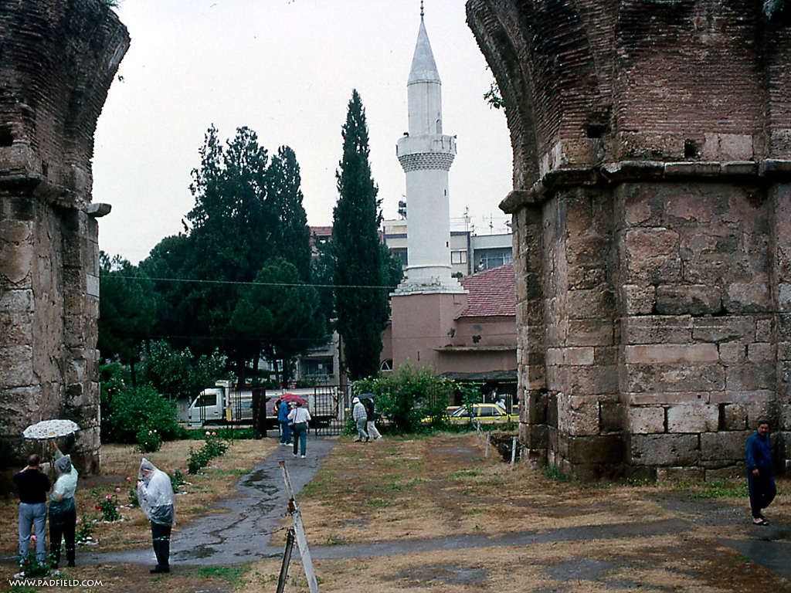
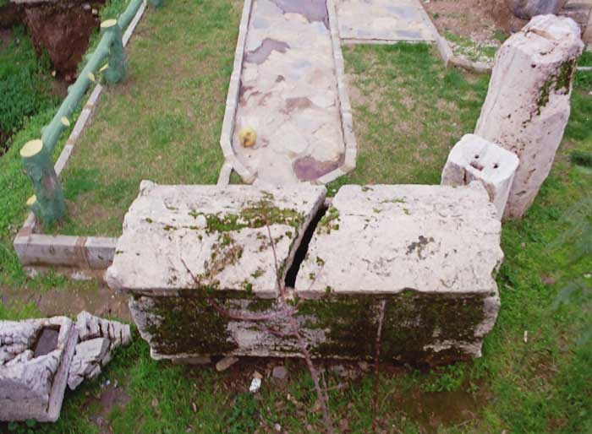
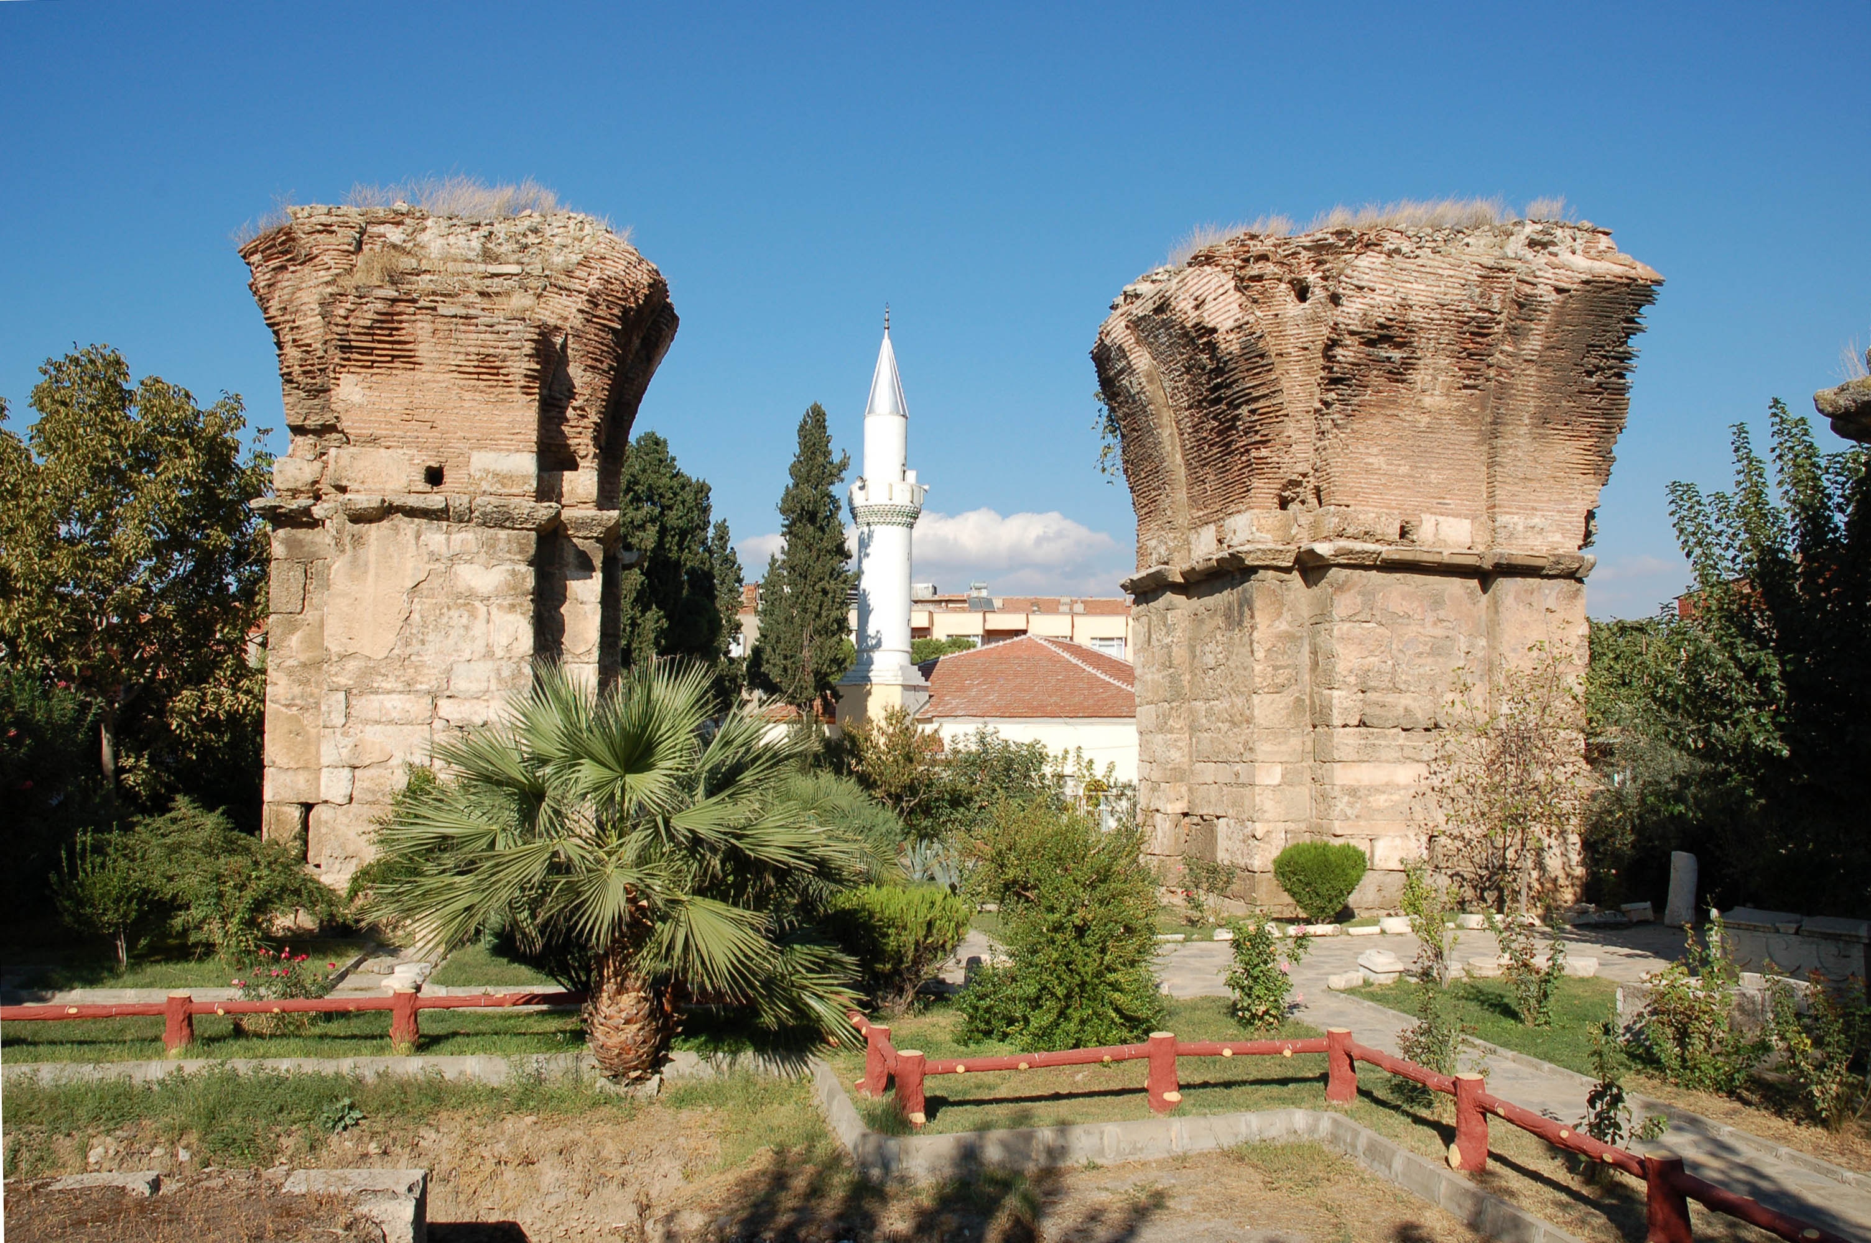
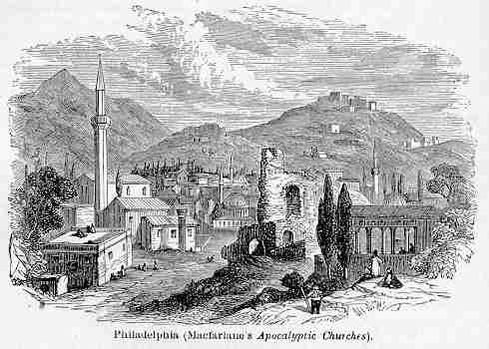
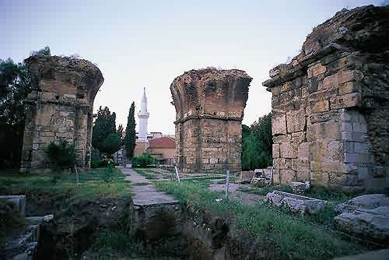
Philadelphia
Philadelphia was located about 30 miles southeast of Sardis in the valley of the Cogamis, a tributary of the Hermus, overlooking a fertile valley. Philadelphia was in the province of Lydia and stood at the place where the borders of Mysia, Lydia, and Phrygia met. This position made it the gateway to the East.

Slide 8
Philadelphia
The city was nearly destroyed and suffered a great deal when a major earthquake hit the area in 17 A.D. Emperor Tiberius, in lieu of the damages, allowed Philadelphia to be free of taxation. Various other emperors aided the area, such as Caligula (37 to 41 A.D.) and Vespasian (69 to 79 A.D.).

Slide 9
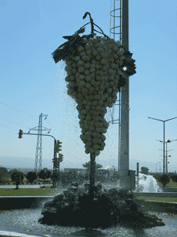
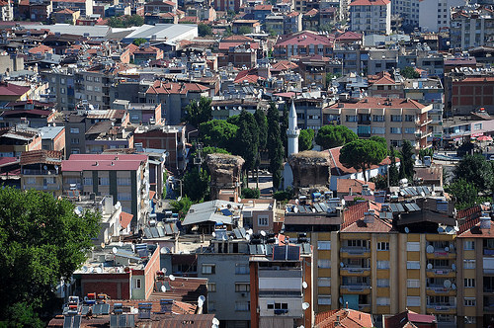
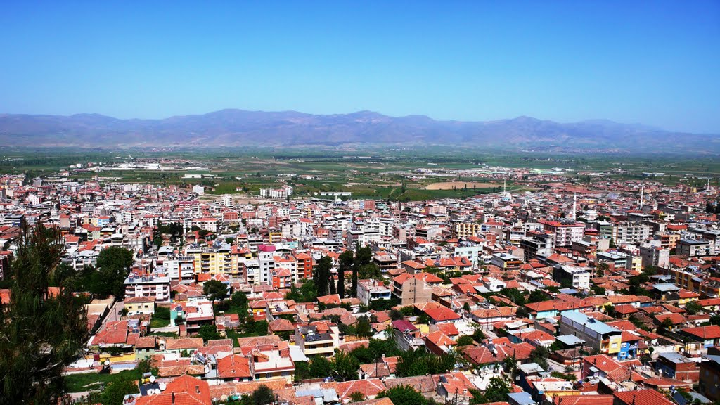
Not much is left of old Philadelphia. Its ruins are engulfed in the modern city, Alaşehir.
Philadelphia

Slide 10
The Letter
Is 22:20-22
‘Then it shall be in that day, that I will call My servant Eliakim the son of Hilkiah; I will clothe him with your robe and strengthen him with your belt; I will commit your responsibility into his hand.
He shall be father
to the inhabitants of Jerusalem and to the house of Judah. The key of the house of David I will lay on his shoulder; so he shall open, and no one shall shut; and he shall shut, and no one shall open.
‘These things says He who is holy, He who is true, “He who has the key of David, He who opens and no one shuts, and shuts and no one opens” – speaking as One who is holy – One who is true
Jesus possesses the Key of David:

Slide 11
Having the key of the house of David, the King of Israel meant three things:
1. He could unlock all the treasure of the palace. Eliakim had the master key to unlock all the doors of the king of Israel. He could open and no one could shut. Jesus Christ has the key to unlock all the riches and wealth of the Father’s bank. God has a bank that contains more riches that anyone on this earth can fathom, and Jesus has the key to it all.

Slide 12
Having the key of the house of David, the King of Israel meant three things:
Discussion:
How does this apply to us?
Are you glad for this or does it confine you?
This is a blessing! How many beautifully decorated doors would we be willing and even eager to march right through if our Lord allowed it?
We would put ourselves and our loved ones in danger if He did not possess the key to lock those doors shut so that we cannot mess up our lives with worldly fame and fortune that would ruin our eternal joy.
Praise the Lord that He shuts and no one opens!!
2. He could lock up whatever he desired to lock up so that no one could get to it. By having this all important key, Eliakim could decide what needed to be kept confined. He also could decide who he allowed to have access and who could not. He could shut and no one could open. Jesus can shut doors so that we cannot walk through them.

Slide 13
Having the key of the house of David, the King of Israel meant three things:
3. No one could get to the king without going through Eliakim – because Eliakim had the key to the throne room. And no one can get to the heavenly Father without going through the resurrected Lord and Savior, Jesus, the Christ. He is the Way – the only Way to eternal life!

Slide 14
The Great Awakening
Before we go further, let’s look at the events of what we now call “The Great Awakening” as we will be able to better appreciate what the Lord had to say in this letter.
Ephesus
29-100
Smyrna
100-313
Pergamos
314-520
Thyatira
540-1517
Sardis
1517-1720
Philadelphia 1730-1930

Slide 15
From Wajam Wikipedia
“The Great Awakening”:
Joseph Tracy, the minister, historian, and preacher who gave this religious phenomenon its name in his influential 1842 book The Great Awakening, saw the First Great Awakening as a precursor to the American Revolution. The evangelical movement of the 1740s played a key role
The term “Great Awakening” refers to several periods of revival in America’s Christian history. According to historians and theologians there are 3 or 4 distinct waves of increased enthusiasm for Christ occurring between 1720 – 1899. The first Great Awakening in America occurred simultaneously with the same miraculous happening in England, Scotland, Wales, and Germany.
in the development of democratic thought,
as well as the belief of the free press and the belief that information should be shared and completely unbiased and uncontrolled. These concepts ushered in the period of the American Revolution. This contributed to create a demand for religious freedom.

Slide 16
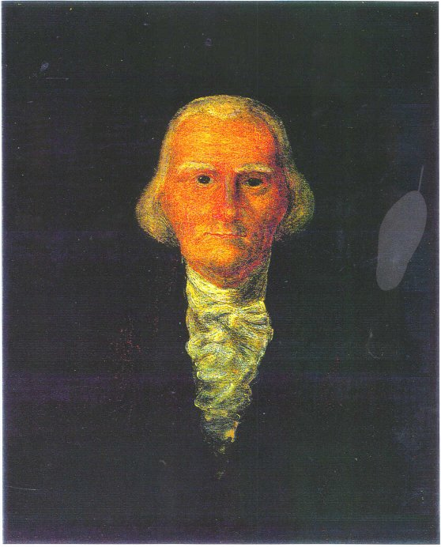
The First Great Awakening (1730-1770) God used passionate men to stir up life once again:
William Tennent, a Scots-Irish immigrant, and his four sons, all clergymen of the Presbyterians not only initiated religious revivals in Pennsylvania and New Jersey during the 1730s but also established a seminary to train clergymen whose fervid, heartfelt preaching would bring sinners to experience evangelical conversion. Originally known as “the Log College,” it is better known today as Princeton University.

Slide 17
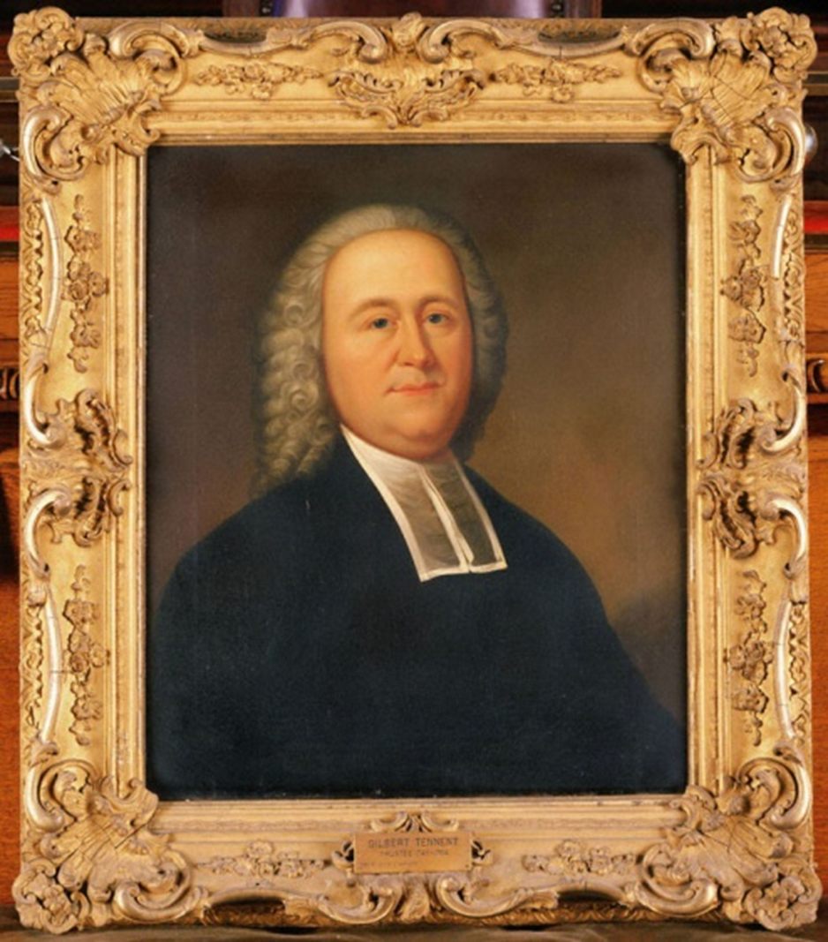
The First Great Awakening (1730-1770) God used these men to stir up life once again:
There he met Theodorus Frelinghuysen, a Dutch Reformed minister whose preaching emphasized holy living and conversion, echoing those of Gilbert’s father. He and Frelinghuysen formed a partnership, often preaching in each other’s churches and traveling throughout New Jersey and nearby colonies. Gilbert was a stirring, enthusiastic preacher, leading many to experience conversion.
In 1739 he met George Whitefield, with whom he shared a zeal for revival. Tennent traveled with Whitefield, introducing him to other ministers in the Middle Colonies and helping to make Whitefield’s preaching tour a success. When Whitefield returned to England, Tennent preached for several months in New England. These tours did much to unite a series of scattered, local revivals into the Great Awakening.
Gilbert Tennent, born in 1703, 1st son of William Tennent, who educated him at the “Log College”. Gilbert wrestled over salvation through his teens, and finally became converted when he was twenty. Three years later he was ordained a Presbyterian minister and began pastoring in New Brunswick, New Jersey.

Slide 18
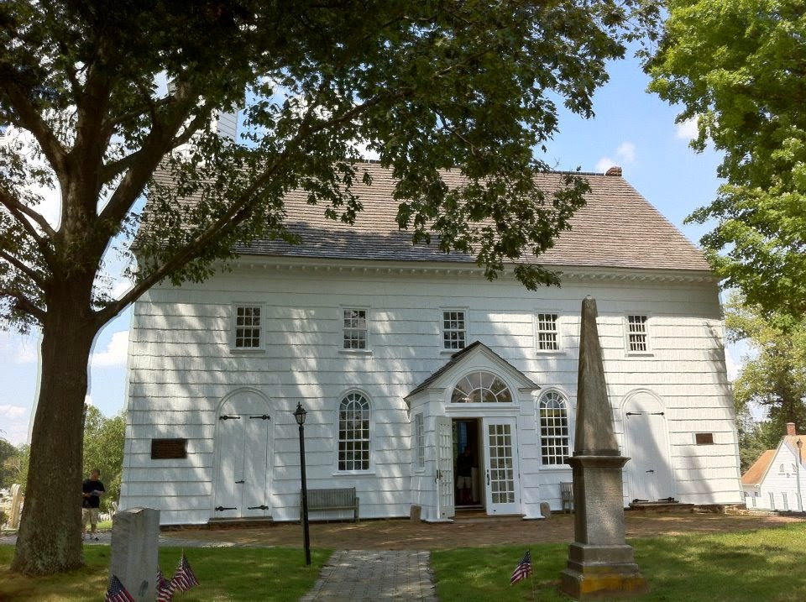
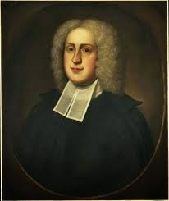
The First Great Awakening (1730-1770) God used passionate men to stir up life once again:
unconsciousness that he was pronounced dead and was fifteen minutes away from being buried before he suddenly and without provocation woke straight up. He had lost his entire memory but otherwise recovered without any seeming effect of the trauma. And then, several weeks later, again without any provocation, all of his memories and mental faculties returned.
His brother John had accepted the pastorate at Old Scots Presbyterian Church in Freehold, New Jersey. When John died unexpectedly, the Presbytery sent William in as his replacement. William Tennent, Jr. began his service at Old Scots in 1732. It was the only church he would ever pastor. He was a beloved pastor who was committed to preaching an evangelical gospel of the new birth
Less than a year after the American Revolution broke out, in March 1777, Reverend Tennent was finally called home. Knowing that he was considered a traitor by the British, the people of Old Scots Church had their beloved pastor buried without markings under the floor of their sanctuary, where he remains to this day.
and the doctrines of grace. Old Scotts Church was strategically situated at a midpoint between the middle colonies and New England. It became a key support point for the Great Awakening throughout the 1730’s and 40’s. In fact, it is the only church where William Tennent, Jr, Gilbert Tennent, George Whitefield, Jonathan Edwards and David Brainerd all preached from the church pulpit.
William Tennent, Jr., born in 1705, 2nd son of William Tennent, was also educated by his father in the “Log College”. After completing his education at the Log College, he commenced study for ordination. However it was during his studies that Tennent experienced one of the most remarkable events you’ll ever hear about. Its called ‘The Trance’ – an unexplainable descent into such a state of

Slide 19
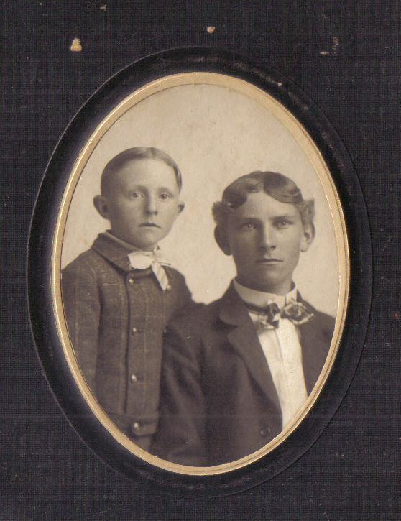
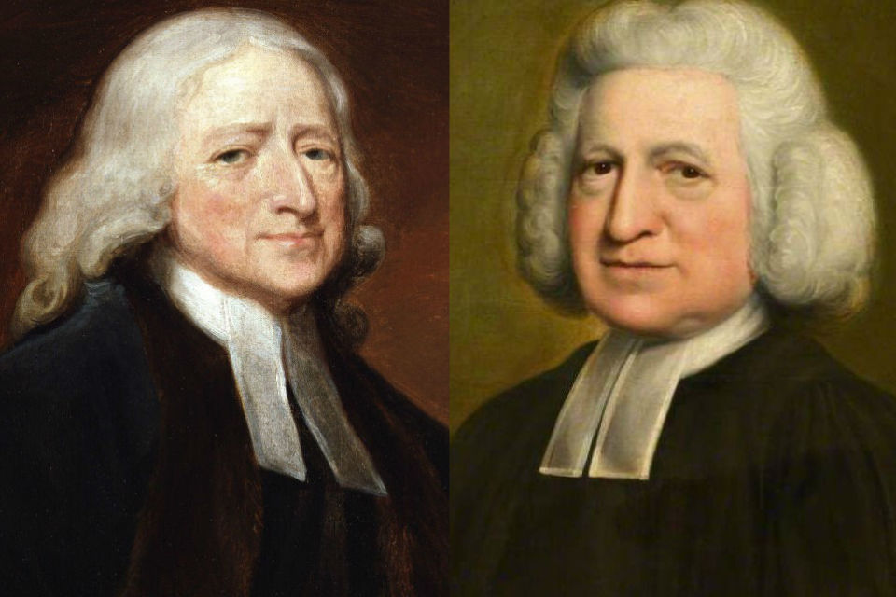
The First Great Awakening (1730-1770) God used these men to stir up life once again:
John quickly became a leader in this group that they named Methodists because they followed strict methods of spiritual growth. In 1735 both John and Charles came to America to the colony of Georgia, but two years later, discouraged, they returned to England. Then, on May 24, 1738, in a small meeting in Aldersgate Street, London, John Wesley had an experience in which his "heart was strangely warmed."
John and Charles Wesley – John was born in 1703 and Charles in 1707 to Samuel Wesley and Susanna (Annesley) Wesley. They were schooled at home by Susanna until they entered Oxford University. While John was away for two years to help his father, Charles formed a group of young men interested in spiritual growth.
After this spiritual conversion, John understood salvation by faith in Christ alone and devoted his life to evangelism. Charles began reading Martin Luther's volume on Galatians in 1738, while ill. He wrote in his diary, "I labored, waited, and prayed to feel 'who loved me, and gave himself for me.'" He shortly found himself convinced, and wrote in his journal, "I now found myself at peace with God, and rejoice in hope of loving Christ."
Two days later he began writing a hymn celebrating his conversion. At evangelist George Whitefield's instigation, John and Charles eventually submitted to "be more vile" and do the unthinkable: preach outside of church buildings. During his ministry, John travelled 250,000 miles on horseback, averaging 20 miles a day for 40 years. He knew 10 languages, produced 400 books, and preached 40,000 sermons.
Throughout his adult life, Charles wrote verse, predominantly hymns for use in Methodist meetings. He produced 56 volumes of hymns in 53 years, producing in his lyrics what brother John called a "distinct and full account of scriptural Christianity." Hundreds of thousands came to know the Lord during their ministry.

Slide 20
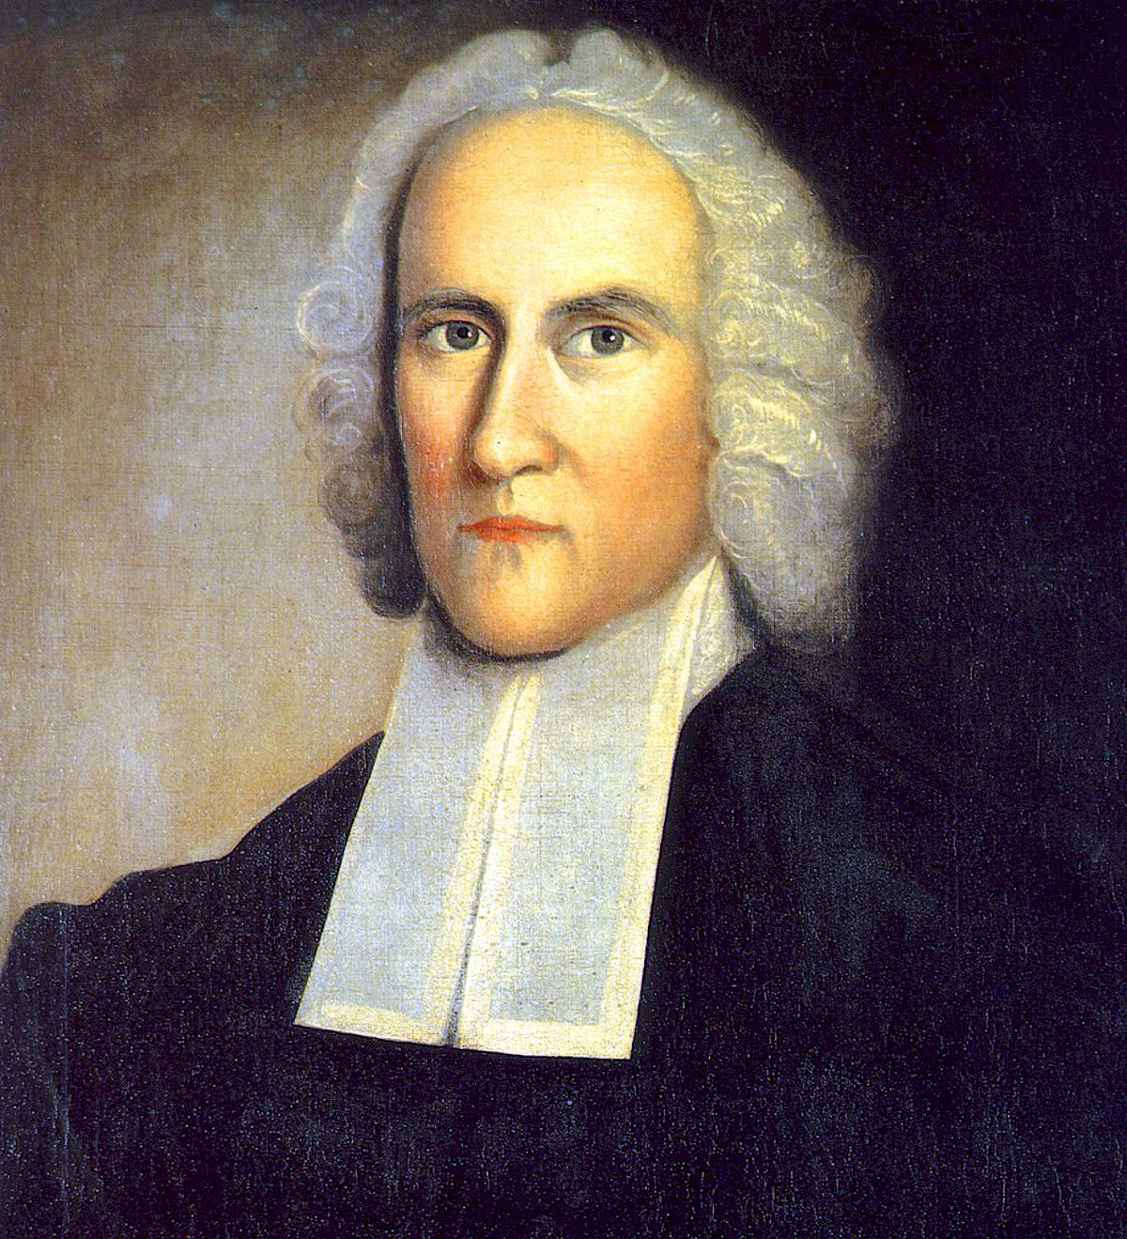
The First Great Awakening (1730-1770) God used these men to stir up life once again:
As a youth, Edwards was unable to accept the sovereignty of God as taught by the reformed churches. However, in 1721 he came to what he called a "delightful conviction." He was meditating on 1 Timothy 1:17, and later remarked, "As I read the words, there came into my soul, and was as it were diffused through it, a sense of the glory of the Divine Being; a new sense, quite different from any thing I ever experienced before…
I thought with myself, how excellent a Being that was, and how happy I should be, if I might enjoy that God, and be rapt up to him in heaven; and be as it were swallowed up in him for ever!" From that point on, Edwards delighted in the sovereignty of God and later recognized this as his conversion to Christ. As a student minister in his grandfather’s church, from 1727-1729, his ritual was thirteen hours of study a day.
When his grandfather died in 1729, he took on the difficult task of the sole ministerial charge of one of the largest and wealthiest congregations in the colony. “Throughout his time in Northampton his preaching brought remarkable religious revivals. Jonathan Edwards was a key figure in what has come to be called the First Great Awakening of the 1730s and 1740s.”
Jonathan Edwards – born in 1703 in East Windsor, Connecticut, to Timothy Edwards, pastor of East Windsor, and Esther (Stoddard) Edwards, he entered Yale in September, 1716 when he was twelve years old and graduated four years later (1720) as valedictorian. He received his Masters three years later.

Slide 21
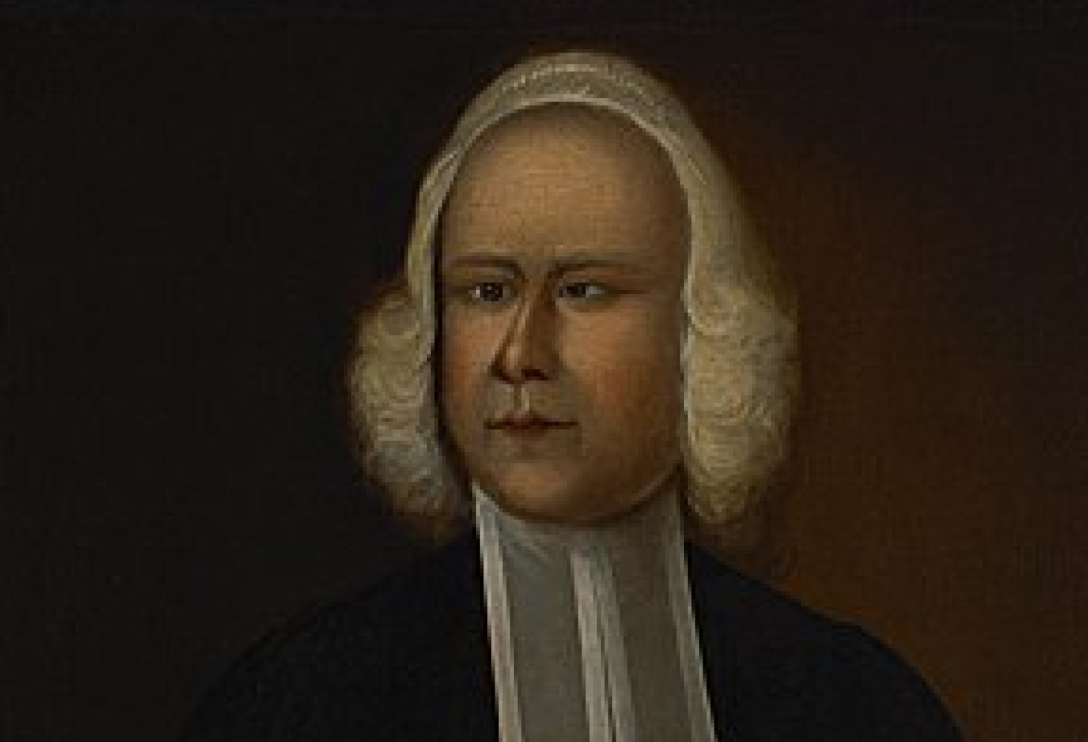
The First Great Awakening (1730-1770) God used these men to stir up life once again:
finally resulted in George's conversion in 1735. He said many years later: "I know the place.... Whenever I go to Oxford, I cannot help running to the spot where Jesus Christ first revealed himself to me and gave me the new birth." He began his work in England in 1739 when he conducted open airfield meetings and would preach to as many as 20,000 people in an open field with no public address equipment whatsoever.
He preached more than 18,000 sermons in his lifetime, an average of 500 a year or ten a week. Fewer than 90 have survived in any form.
He had a booming voice and could speak and preach to that many people the Word of God. He firmly preached the Doctrines of Grace as his theology yet unrivaled as an aggressive evangelist. In his preaching ministry he crossed the Atlantic thirteen times and became known as the 'apostle of the British empire.' Though a clergyman of the Church of England, he cooperated with and had a profound impact
on people and churches of many traditions, including Presbyterians, Congregationalists, and Baptists. All throughout the New England colonies there was an air of revivalism. It is estimated that the population of all the colonies at that time was about 2,000,000. No less than 50,000 of them came to know the Lord through George Whitefield.
George Whitefield b. 1714 – In 1732 at age 17, George entered Pembroke College at Oxford. He was gradually drawn into a group called the "Holy Club" where he met John and Charles Wesley. Charles Wesley loaned him the book, The Life of God in the Soul of Man. The reading of this book, after a long and painful struggle which even affected him physically,

Slide 22
The Second Great Awakening 1800 – 1840
God chose specific USA sections to kindle revival fires.

Slide 23
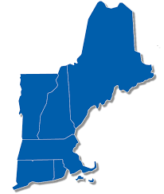
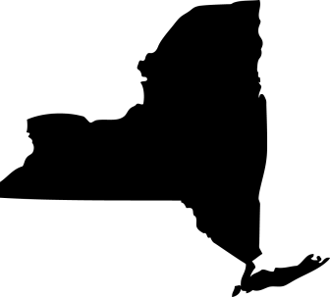
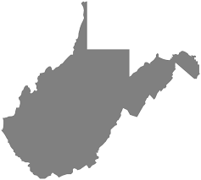
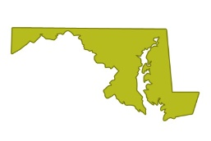
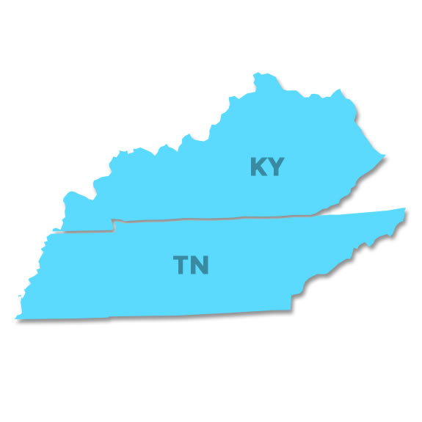
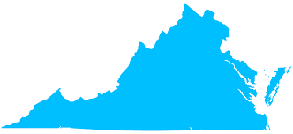
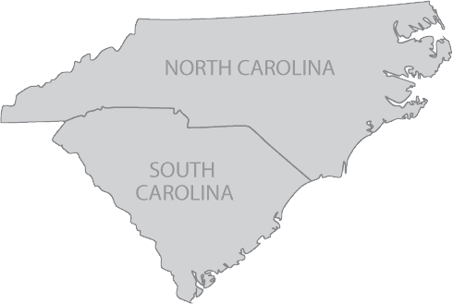
The Second Great Awakening 1800 - 1840
In western New York, the spirit of revival encouraged the emergence of new denominations. Charles G Finney, a lawyer from Adams, New York was the key figure for revivals in the “burned-over district” in the 1820’s & 1830’s.
In New England, the renewed interest in religion inspired a wave of social activism. Interdenominational missionary societies sprang up with a goal to evangelize the West. Abolition groups formed to obtain freedom for all Americans. The
Society for the Promotion of Temperance began – to inspire people to abstain from liquor and alcoholic beverages in order to strengthen the families. The American Bible Society dispersed the Bible and Christian literature throughout America. Many other
In the Appalachian Region and Southern States, the revival took on characteristics similar to the First Great Awakening. But here, the center of the revival was the camp meeting. The first one took place in July 1800 at Gasper River Church in southwestern Kentucky.
efforts to reform prisons and care for the handicapped and mentally ill also began.
This second great religious revival in American history consisted of several kinds of activity, distinguished by locale and expression of religious commitment.
A much larger one was held at Cane Ridge, Kentucky, in August 1801, with crowds of 10,000–25,000, and Presbyterian, Baptist, and Methodist ministers participated. This event created the organized revival for the major mode of church expansion for Methodists & Baptists.
God chose specific USA sections to kindle revival fires.

Slide 24
New York City
Jeremiah Lanphier
48-year-old businessman who began work as an urban missionary for the North Dutch Reformed Church in July 1857.
The Third Great Awakening 1857 – 1930
God honored the fervent prayers of His people.

Slide 25
Results of Prayer!
What Happened??
Jeremiah Lanphier began what seemed like an insignificant weekly prayer meeting on Sept 23, 1857 on Fulton Street in New York City that impacted America.
Two days after Lanphier’s prayer meeting began, the Bank of Pennsylvania failed in Philadelphia, sending shock waves through America’s financial community.

Slide 26
Results of Prayer!
What Happened??
In a few days’ time, Lanphier’s meeting began to meet daily.
Soon the crowds attending the Fulton Street gathering overflowed into nearby John Street Methodist Church.
On October 10 [1857] the New York stock market crashed, putting many stockbrokers and clerks out of work, and shutting down businesses everywhere.

Slide 27
Results of Prayer!
What Happened??
Within six months 10,000 people were gathering daily for prayer in numerous places throughout New York.
The financial panic, it seems, was the catalyst that triggered the awakening.

Slide 28
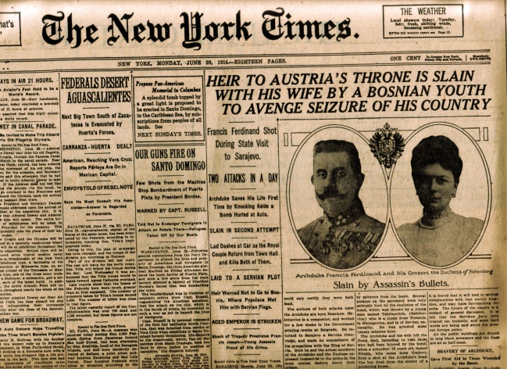
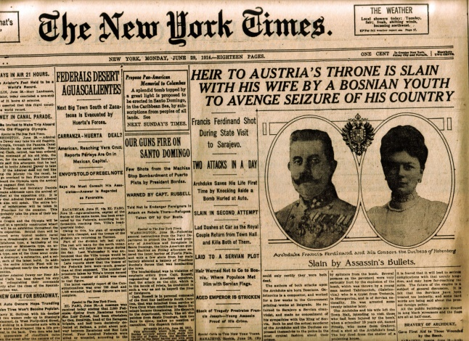
Prayer Meeting Grows!
Dr. Henry Ward Beecher leading 3,000 people in devotions at Burton’s Theater! While he was reading Scripture recently, Beecher was interrupted by singing from an overflow prayer meeting crowd in an adjoining barroom! He then led the group in thanksgiving that such a thing could happen!

Slide 29
The Fire Spreads!
How did it work??
Other major cities also developed prayer meetings.
The form of worship was always the same: any person might pray, give a testimony or an exhortation, or lead in singing as he or she “felt led.”

Slide 30
The Fire Spreads!
How did it work??
Little planning was done for the meetings, the chief rules were that a meeting should begin and end punctually, and that no one should speak or pray for very long.
Although pastors such as Beecher often attended and lent their enthusiastic support, laypeople provided the leadership.

Slide 31
Canada!!
From June through October 1857,
Dr. Walter Palmer and his wife Phoebe conducted camp meetings in Ontario and Quebec with crowds of 5,000 and more.

Slide 32
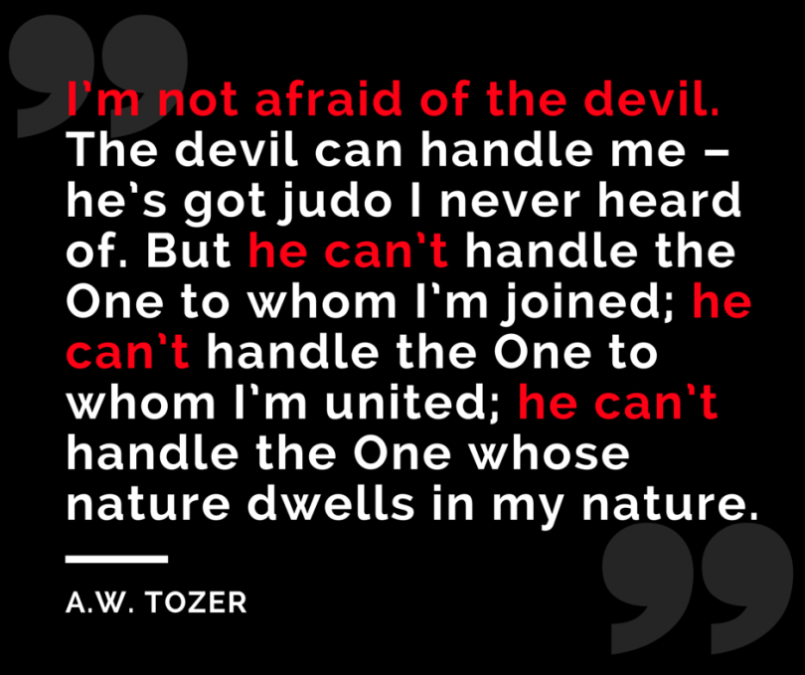
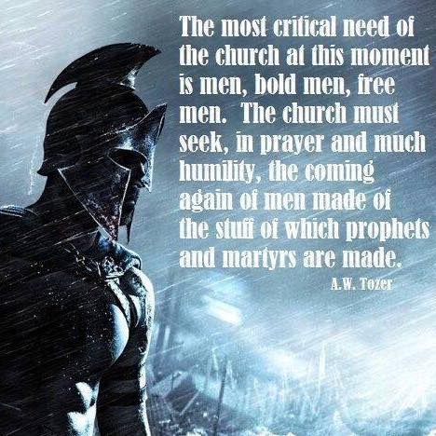
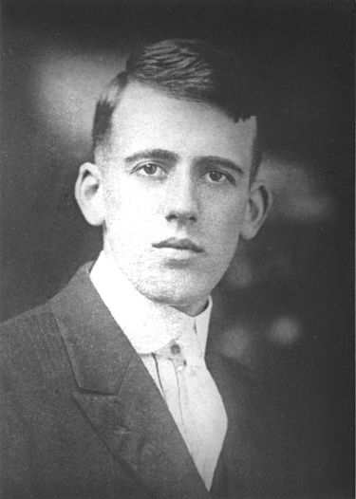
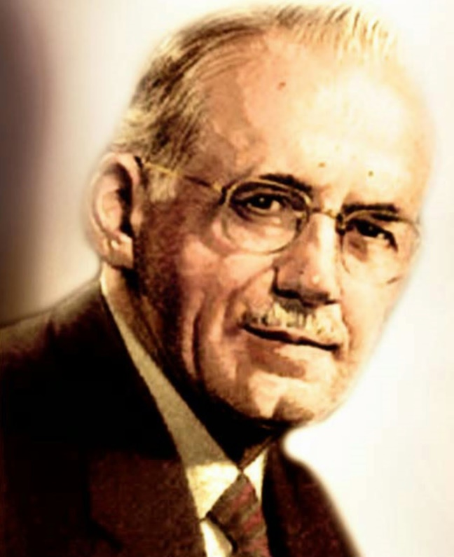
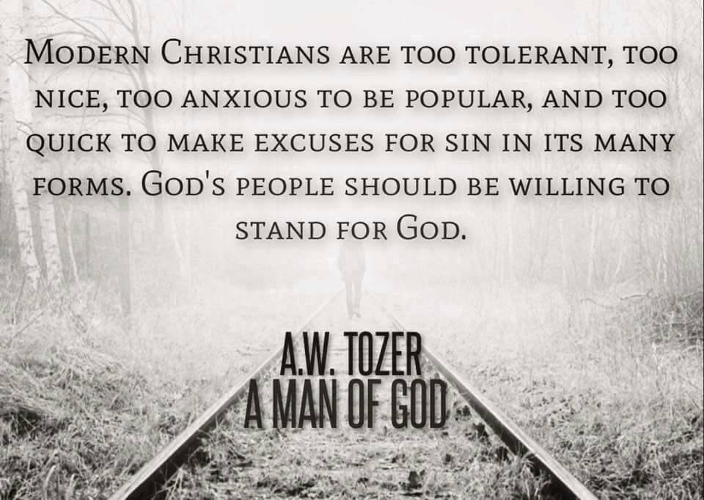
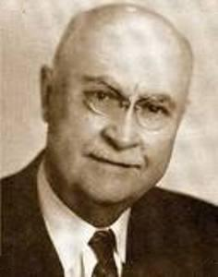
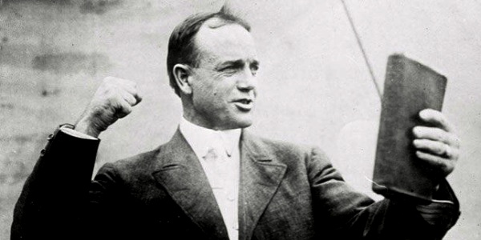
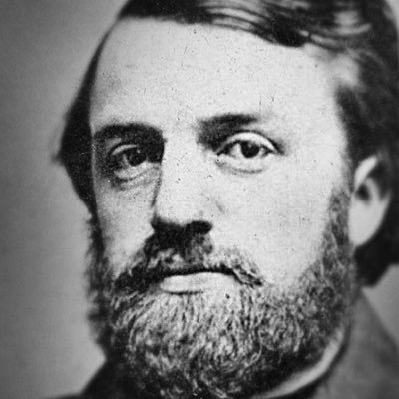
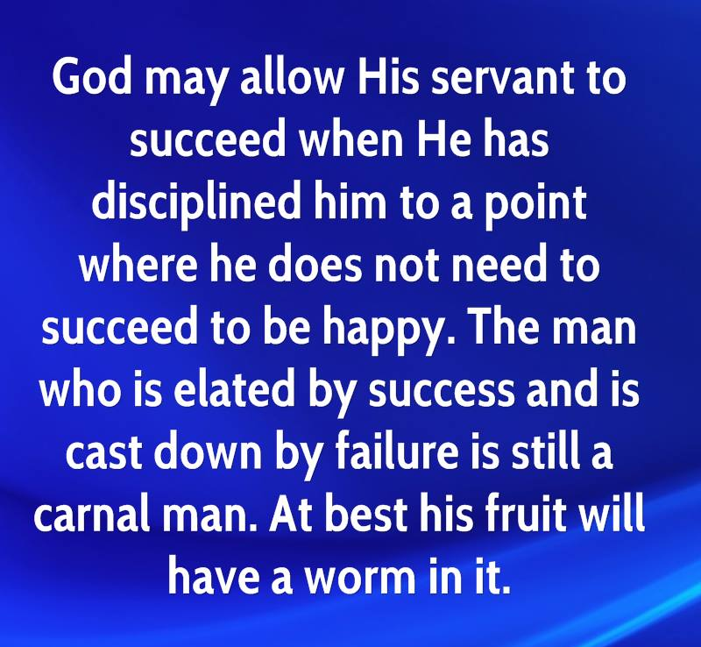
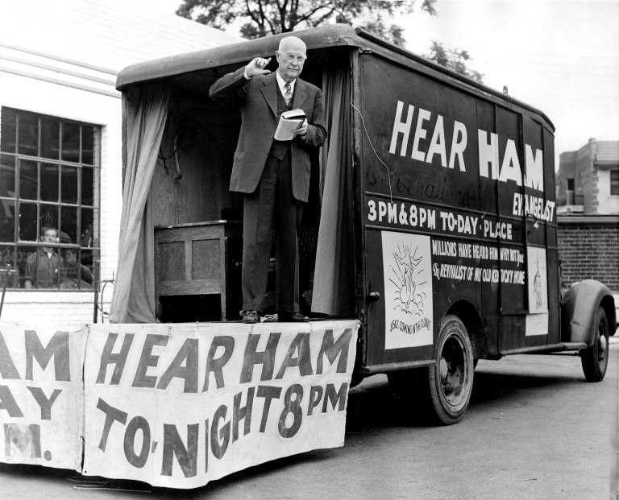
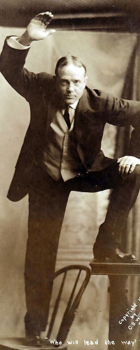
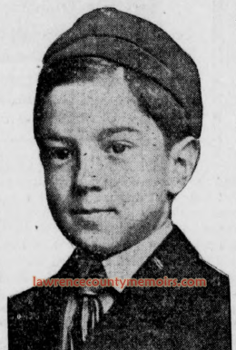
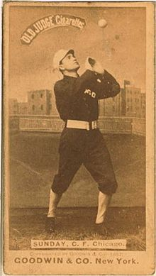
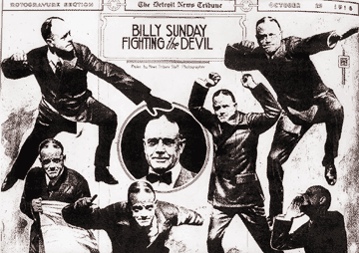
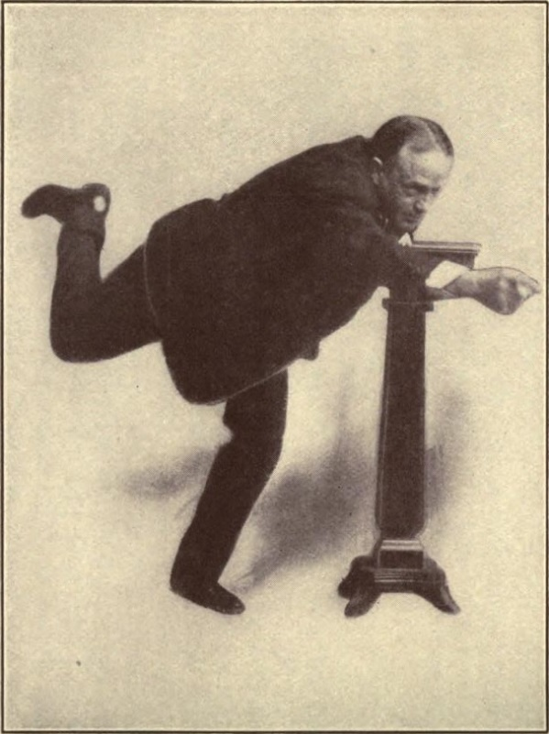
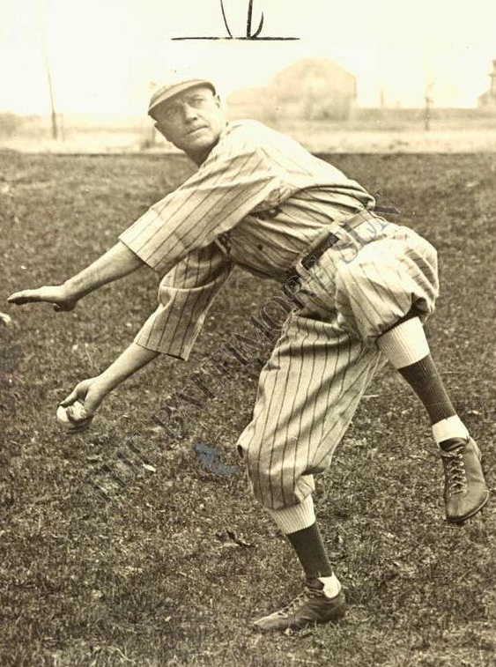
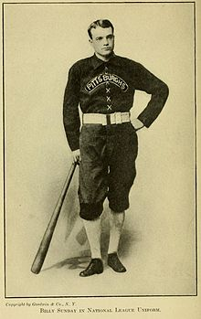
God used men like…
Dwight L. Moody
Billy Sunday
A.W. Tozer
Mordechi Ham
and others
to bring great revivals across America well into the 1900’s.
“The Bible was not given to increase our knowledge, but to change our lives!”

Slide 33
On with the Letter to the Church of Philadelphia…

Slide 34
Commendation
I know your works – We’ve seen this statement a few times now in our study. Make no mistakes…God knows our works! God knows what we are doing in His church. He will hold us accountable for what we allow in His church and for what we do not allow.
For what have I to do with judging those also who are outside? Do you not judge those who are inside? But those who are outside God judges. Therefore “put away from yourselves the evil person.” Dare any of you,
having a matter against another, go to law before the unrighteous, and not before the saints? Do you not know that the saints will judge the world? And if the world will be judged by you, are you unworthy to judge the smallest matters?
1 Cor 5:12 – 6:2
1 Cor 5:12 – 6:2
The Letter

Slide 35
Commendation
See, I have set before you an open door –
God opened the door for the Church at Philadelphia to spread the Gospel and for it to fall on ears that could hear. Only God can do this!
God opened doors during the “Great Awakening” as well: Mission work to China, Africa, South America, and around the world blossomed during the “Third Awakening”. Gospel Radio and Television programs airing the news of freedom in Christ began in the 1930’s, which exploded an awareness and permeated the world even behind the iron curtain.
The Letter

Slide 36
Commendation
Indeed I will make those of the synagogue of Satan, who say they are Jews and are not, but lie—indeed I will make them come and worship before your feet, and to know that I have loved you. –
It’s strange to find the synagogue of Satan mentioned in the only two churches where God did not find any condemnation! It seems that when the church exists in Satan’s dominion and must fight it daily, it becomes pure.
The Letter

Slide 37
Commendation
Because you have kept My command to persevere, I also will keep you from the hour of trial which shall come upon the whole world, to test those who dwell on the earth. –
This most probably is in reference to the Great Tribulation period. This introduces a very intriguing question, and one that is highly debated: Will the church go through the Great Tribulation? There are three schools of thought concerning when the bride is taken out of the world:
Pre-Tribulationalists – Mid-Tribulationalists – Post-Tribulationalists.
The Letter

Slide 38
Some Reasons for a Pre-Tribulation Rapture (or caught away event)
1. The church is the beloved bride of the Lord Jesus Christ and the Great Tribulation will be the most damnable time this earth has ever had when God will pour out His judgment. Why would the Lord put His bride through such a time like that? The Bride has cleansed her garments in the blood of the Lamb! Her sins are already judged and paid at enormous cost. Why then, would she have to suffer the Great Tribulation?

Slide 39
Some Reasons for a Pre-Tribulation Rapture (or caught away event)
2. There are types in the Bible such as Enoch who is a type of the church – Enoch was taken away before the flood – before judgment came. … Noah is a type of the Jewish nation that will go through the Tribulation – yet preserved to come out safely.

Slide 40
Some Reasons for a Pre-Tribulation Rapture (or caught away event)
This scripture obviously is speaking of the antichrist of the Great Tribulation period. “He who now restrains,” in the opinion of those who hold the Pre-Tribulation Rapture view, is none other than the Holy Spirit who lives within each Believer. “until He is taken out of the way” refers to when the Bride (in whom the Holy Spirit dwells) is taken out of the world. Only then can the antichrist (lawless one) be revealed!
3. 2 Thessalonians 2:6-14 – And now you know what is restraining, that he may be revealed in his own time. For the mystery of lawlessness is already at work; only He who now restrains will do so until He is taken out of the way. And then the lawless one will be revealed, whom the Lord will consume with the breath of His mouth and destroy with the brightness of His coming. The coming of the lawless one
is according to the working of Satan, with all power, signs, and lying wonders, and with all unrighteous deception among those who perish, because they did not receive the love of the truth, that they might be saved. And for this reason God will send them strong delusion, that they should believe the lie, that they all may be condemned who did not believe the truth but had pleasure in
But we are bound to give thanks to God always for you, brethren beloved by the Lord, because God from the beginning chose you for salvation through sanctification by the Spirit and belief in the truth, to which He called you by our gospel, for the obtaining of the glory of our Lord Jesus Christ.

Slide 41
Some Reasons for a Mid-Tribulation Rapture (or caught away event)
The verses just preceding the verses which those who hold the Pre-Tribulation opinion stand upon has qualified that this is being written so that no one is deceived about when Christ would come. And they clearly state that Christ will not come until the man of sin is revealed. Now, I am aware that Pre-Trib thinkers differentiate between “The Day of the Lord” or “The Second Coming” (which is public) and the “Rapture of the
Saints” (which is private). But tell me, why is Paul so ardent that we not be deceived if we will already be gone? Is he leaving this message for those who are left? Maybe… if Satan is clever enough to disguise the rapture so that those left behind would not even realize what has happened. However, it seems pretty plain that he is leaving this for the saints or others who read God’s Word and might be confused.
1. 2 Thessalonians 2:1-6 – Now, brethren, concerning the coming of our Lord Jesus Christ and our gathering together to Him, we ask you, not to be soon shaken in mind or troubled, either by spirit or by word or by letter, as if from us, as though the day of Christ had come. Let no one deceive you by any means; for that Day will not come unless the falling away comes first, and the man of sin is revealed, the son of perdition, who
opposes and exalts himself above all that is called God or that is worshiped, so that he sits as God in the temple of God, showing himself that he is God. Do you not remember that when I was still with you I told you these things? And now you know what is restraining, that he may be revealed in his own time.
We’re not leaving on Haley’s comet, we’re not committing suicide in order to go with the Lord. We must see the falling away and the man of sin revealed first. Only then will Christ return.

Slide 42
Some Reasons for a Mid-Tribulation Rapture (or caught away event)
2. “He who now restrains is taken out of the way” The Mid-Trib opinionates suggest that Michael the Archangel is responsible for restraining the evil on this earth. Look at Daniel 12:1 – At that time Michael shall stand up, The great prince who stands watch over the sons of your people; And there shall be a time of trouble, Such as never was since there was a nation, Even to that time. And at that time your people shall be delivered
Every one who is found written in the book.
Wow. That’s a really powerful verse. When Michael stands up, is that the sign for his angels to withdraw their powerful assistance on this earth and allow the man of sin to come forth?

Slide 43
Some Reasons for a Mid-Tribulation Rapture (or caught away event)
3. In Matthew 24, Jesus told us of the events that would unfold during the time of His return. The order in which He gives the events differs from that of the Pre-Trib view, but is spot on with a Mid-Trib “Pre-Wrath” Rapture.

Slide 44
Warning!
Behold, I am coming quickly! Hold fast what you have, that no one may take your crown. – There are five crowns mentioned in the Bible:
Incorruptible Crown
Crown of Rejoicing
3. Crown of Righteousness
4. Crown of Life
5. Crown of Glory
LIFE
Jam 1:12
for Believers who endure temptation & love Him
INCORRUPTIBLE
1 Cor. 9:25 –
for Believers who run the race well
REJOICING
1 Thes 2:19 – for Believers who see souls saved
RIGHTEOUSNESS
2 Tim 4:8
for Believers who love His appearing
GLORY
1 Peter 5:4
for faithful pastors
The Letter

Slide 45
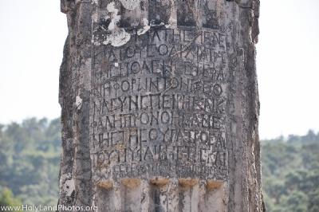
The Letter
A pillar is used for three things:
1. Strength – to hold up the roof
2. Beauty – they enhance the building! The overcomers will reflect the beauty of Christ
3. Commemoration – custom in Philadelphia was to place a pillar in commemoration of someone who had done a great deed.
He who overcomes, I will make him a pillar in the temple of My God, and he shall go out no more. I will write on him the name of My God and the name of the city of My God, the New Jerusalem, which comes down out of heaven from My God. And I will write on him My new name.
Closing

Slide 46
The Letter
My new name –
Revelation 22:4 says that His name will be in our foreheads! This is a sign of belonging. We belong to God, we are citizens of the New Jerusalem, and we belong to Jesus Christ, the King of all kings and the Lord of all lords – forever and ever.
Closing

