Slide 1
The Church of Sardis The Fruitless/dead Church
Lesson 9 in When Are We Now?
The first of three studies of
The Revelation of Jesus Christ
by Paige Ramsey

Slide 2
Revelation 3:1-6
And to the angel of the church in Sardis write, “These things says He who has the seven Spirits of God and the seven stars: ‘I know your works, that you have a name that you are alive, but you are dead.

Slide 3
Revelation 3:1-6
“‘Be watchful, and strengthen the things which remain, that are ready to die, for I have not found your works perfect before God.
Remember therefore how you have received and heard; hold fast and repent.

Slide 4
Revelation 3:1-6
“‘Therefore if you will not watch, I will come upon you as a thief, and you will not know what hour I will come upon you.
You have a few names even in Sardis who have not defiled their garments; and they shall walk with Me in white, for they are worthy.

Slide 5
Revelation 3:1-6
“‘He who overcomes shall be clothed in white garments, and I will not blot out his name from the Book of Life; but I will confess his name before My Father and before His angels.
He who has an ear, let him hear what the Spirit says to the churches.’”

Slide 6
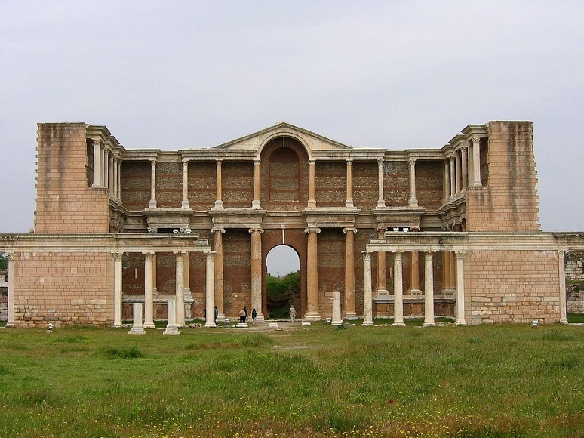
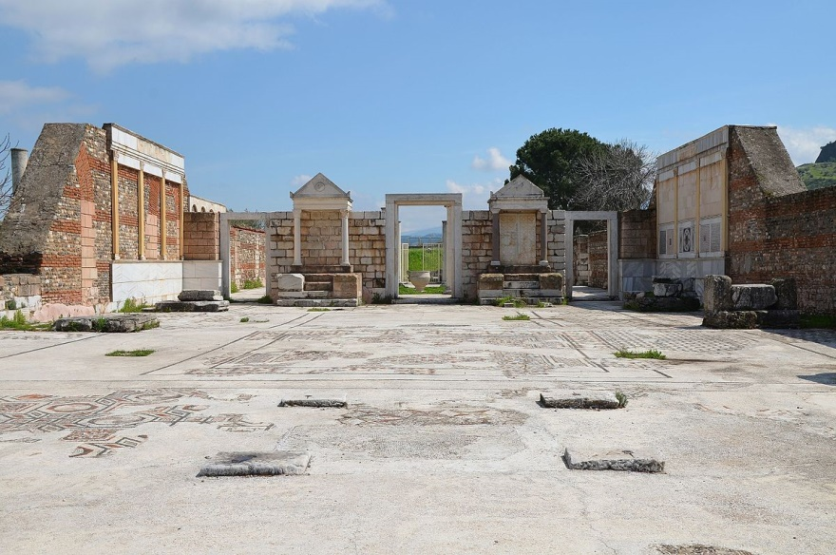
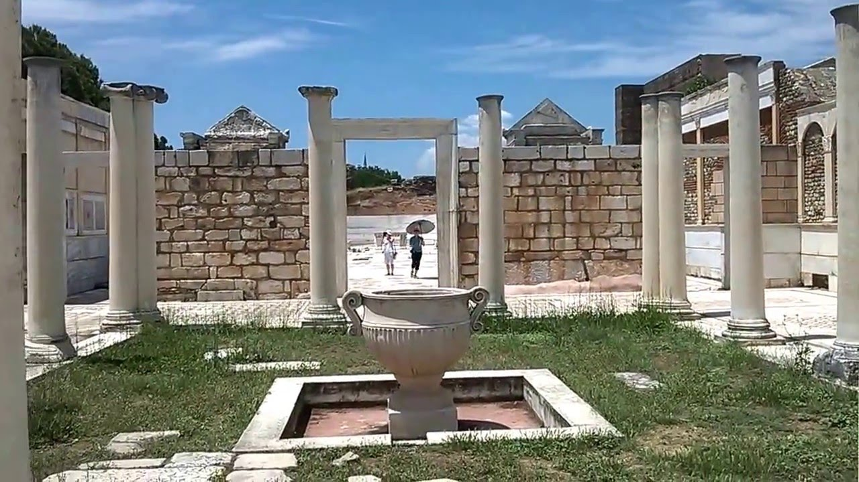
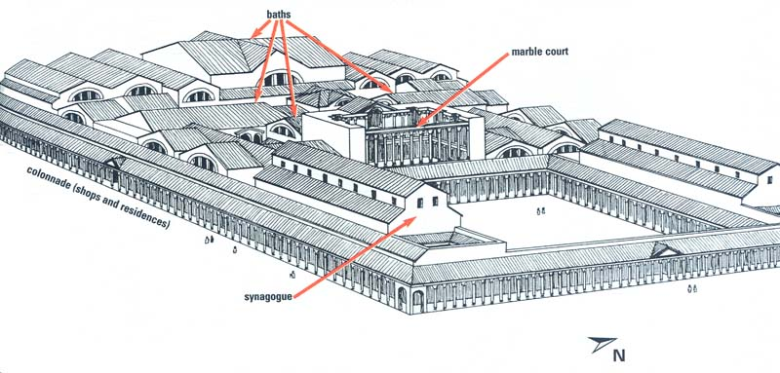
Sardis
This city, which sits at the foot of Mount Tmolus, thirty-three miles from Thyatira, was at one time the capital metropolis of the country of Lydia and the seat of King Croesus. The pastor (“messenger” or “angel”) of the church at the time John sent this letter is unknown.
Gymnasium & Bathhouse in Sardis
Ruins of Synagogue in Sardis

Slide 7
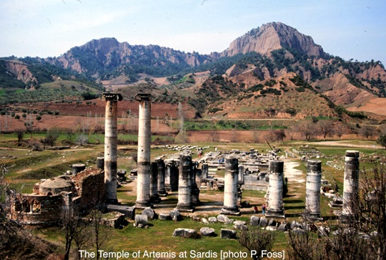
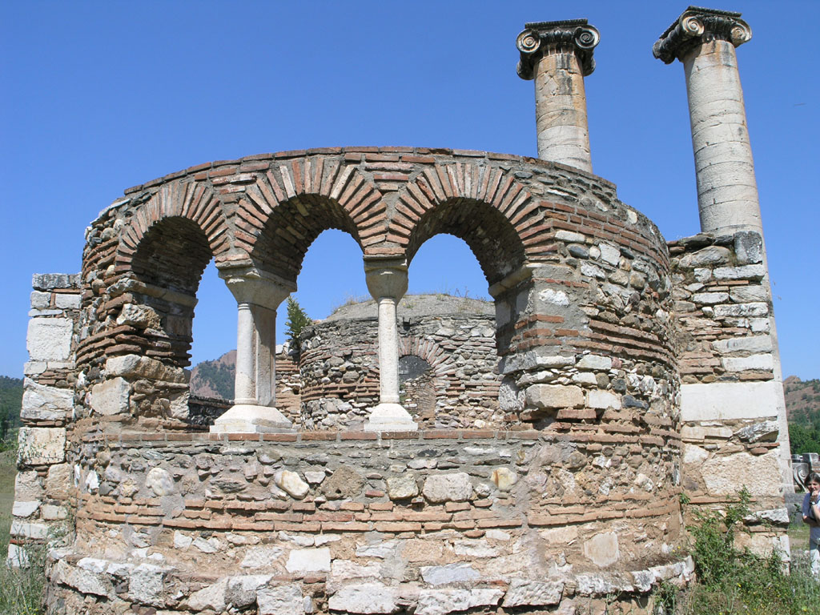
Sardis
According to Dr. John Gill, in the second century, just after this letter was sent, Melito became the pastor. Some believe this may be the man to whom the term “angel” was intended, as he contributed some significant writings on the Book of the Revelation and Christian apologetics.
Byzantine Church in Sardis
Built in late 3rd Century A.D,

Slide 8
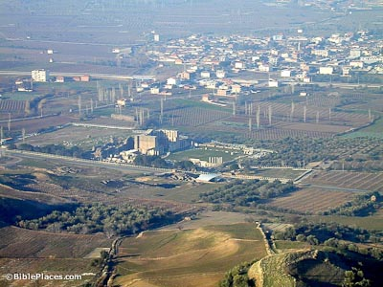
Sardis
Now Sardis is an obscure village whose inhabitants are shepherds and cattlemen.

Slide 9
The Letter
These things say He who has the seven Spirits of God, and the seven stars – there are not seven individual, distinct Holy Spirits. Isaiah 11:1-2 names these as: the Spirit of the Lord, Wisdom, Understanding, Counsel, Might, Knowledge, and Fear of the Lord. The seven Spirits of God represent the fullness of the Holy Spirit – His full work, His empowering, His teaching, His wisdom-giving.
Seven is the number of completion (once something is complete, it is perfect, whole).

Slide 10
The Letter
Perhaps the Lord mentions this aspect of Himself (He who has the seven Spirits of God) because this church was dead – there was no evidence of the Spirit working in any capacity. The Lord wants us to be part of a living church – where the Spirit is at work in the congregation.

Slide 11
The Letter
In his letter to the Romans, Paul shares with us the seven Grace Gifts of the Spirit, and lists them as: Prophecy, Ministry, Teaching, Exhortation, Giving, Leadership, and Mercy.

Slide 12
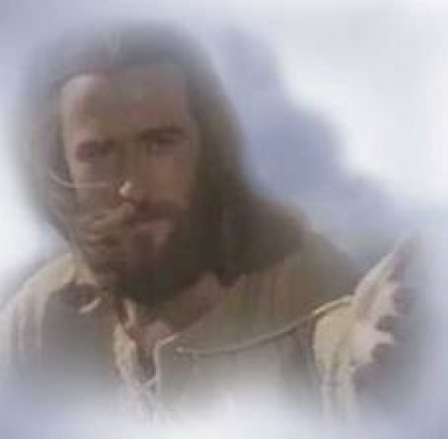
The Letter
Prophecy
Leadership
A spiritual gift is given to each believer, and each individual church needs a variety of believers who each hold one of the seven gifts. These seven gifts complete the body.
Ministry
Giving
Teaching
Mercy
Exhortation

Slide 13
The Letter
1 Chronicles 16:22
Touch not mine anointed, and do my prophets no harm.
They are the messengers of God to the church. God speaks His Word through His man, and His man gives His Word to the people.
7 Stars = 7 Pastors
This must have assured the pastor of Sardis whose church is fruitless and dead.
God still had him in His hand.

Slide 14
Commendation
The Letter
NONE!!
Only Sardis and Laodicea have nothing good for the Lord to mention.

Slide 15
Complaint
The Letter
Jesus cursed a fig tree with no fruit because it bore lots of leaves – looking like it was alive and well, but no fruit.
The church at Sardis had the appearance of life but they were dead.
I know your works, that you have a name that you are alive, but you are dead.
This was a congregation of unregenerated people who were playing church!

Slide 16
Complaint
Sardis was dead, yet her past was still shining.
The Letter
Light – 186,000mps
= 63 trillion miles per year
A Polar Star takes 33 years to reach earth
If that star dies today, it would no longer even be there, and yet it would continue to shine on earth for 33 more years, looking just as brilliant as before it died.

Slide 17
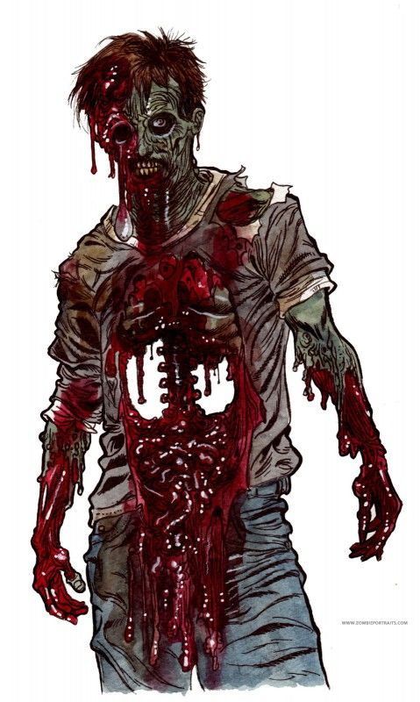
Complaint
The Letter
“I see dead people… walking around like regular people… they don’t know that they’re dead.”
the dead act like they are alive:
1779 – Samuel Taylor Colridge The Rime of the Ancient Mariner
Disney’s Pirates of the Caribbean
M. Night Shyamalan’s The Sixth Sense
Ghost Whisperer, Ghost Hunters
Zombies – The Walking Dead

Slide 18
Complaint
Artificiality had taken over Sardis
did not realize they were dead
still going through the motions
force-operating the machinery of a dead church
like a dead body kept alive on artificial life-support
The Letter

Slide 19
Complaint
Artificial flowers
look very real and alive
don’t need food or water
One who is not born again
can look very much alive!
doesn’t need the Holy Spirit
doesn’t need the Word of God
is dead
fake – no life
The Letter

Slide 20
Complaint
The Letter
look at churches today and see:
a trend to replace true, spiritual life with a fake, artificial replica
no tears for the lost on the altars
no hunger pains for digging into the Word of God
no thirst for the Holy Spirit of Truth

Slide 21
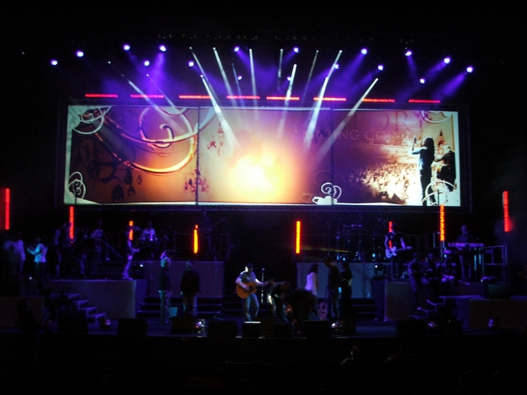
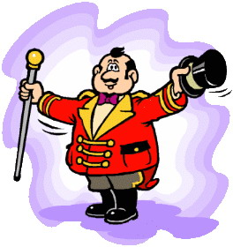
Complaint
The Letter
Instead they have:
artificial methods designed for physical growth
mood-setting devices to activate the emotions so people “feel good”
positive-thinking type sermons to give a false hope

Slide 22
Counsel
Be watchful, and strengthen the things which remain, that are ready to die, for I have not found your works perfect before God.
We must watch and strengthen and pamper the areas where true spiritual life is evident!
The Letter

Slide 23
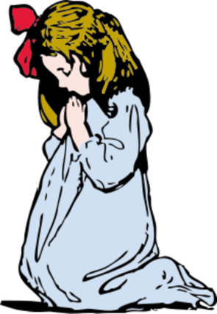
Counsel
Remember therefore how you have received and heard; hold fast and repent.
The Letter

Slide 24
Warning!
Therefore if you will not watch, I will come upon you as a thief, and you will not know what hour I will come upon you.
Sound familiar?
The Lord wants us to watch out for His church!
He didn’t speak with joy for His coming but as a warning.
We must watch and care for life in the church!
The Letter

Slide 25
Closing
You have a few names even in Sardis who have not defiled their garments; and they shall walk with Me in white, for they are worthy.
A few names…
Apparently, these few believers among the dead had very little influence.
But… they are worthy!! Wow!
The Letter

Slide 26
The Letter
These few never dirtied themselves with a fake, artificial front like the dead who were running things in the church.
Watch out for lifelessness! Watch for the leading of the Holy Spirit – not the leading of men.
Keep your spirit in tune with God’s Spirit and not with the dead spirit of the world!
Closing

Slide 27
The Letter
He who overcomes shall be clothed in white garments, and I will not blot out his name from the Book of Life; but I will confess his name before My Father and before His angels.
God’s people will never be blotted out of the Book of Life!
God’s people are overcomers. They cannot be deceived into unbelief. (Matthew 24:24)
Closing

Slide 28
The Letter
Quote from Jamison, Fausset, & Brown:
“A register was kept in ancient cities of their citizens: the names of the dead were of course erased. So those who have a name that they live and are dead (Rev 3:1), are blotted out of God’s roll of the heavenly citizens and heirs of eternal life; not that in God’s electing decree they ever were in His book of life.”
Closing

Slide 29
The Letter
Quote from Dr. John Gill:
“…this being signified by a book, and by writing names in it, shows the exact knowledge God has of his elect, the value he has for them, his remembrance of them, his love to them, and care for them; and that this election is of particular persons by name, and is sure and certain; …
Closing

Slide 30
The Letter
Quote from Dr. John Gill:
“…for those whose names are written in it shall never be blotted out, they will always remain in the number of God's elect, and can never become reprobates, or shall ever perish; because of the unchangeableness of the nature and love of God, the firmness of his purposes, ….
Closing

Slide 31
The Letter
Quote from Dr. John Gill:
“…the omnipotence of his arm, the death and intercession of Christ for them, their union to him, and being in him, the impossibility of their seduction by false teachers, and the security of their persons, grace, and glory in Christ, and in whose keeping this book of life is….”
Closing

Slide 32
The Letter
He who has an ear, let him hear what the Spirit says to the churches.
Again, the continual reminder that not everyone has the spiritual ears to hear what the Spirit says.
But if we do… we have the responsibility to listen and respond.
Closing

Slide 33
Church Age Timeline
1517 – 1720

Slide 34
In this study, we are searching out a theory that the seven churches of the Revelation are representative of the different phases in the completed Church Age.
Ephesus
29-100AD
Smyrna
100-313AD
Pergamos
314-520AD
Thyatira
540-1517AD
Sardis
1517-1720AD

Slide 35
In the preceding era represented by the Church of Thyatira, the Roman religion took over the church – the beginning of the popery & laity. No longer were the members on equal footing – there was a showy distinction and power of the clergy, putting them on a higher plane than the common members. Traditions and dogma were added to the church.

Slide 36
Quote from Dr. Dan W. Cozart (2009):
“The church that had emerged out of the Dark Ages may not have had the gross corruption and idolatry, but soon began to slumber and die, and this seems to be the church of Sardis.”

Slide 37
Quote from Dr. John Gill (1747):
“…that this church is an emblem of the reformed churches from Popery, is evident not only from its following the Thyatirian state, which expresses the darkness of Popery, and the depths of Satan in it; but from its being clear of Balaam, and those that held his doctrine;…
“This church represents the state of the church from the time of the Reformation by Luther and others, until a more glorious state of the church appears, or until the spiritual reign of Christ in the Philadelphian period; under the Sardian church state we now are:…

Slide 38
Quote from Dr. John Gill (1747):
This concept began to ring true for many others after the Reformation – recognizing the Dark Ages with the lack of God’s Word.
Suddenly, the prophecy became clear in the light of the Gospel!
Though when he wrote this,
he was twenty years into the Philadelphian period and had not yet detected the change, he knew he was not living in the last of the end times!
He accurately pinpointed the approximate era and recognized that the Philadelphian period had to come before the Laodicean period could emerge.
Dr. Gill shows an amazing insight into the Church Age and how the seven churches of Revelation depict it!
“…and from the Nicolaitans and their tenets, and from Jezebel, and those that committed adultery with her; things which the two former churches are charged with; but from these the present church reformed.”

Slide 39
European General Renaissance
Though among
the peasants, life remained virtually unchanged for most of this period, the wealthier paved a way for dramatic changes to take place.
Late 15th Century through late 16th Century
Rebirth of education in Europe
Began among the wealthy
Return to earlier forms of education
logic of the Greeks
Linguistics
Rediscovery of Arts and Architecture
Slowly, the social culture and posture of the people began to change.

Slide 40
Some significant discoveries that affected change were:
Discovery of the Americas
Invention of the printing press–by Johanna Gutenberg
Printed Word of God – “You shall know the Truth and the Truth shall set you free!”
Expression in music, poetry, & literature flourished!

Slide 41
The Scientific Revolution
1545 – 1795 AD
The Emergence of Modern Science

Slide 42
Emergence of Modern Science
Science made great achievements!
Sir Isaac Newton’s work most assuredly!
Developments in mathematics, physics, astronomy, biology, medicine, and chemistry transformed views of society and nature.

Slide 43
The Reformation
1517 – 1750 AD
Exposing the heresy of the Roman Church

Slide 44
Different denominations appeared as they came out of the Roman Church.
The Anabaptists who had been in hiding for centuries also emerged.
It exploded when Martin Luther nailed his ninety-five thesis on the door of his church, using Scripture to expose the Roman Church’s misleading
This brought about her violent rage in Europe and subsided when the Roman Church drove out most of those who came against her into America

Slide 45
Huss preached key Reformation themes (like hostility to indulgences) a century before Luther drew up his 95 Theses. But the Reformers also looked to Huss's life, in particular, his steadfast commitment in the face of the church's cunning brutality.
Huss heard the gospel through the writings of John Wycliffe. Upon finding his writings, Martin Luther proclaimed, "I was overwhelmed with astonishment! I could not understand for what cause they had burnt so great a man, who explained the Scriptures with so much gravity and skill."
Some Anabaptists who paved the way for the Reformation to occur are:
Peter Waldo – 1140–1205 AD Began his work in 1170 AD
John Wycliffe – 1320–1384 AD
John Huss – 1369–1415 AD
He opposed many of the Roman Church doctrines, and died before he could be sentenced to death by the church. 43 years after his death, officials dug up his body, burned his remains, and threw the ashes into the River Swift. Still, they couldn't get rid of him.
Two hundred years before Luther posted his 95 Thesis! “Believing that every Christian should have access to Scripture (only Latin translations were available at the time), he began translating the Bible into English, with the help of his good friend John Purvey.”
Waldo appears on the scene of history in 1170, long before the Reformation in Lyons as a successful businessman who, touched to his core by a traveling minstrel's religious ballad, gave away his money to live in poverty as a preacher of the Gospel.
He soon had the Gospels memorized. A number of young men, impressed by his intelligence and sincerity, followed him in giving away their possessions and found a new joy and freedom in living according to the spirit of the Gospels.
Having persuaded a sympathetic priest to translate large sections of the New Testament from Latin into the regional language, Provençal, Peter wandered through Lyons, bringing the message of Christ to anyone who would listen to him.
Wycliffe's teachings, though suppressed, continued to spread.
In 1208 a third
of the Waldenses and Albigenses had been murdered by the Church of Rome.

Slide 46
Some who stand out in the Reformation:
Martin Luther 1483–1546 AD
John Calvin 1509–1564 AD
Ulrich Zwingli 1484–1531 AD
Felix Manz 1498–1527 AD
and many others
Germany.
Luther’s followers became the Lutheran Church – with a hierarchy similar to the Roman Catholic Church
Felix Manz, an Anabaptist reformer and martyr, stood against infant baptism, and baptized adults, like the Christians of old, which cost him his life. The city council drowned him in the river.
Ulrich Zwingli , a
Swiss Protestant Reformer, accepted the supreme authority of the Scripture and stressed Divine sovereignty with a wide hope of salvation. His followers were mostly Anabaptists.
Calvin taught the doctrines of Grace. His followers became the Presbyterian Church which also has a hierarchy like the Roman Catholic Church.

Slide 47
Concluding
Know what to look for!
Marks of a Living Church

Slide 48
Marks of a Living Church:
Growth – Not always in numbers, but individual spiritual growth
Compassion – desire to reach other people
Union, Harmony, Accord – a living church will work together
Emotion – Psalm 115:17-18 – a church so stiff that emotions cannot be a part of your faith, is a sign of a dead church

Slide 49
The Church of Sardis The Fruitless/dead Church
Lesson 9 in When Are We Now?
The first of three studies of
The Revelation of Jesus Christ
by Paige Ramsey

