Slide 1
The Church of Smyrna
Lesson 6 in “When Are We Now?”
The first of three studies in
The Revelation of Jesus Christ
by Paige Ramsey

Slide 2
Revelation 2:8-11
And to the angel of the church in Smyrna write; “These things says the First and the Last, who was dead, and came to life; I know your works, tribulation, and poverty, (but you are rich) and I know the blasphemy of those who say they are Jews, and are not, but are a synagogue of Satan.

Slide 3
Revelation 2:8-11
Do not fear any of those things which you are about to suffer. Indeed, the devil is about to throw some of you into prison, that you may be tested, and you will have tribulation ten days. Be faithful until death, and I will give you the crown of life.

Slide 4
Revelation 2:8-11
He who has an ear, let him hear what the Spirit says to the churches. He who overcomes shall not be hurt by the second death.”

Slide 5
Earmarks of the Church at Smyrna
Keyword “L” – Longsuffering
Type of Church “F” – Fearful
Issue “ism” – Povertyism & Ritualism
Represents Church Age – 100 AD - 312 AD

Slide 6
The word smyrna is the same word as myrrh.
It means suffering.
The Bible speaks about myrrh in the life of Jesus:

Slide 7
The wise men brought Jesus gifts of gold, frankincense, & smyrna (myrrh)
Jesus was offered wine & smyrna (myrrh) to drink when He went to the cross (Mark 15:23)
Nicodemus brought 100 pounds of smyrna (myrrh) and aloes in which to place the body of Jesus (John 19:39)

Slide 8
Myrrh – a very rare and expensive plant
named myrrh because it must suffer: it has to be crushed in order to release its strong fragrance.
Grapes are crushed (put under pressure) until its blood – the wine – flows.

Slide 9
Myrrh – a very rare and expensive plant
The human body, when put under pressure due to stress, a very rare phenomenon can occur:
The person will produce sweat mingled with blood.
This occurred to Jesus in the garden of Gethsemane just before His arrest. Our Lord was crushed until His precious wine flowed.
The abundantly sweet fragrance of God’s grace could never have been known until Jesus was totally crushed on that cross to pay the price for our sin.

Slide 10
Quote from: Dave Miller, PhD in his book, Hematidrosis, © 2010 Apologetics Press
Luke, the author of Luke and Acts, was a physician. His writings manifest an intimate acquaintance with the technical language of the Greek medical schools of Asia Minor. For example, of the four gospel writers, only Dr. Luke referred to Jesus’ ordeal as “agony”.

Slide 11
Quote from: Dave Miller, PhD in his book, Hematidrosis, © 2010 Apologetics Press
…we learn during His prayer “his sweat was as it were great drops of blood falling down to the ground” (Luke 22:44). Only Luke referred to Jesus’ sweat (idros), a much used term in medical language, and only Luke referred to Jesus’ sweat as consisting of great drops of blood

Slide 12
Quote from: Dave Miller, PhD in his book, Hematidrosis, © 2010 Apologetics Press
(thromboi haimatos)—a medical condition alluded to by both Aristotle and Theophrastus (Hobart, 1882, pp. 80-84). The Greek term thromboi (from which we get thrombus, thrombin, et al.) refers to clots of blood (Nicoll, n.d., 1:631; Vincent, 1887, 1:425).

Slide 13
Quote from: Dave Miller, PhD in his book, Hematidrosis, © 2010 Apologetics Press
Bible scholar Richard Lenski commented on the use of this term: “‘As clots,’ thromboi, means that the blood mingled with the sweat and thickened the globules so that they fell to the ground in little clots and did not merely stain the skin” (1961, p. 1077).

Slide 14
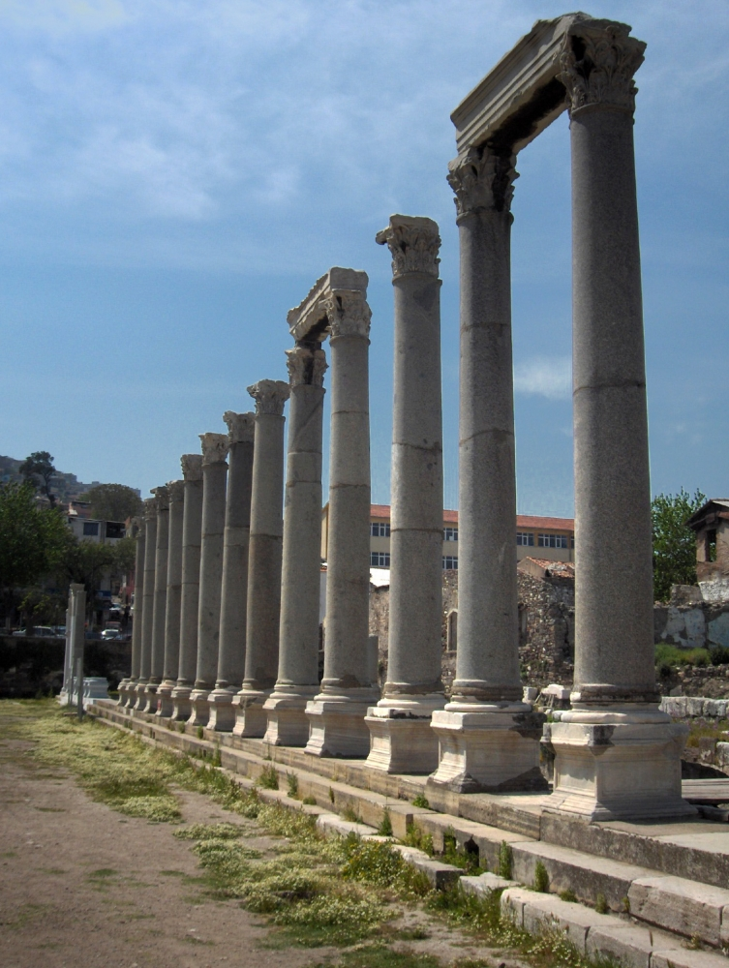
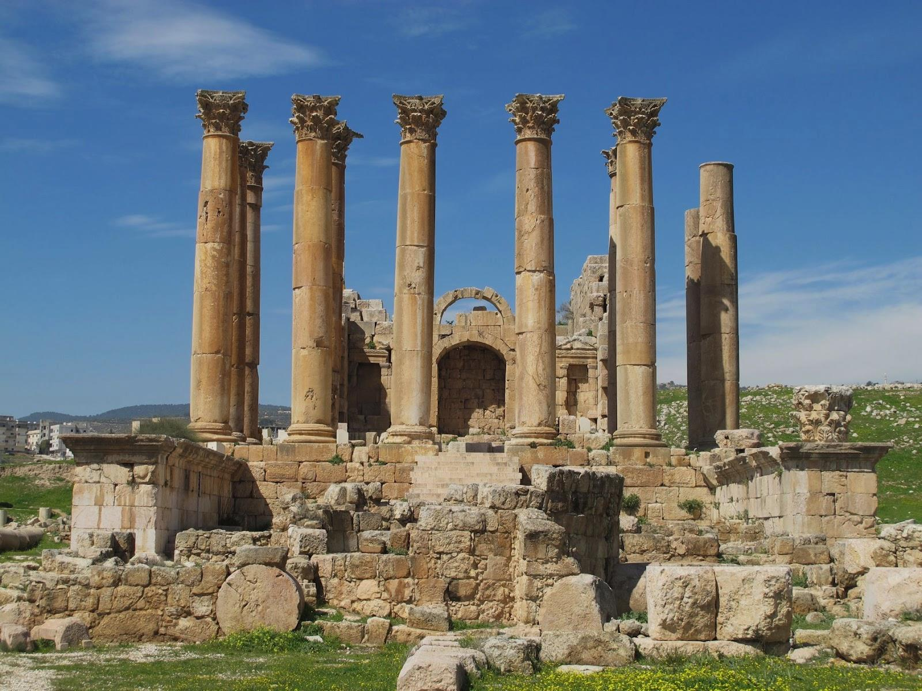
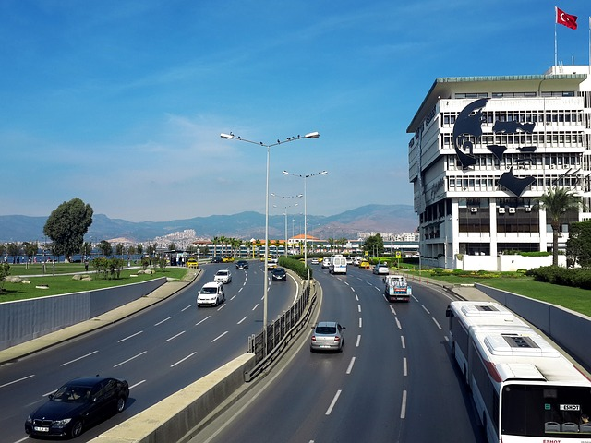
The Church of Smyrna
City of Izmir
Temple of Artemis

Slide 15
The Christians at Smyrna were crushed for their devotion to Christ. As a result, the church throughout the age has drawn strength and comfort to face brutal persecution, and the world smelled the desirable fragrance of God’s amazing grace!!

Slide 16
The Commendation – verse 9
I know your works –
Just as in Ephesus, God knew the energetic works done in the church of Smyrna. They were diligent to do the work that God had ordained them to do, and He was delighted in their focus.

Slide 17
The Commendation – verse 9
He sees our hardships as well. He does not overlook the difficulties we face in our society, in our government, in our homes, or in our church. He sees – He knows. It is a comfort to know that God knows. We can be at peace because God knows.
I know your tribulation –
Our Lord saw the hardships facing those who claimed His name in Smyrna. He saw their persecution. He saw the torture.

Slide 18
The Commendation – verse 9
I know your poverty (but you are rich)
The Christians in Smyrna were
not materially wealthy
not in high society
couldn’t afford a beautiful edifice

Slide 19
The Commendation – verse 9
Poverty presents its own bundle of dilemmas that includes feelings of insignificance, inferiority, and depression.
Life wasn’t easy for the Christians in Smyrna.
And yet… they had found true LIFE!
They had found a peace that surpasses understanding! They had a deeper purpose for living than just getting by, serving their earthly masters, and living out their days. They had found the ultimate reason for living! A sure hope for their future!
This earthly life had no meaning for them – they were headed for a better place! They had far greater riches than the wealthiest of the wealthy! They were rich even beyond what they could fathom!
They couldn’t afford to take off work to get things done at the church. They couldn’t afford education. They had pressing bills at home.

Slide 20
The Commendation – verse 9
In John 8:37, Jesus says to a group of “Jews” like these: “I know that you are Abraham’s descendants, but you seek to kill Me because My word has no place in you.” They were not true sons of Abraham in spirit. And they had turned the synagogue into a place to learn of hatred for others – a place that exalted the Hebrew race – not the God of the Hebrews.
These pious “Jews” (who were not Jews in heart) gave the Christians in Smyrna much grief. They were vehemently against Christianity because of the acclamation that Jesus of Nazareth is the long awaited Messiah.
The “Jews” in Smyrna probably included some of the wealthier citizens, and therefore, the pressure was great among all who had servants who proclaimed this new belief in Jesus.
I know the blasphemy of those who say they are Jews and are not, but are a synagogue of Satan –
A synagogue is a place of learning. There were “Jews” in the city of Smyrna who were not Jews in heart. They had no love for God.

Slide 21
Do you know of “Christians” who are not Christians in heart?
What kind of similarities are there to “Jews” who are not Jews in heart?

Slide 22
The Complaint and Counsel –
This is one of two churches that the Lord did not have anything to complain about, and thus, no need for counsel. Though they had it so hard and struggled through so many difficulties, the Lord was completely pleased with them!
What are your thoughts
about this?
None!!

Slide 23
The Closing – verse 11
The Lord closed with the same closing as He did with the Church at Ephesus, reminding the members of the Church in Smyrna that not all have the spiritual ears to discern what the Spirit is saying.
“He who has an ear, let him hear what the Spirit says to the churches.”

Slide 24
The Reward – verse 11
Revelation 21:8 –
But the cowardly, unbelieving, abominable, murderers, sexually immoral, sorcerers, idolaters, and all liars shall have their part in the lake which burns with fire and brimstone, which is the second death.
Revelation 20:14-15 –
Then Death and Hades were cast into the lake of fire. This is the second death. And anyone not found written in the Book of Life was cast into the lake of fire.
“He who overcomes shall not be hurt by the second death.”

Slide 25
Have you heard the statement,
“If you go to hell, you will stay there forever and ever”?
There are four words which are translated “hell” in our English Bibles.
tartaroō
From Tartaros̄ (the deepest abyss of Hades); to incarcerate in eternal torment: - cast down to hell.
Total KJV occurrences: 1
In the Revelation, John uses the term “lake of fire” four times.
This most closely relates to the term “gehenna” which Jesus used to describe the place of eternal punishment.
Gehenna
Of Hebrew origin;
valley of Hinnom; gehenna (or Ge-Hinnom), a valley of Jerusalem, used (figuratively) as a name for the place (or state) of everlasting punishment: - hell.
Total KJV occurrences: 12
The OT Hebrew word Sheol has been translated as “grave” “pit” and “hell”
The NT Greek word Hades has been translated as “grave” and “hell”

Slide 26
Picture of Sheol/Hades
4,000 miles
down
Earth
Paradise (Abraham's Bosom)
Great Gulf
Torment
Tartarus
Bottomless
Pit

Slide 27
Picture of Sheol/Hades - Past
Paradise (Abraham's Bosom)
Great Gulf
Torment
Tartarus
Luke 16:19-31
Matt. 12:40
Jonah 2:2
1 Peter 3:19
2 Peter 2:4
Psalm 16:10
Acts 2:27-31
Bottomless
Pit

Slide 28
Picture of Sheol/Hades - Present
Torment
Great Gulf
Torment
Tartarus
Bottomless
Pit
Isaiah 5:14
Habakuk 2:5

Slide 29
After the Great White Throne Judgment, death and hell (Sheol-Hades) are thrown into the Lake of Fire (Gehenna).
The Second Death = Lake of Fire – separation from God forever

Slide 30
The Church of Smyrna – Represents 100 AD–312 AD
1. He was just 3 years old when his father died. It was little loss to the boy for His father had been a killer, a bully, and a cheat.
His name was Nero.
2. His mother took over the family trade and continued the boy’s education. She murdered his stepfather with a bowl of poisoned mushrooms.
3. He was reared in squalor and proved to be a notable son of his parents. He was still young when he committed his first murder, killing a teenage boy who got in his way and watched him die with calloused indifference.
4. He married at age fifteen, but soon had his wife killed. He married again, and slaughtered his second wife also. In order to marry the third time, he murdered the husband of the woman he wanted.
5. His mother annoyed him, so he arranged for her murder.
6. He was an ugly man with a bull neck, beetle brows, a flat nose, and a tough mouth. He had a pot belly, spindly legs, bad skin, and an offensive odor.
7. At the age of 31 he was sentenced to death by flogging. He fled to a dingy basement, and in the house of a slave, he cut his own throat.
8. He gave the infant church its first taste of things to come.
An important figure during this time period… Can you guess who?

Slide 31
A Look at Our Timeline
64 AD Nero sets fire to the city of Rome and blames the Christians. Nero then launches severe Christian persecution
70 AD Titus (son of Vespasian) destroys the city of Jerusalem, the temple, and expels the Jews from the city, hoping to destroy the church – Christians dispersed throughout the world

Slide 32
98 AD John dies on the Isle of Patmos; Trajan becomes emperor; institutes the policy not to seek out Christians, but if they were brought before authorities, they’d be punished–usually executed
130 AD Conversion of Justin Martyr; Justin loved philosophy. He was an apologist, and taught that the seeds of truth (logos) could be found in all religions, but that only Christianity taught the whole truth

Slide 33
156 AD Polycarp was martyred in Smyrna by being burned to death
161 AD Marcus Aurelius becomes emperor. He abandoned Trajan's passive approach and actively sought Christians to persecute them throughout the empire
165 AD Justin is martyred

Slide 34
202 AD Septimus Severus tries to unite the empire under one religion, worship of the Unconquered Sun. Jews and Christians refuse and are vehemently persecuted
249-251 The reign of Decius. He ordered everyone in the empire to burn incense to him. Those who did not were persecuted

Slide 35
249 AD Cyprian (the Bishop of Carthage) goes into hiding because of the persecution
258 AD Cyprian is martyred
284 AD The Diocletian persecution begins
305 AD The end of the Diocletian persecution

Slide 36
Hebrews 11:36-40
And others had trials of cruel mocking and scourging, yes, and more – of bonds and imprisonment: They were stoned, they were sawn in two, were tempted, slain with the sword: they wandered about in sheepskins and goatskins; being destitute, afflicted, tormented; (Of whom the world was not worthy)

Slide 37
Hebrews 11:36-40
Hebrews 11:36-38 describes the trials and tribulations that were experienced by those who served the Lord before Christ came to the earth. We have historical evidence that all those things and more have been afflicted onto the Christians in the second and third centuries.
they wandered in deserts, and in mountains, in dens and caves of the earth. And these all, having obtained a good report through faith, did not receive the promise: God having provided a better thing for us, that they without us should not be made perfect.

Slide 38
Poverty –
During this time period, Christians were discriminated against because of their stand for Christ – no one would hire them – no one would socialize with them. They were in poverty both materially and socially.
Yet, the Lord said to Smyrna,
“You are rich”

Slide 39
Shadrach, Meshack, & Abednigo were stronger after the fiery furnace
Daniel became stronger in the lion’s den
Paul’s strength abided in his infirmity
As Christians face trials, their faith in the Lord becomes stronger, their confidence in His way is fortified, their stamina is increased, and their ability to fight Satan is intensified.
Jesus told us to rejoice when men revile and persecute us, and say all kind of evil against us falsely for His sake because our reward is great in heaven!!

Slide 40
According to history, Christians were:
burned,
beaten,
stoned,
thrown to the lions and other wild animals,
had their intestines wound onto a winch,
racked until the bones were all out of joint,

Slide 41
According to history, Christians were:
scourged until the flesh fell off the bones then salt and vinegar were poured into the wounds,
tortured on the wheel,
had their flesh lacerated with iron forks,
displayed to the public in the nude,
burned with plates of red-hot irons,
and more.
When they did not die from the torture, they were beheaded, boiled in oil, or thrown into the sea with a millstone tied around the neck.

Slide 42
The Wheel of Torture
The Wheel originated in Greece and quickly spread to Germany, France, Russia, England and Sweden. The device consists of a large wooden wheel with many spokes. The victim's limbs were tied to the spokes and the wheel itself was slowly revolved.

Slide 43
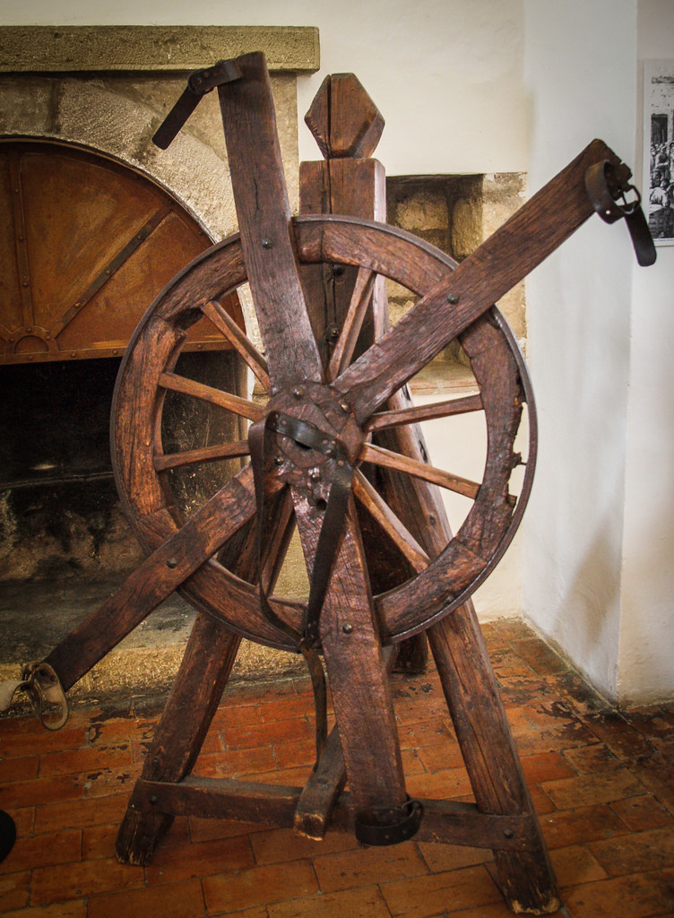
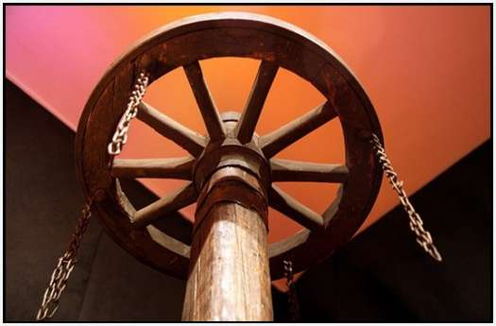
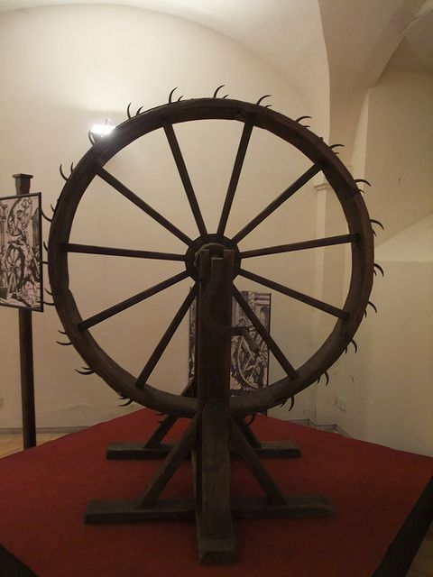
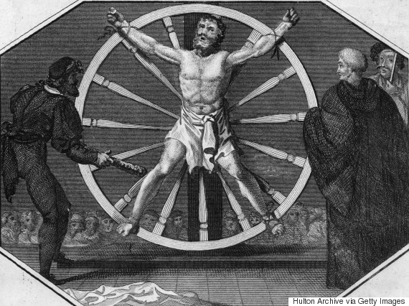
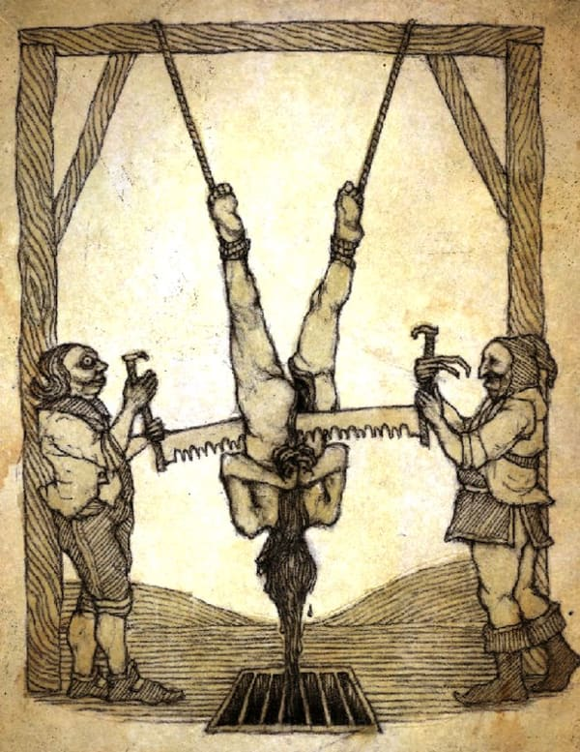
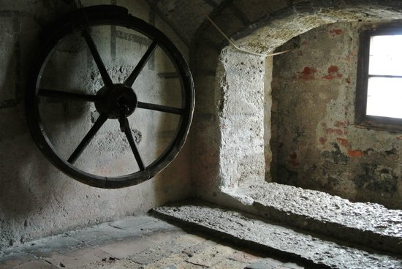
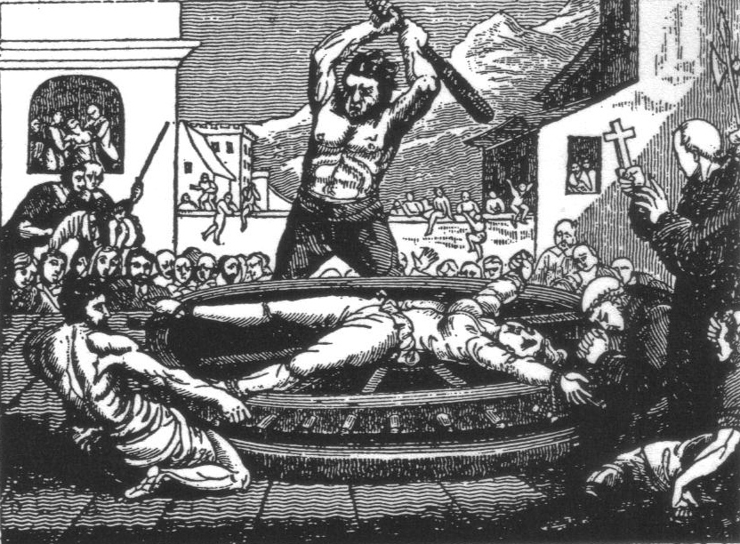
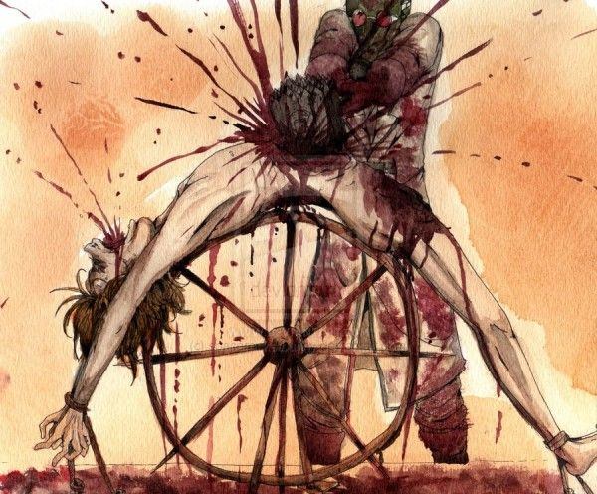
The Wheel of Torture
Through the openings between the spokes, the torturer usually hit the victim with an iron hammer that could easily break the victim's bones. Once his bones were broken, he was left on the wheel to die, sometimes placed on a tall pole so the birds could feed from the still-living human.
Torture chamber Salzburg, Austria

Slide 44
Domitian established emperor worship – once a citizen bowed to Caesar and called him Lord, he/she could go worship any other god of choice – the Christians would not do this.
Why were they tortured and killed?
Because Christians would not add their God to the other Roman or Greek gods.

Slide 45
A twelve year old girl named Agnes, who lived during Diocletian’s persecution (284-305 AD), was told to offer incense at the altar of Minerva in Rome.
When she refused, she was stripped naked and had to stand in a public street. After sufficient humiliation, she was beheaded.
Why were they tortured and killed?
Because Christians would not add their God to the other Roman or Greek gods.
All one would have to do sometimes is just acknowledge that another god existed.

Slide 46
What do you think our Lord would have thought about the Christians who lived in persecution during this time period?
In heaven’s eyes, were these poverty Christians rich?
How do you think they viewed their own lives?

Slide 47
Polycarp (AD 69–156) Bishop of Smyrna (ordained by John)
Polycarp
instructed by apostles
conversed with many who had seen Christ
appointed bishop of the Church in Smyrna by apostles in Asia
always taught the things which he had learned from the apostles

Slide 48
Polycarp eventually visited Rome around 155 A.D
He was an old man of about 86 yrs
It took months to get there from Smyrna at that time - a physically difficult trip for Polycarp.

Slide 49
So many heresies were originating in Rome he felt that as the senior leader of the true Church, he needed to personally try to deal with them
Both John and Polycarp strongly renounced the Gnostic heretics

Slide 50
Polycarp: “Eighty and six years have I served the Lord and He never did me harm. How can I deny Him now? Do what you will.”
As he was burning at the stake, he thanked the Lord that He thought him worthy to be martyred for His kingdom’s sake.

Slide 51
Be Faithful!
God asks us to be faithful – not to be successful
God honors faithfulness – even though it may seem to be a total failure – a total defeat
When we are faithful to do what God asks of us, He is pleased and will reward the faithfulness

Slide 52
Be Faithful!
Sometimes we think success is the reward of faithfulness – it is not
Sometimes defeat comes even though we are faithful

Slide 53
Persecution Today in This Country
We may have to make a decision to follow Christ or bow to the government’s tolerance (acknowledging other gods)
How many will deny their faith to keep the peace, to stay out of jail, or to keep their job?

Slide 54
Persecution Today in This Country
The Christians in the city of Smyrna so long ago knew that death doesn’t last forever – it only acts as an open door to God.

Slide 55
Persecution Today in This Country
Do we have that kind of faith for ourselves?
Can we watch our Christian loved ones being persecuted for the Lord?

Slide 56
That concludes our study of The Church of Smyrna
Lesson 6 in “When Are We Now?”
The first of three studies in
The Revelation of Jesus Christ
by Paige Ramsey

