Slide 1
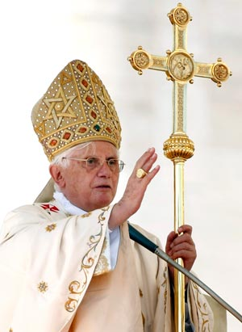
The Church of Thyatira
“the False Church”
Lesson 8 in When Are We Now?
(the first of three studies of The Revelation) by Paige Ramsey

Slide 2
Review of Church History in 312 – 590 A.D.

Slide 3
Pergamos (which means married) was married to the world.
The “Church” (led by Roman officials) marketed the gospel by allowing people to keep their pagan practices and simply rename idols & celebrations “converting” them into “Christian” ones.
During the Church Age it represents (312–500 AD),
the “Church” married into the pagan world system.

Slide 4
Pergamos (which means married) was married to the world.
Codex Theodosianus XVI 1.2.
It is Our will that all the peoples who are ruled by the administration of Our Clemency shall practice that religion which the divine Peter the Apostle transmitted to the Romans....
…The rest, whom We adjudge demented and insane, shall sustain the infamy of heretical dogmas, their meeting places shall not receive the name of churches, and they shall be smitten first by divine vengeance and secondly by the retribution of Our own initiative.
Forced conversion was a major means in the Christianization of the Roman Empire.
In 392 A.D. the emperor, Theodosius I, made Christianity the only legal religion of the empire, and forbade Pagan practices by law as a means to stabilize the declining empire.

Slide 5
Codex Theodosianus XVI 1.2.
led to the destruction of most pagan temples in the empire.
To make this massive conversion easier, the government acknowledged some of the pagan practices as “Christian.”

Slide 6
George Parsons: If You Cannot Beat Them, Join Them!
Thousands of unsaved pagans became baptized and started calling themselves "Christians." Did water baptism make them true Christians? The church gained in QUANTITY but it lost in QUALITY. There was a massive growth in numbers but no growth in purity. The church was becoming more and more worldly and corrupt.
The host of hypocrites and pretenders that was entering the church was multiplying beyond control.
As you can well imagine, many heathen customs and practices crept into the church.
The pagan images and statues were still honored, but they were given "Christian" names such as Peter or Mary. Artemis (Diana) worship was changed to Mary worship. Also Isis, the Egyptian goddess was easily transformed into Mary. Worshippers of Isis called her "the Great Virgin" and "Mother of the God".
Some surviving images of Isis holding the child Horus are in a pose very similar to that of some early Christian Madonnas (showing Mary holding the infant Jesus). Heathen temples were consecrated and changed into churches. Heathen feasts were given Christian names.
It was just the same old paganism or heathenism under a new name!
The church had not conquered the world. THE WORLD HAD CONQUERED THE CHURCH!
Paganism had put on new clothes but it was the same old paganism.

Slide 7
Do we see paganism in our world today?
Do we see it in our churches?
Name some pagan practices that are seen in our Christian homes or churches

Slide 8
A Look at Our Timeline
312 AD Constantine defeats Maxentius (Battle of Milvian Bridge) and becomes Emperor of the West. Constantine used the letters chi and rho (first two letters in "Christ") as his symbol.
312 AD Caecilian elected bishop of Carthage. (results in Donatist Churches)
313 AD Edict of Milan gives Christians equal rights.

Slide 9
324 AD Constantine defeats Licinius and becomes Emperor of both East and West.
325 AD Council of Nicea condemns Arianism (belief that Jesus was created).
337 AD Constantine dies
340 AD Ulfilas converts to Arian Christianity, takes it to Germanic tribes, gives them an alphabet, and translates the Bible into German. Most Germanic tribes become Arian Christians

Slide 10
353 AD Emperor Constantius releases his pro-Arian campaign and drives Athanasius (bishop) from Alexandria
361-363 AD Reign of Julian the Apostate, who converts from “Christianity” to paganism and restores paganism in Rome
367 AD A letter of Athanasius names the 66 books of the canon
(Athanasius dies in 373)

Slide 11
381 AD Council of Constantinople – defeats Arianism & Appolloarianism and declares Father/Son/Holy Spirit as one God in three persons.
393 AD The Council of Hippo recognizes the canon.
To be recognized, a book had to be ¹⁾Apostolic, ²⁾fit in with the other scriptures, and ³⁾have been of fruitful use throughout the church up to that time.

Slide 12
397-401 Augustine (age 22-26) writes Confessions
411-430 Augustine's Anti-Pelagian writings. (Pelagius rejected that we all fell in Adam and have a sin nature. We could earn our salvation by works, so grace is not necessary) Augustine insisted that we all sinned in Adam, resulting in spiritual death, guilt, & our diseased nature. God's grace is necessary not only to be able to choose to obey God's commands, but to be able to choose to turn to God initially for salvation.

Slide 13
418 The Council of Carthage anathematized the teachings of Pelagius.
434 Patrick begins his mission to spread the Gospel in Ireland.
590 Gregory the Great becomes pope. He develops the idea of Purgatory.

Slide 14
Revelation 2:18-29
“And to the angel of the church in Thyatira write,
‘These things says the Son of God, who has eyes like a flame of fire, and His feet like fine brass: “I know your works, love, service, faith, and your patience; and as for your works, the last are more than the first.

Slide 15
Revelation 2:18-29
“Nevertheless I have a few things against you, because you allow that woman Jezebel, who calls herself a prophetess, to teach and seduce My servants to commit sexual immorality and eat things sacrificed to idols. And I gave her time to repent of her sexual immorality, and she did not repent.

Slide 16
Revelation 2:18-29
Indeed I will cast her into a sickbed, and those who commit adultery with her into great tribulation, unless they repent of their deeds. I will kill her children with death, and all the churches shall know that I am He who searches the minds and hearts. And I will give to each one of you according to your works.

Slide 17
Revelation 2:18-29
²⁴ “Now to you I say, and to the rest in Thyatira, as many as do not have this doctrine, who have not known the depths of Satan, as they say, I will put on you no other burden. But hold fast what you have till I come. And he who overcomes, and keeps My works until the end, to him I will give power over the nations—

Slide 18
Revelation 2:18-29
‘He shall rule them with a rod of iron; They shall be dashed to pieces like the potter’s vessels’ — as I also have received from My Father; and I will give him the morning star.
²⁹ “He who has an ear, let him hear what the Spirit says to the churches.”’

Slide 19
a noticeable digression
Ephesus – hated the Nicolaitans
Smyrna – suffered
Pergamos – some hold the doctrine of Balaam & Nicolaitans
Thyatira – allowed Jezebel to promote idolatry
These churches get further away from the truth, and the church as a whole got further away from the truth with each time period they represent in the Church Age.
Note: *Each city had one church
*no church buildings – services in homes
*many congregations – one church

Slide 20
conflicting definitions for the word “thyatira”
“hill graveyard” – a dead church
“castle of Thya” – edifice of death
“daughter” – offspring of the previous
“compromising” church
“continual sacrificing” - the Bible says there is only one sacrifice – once for all! (Hebrews 9:28; 10:14) No longer are we required to make a sacrifice for sin – He is our sacrifice! “It is finished!”

Slide 21
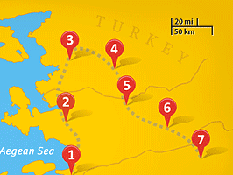
Thyatira is a mud-built town in Turkey, 58 miles N.E. of Smyrna.
Pergamos
Thyatira
Thyatira
Sardis
Smyrna
Philadelphia
Laodicea
Ephesus

Slide 22
Quick History of Thyatira
This city was destroyed & rebuilt over and over again, re-established in 301-281 BC.
Before it was Thyatira, it bore the names Pelopia and Semiramis.
Pelopia is the name of a mythical girl who was raped by her father and committed suicide.
Semiramis is a well-known name in
ancient history.

Slide 23
Quote by Bryce Self
“Any effort to trace the origins of the myth, legend, and lore of goddess-worship will eventually lead one back to a single historical figure---Semiramis, wife of Nimrod and queen of Babylon, and this is especially true when considering the goddess/planet Venus.”
Bryce Self
Semiramis, The Queen of Babylon
http://www.ldolphin.org/semir.html

Slide 24
Interesting Observation
The religious system that Semiramis constructed in the ancient world and the very wide-spread worship of her son, Tammuz, was very similar to the Roman Catholic religious system and resulted in the Tower of Babel and thus, the confounding of languages.

Slide 25
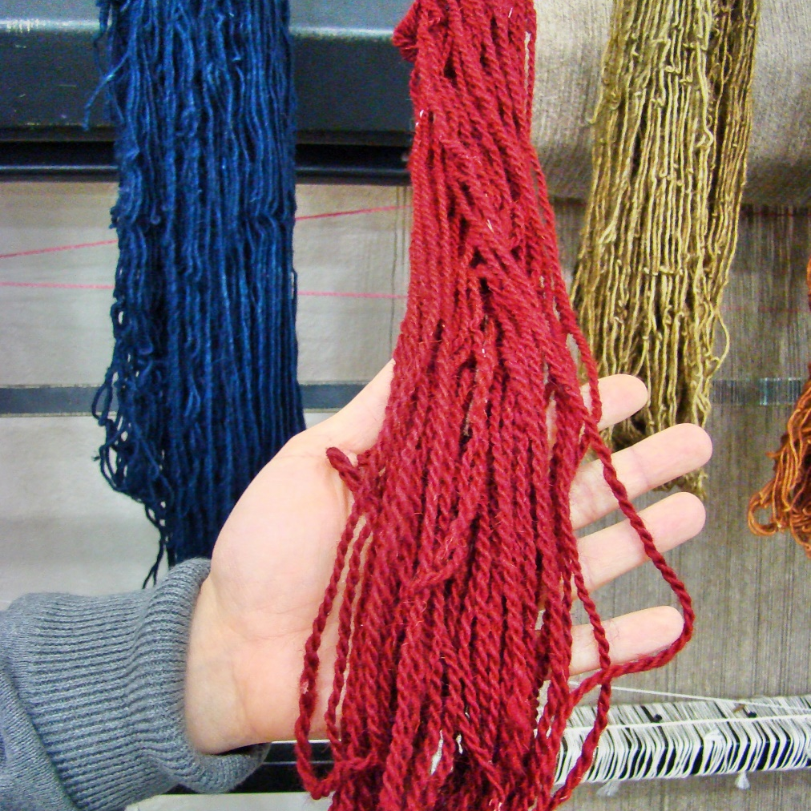
Industry of Thyatira
dyes and fabrics

Slide 26
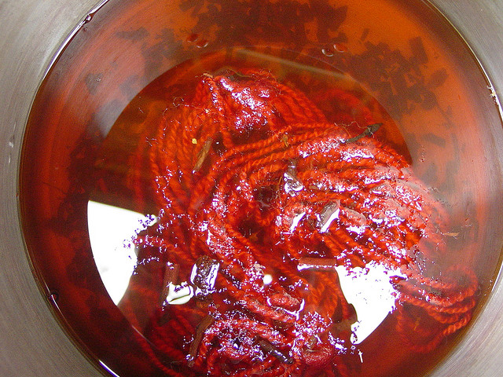
Dyes & fabric
Lydia, a seller of purple came from Thyatira (Acts 16:14)
Thyatirans discovered the madder root, which provided a more permanent, deeper color of red, called “purple” in that day. Today the color is called “Turkish-red” or “scarlet”.
Dyeing Yarn in Madder Root

Slide 27
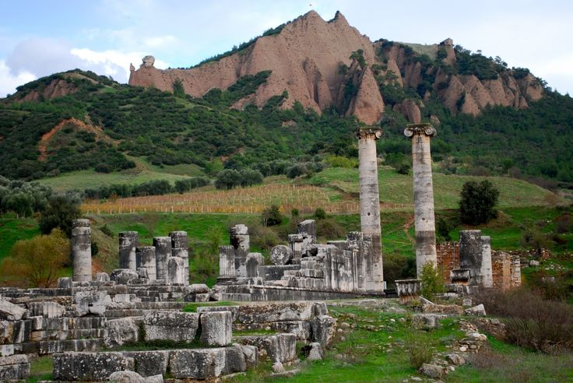
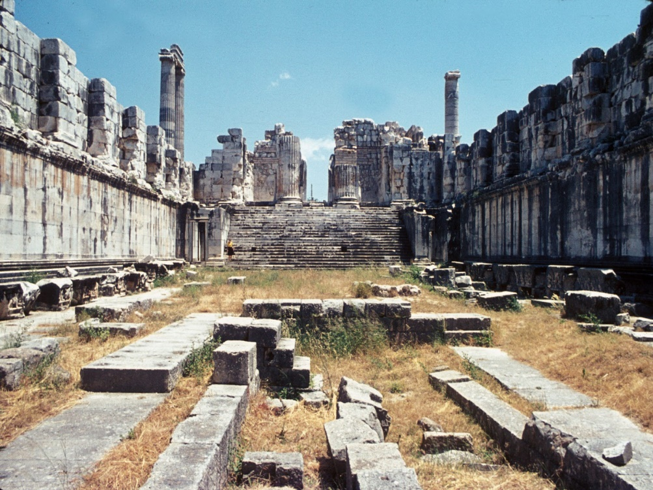
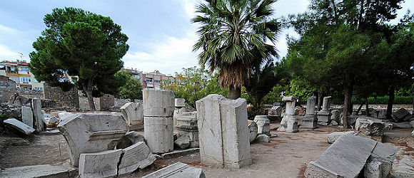
Ruins of Thyatira

Slide 28
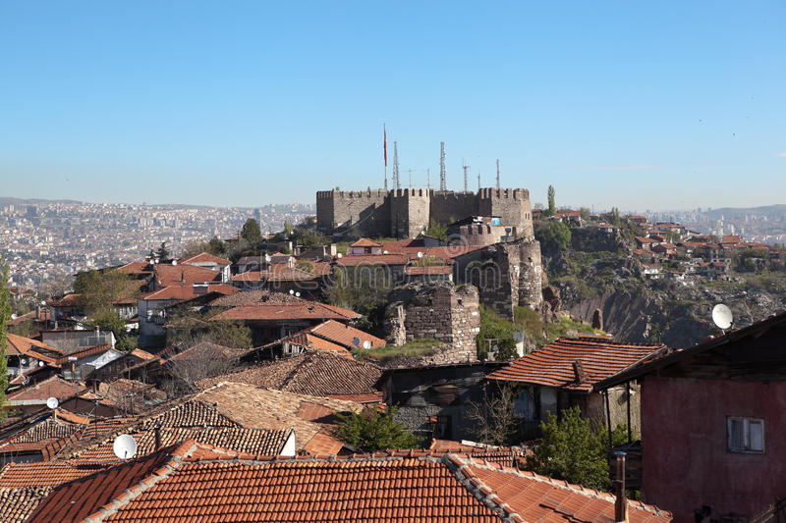
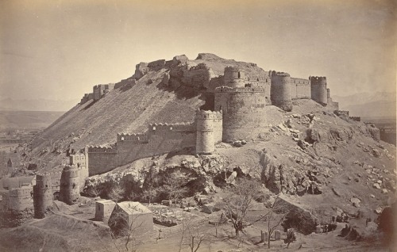
Ak-Hussin (Akhusin)
“White Fort on hill Husin”
Modern Day

Slide 29
These things says the son of God, who has eyes like a flame of fire, and His feet like fine brass
God’s eyes see all the sin in the church. Nothing escapes His fiery eyes of judgment. His feet are swift to judge what He finds. The fact that the Lord began His letter to Thyatira this way shows
He is not happy with this church.

Slide 30
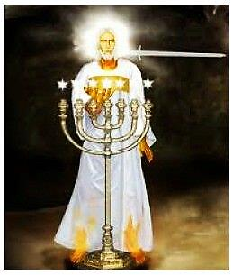
These things says the son of God, who has eyes like a flame of fire, and His feet like fine brass
He is not happy with this church.
He doesn’t say from “He who holds the seven stars” or “He who walks in the midst of the churches”
– He is up front that He is their Judge.

Slide 31
I know your works, and charity, and service, and faith, and your patience, and your works; and the last to be more than the first.
Works mentioned twice, the latter works are greater than the former works.
Obviously, not all the church in Thyatira were involved with the false-church methodology.
Some remained pure.

Slide 32
I know your works, and charity, and service, and faith, and your patience, and your works; and the last to be more than the first.
They had love for each other and for the Lord, they served the Lord, expressed their faith, and had patience.
In fact, looking at this list, they were a pretty good lot!
But… they were allowing the false-church to continue and grow.

Slide 33
…because you allow that woman Jezebel, who calls herself a prophetess, to teach and seduce My servants to commit sexual immorality and eat things sacrificed to idols.
Jezebel is not the name of the woman who was the perpetrator in the church at Thyatira. Jezebel is the term used so the pastor (angel) of the church would recognize where this teaching was coming from, and also makes it much easier for us, 2,000 years later to pin point the offense.

Slide 34
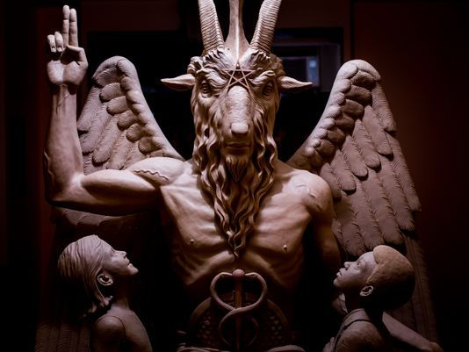
…because you allow that woman Jezebel, who calls herself a prophetess, to teach and seduce My servants to commit sexual immorality and eat things sacrificed to idols.
Jezebel was a queen who wanted to unite the Israelite worship of Yahweh with Baal worship. She came from Baal worship and did not wish to abolish her former beliefs. She distributed idols for the Israelites to worship and spread that idolatry throughout Israel.

Slide 35
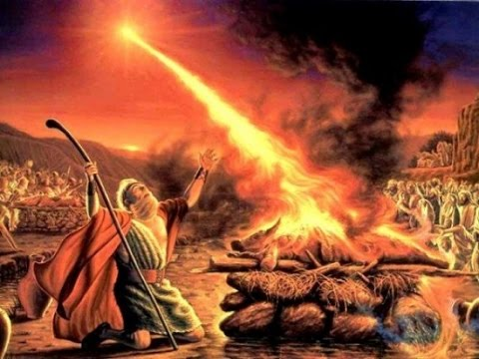
…because you allow that woman Jezebel, who calls herself a prophetess, to teach and seduce My servants to commit sexual immorality and eat things sacrificed to idols.
After Elijah challenged the prophets of Baal, making a mockery of them, and the onlookers executed them, Ahab told Jezebel and Jezebel threatened to murder Elijah the next day (1 Kings 19:1-2).

Slide 36
God has always been strict about the purity of worship. The first commandment given to Moses was, “Thou shalt not have any other gods before me.” However, this is the very commandment the church continues to break over and over again. We continue to try to blend different beliefs into our worship of God Almighty. In fact, the modern ecumenical movement says, “doctrine doesn’t matter… we all just need to love one another… we need to express tolerance…”
“The antichrist will successfully use this method (modern ecumenicalism) to its fullest extent, and the false prophet will lead it!”
Notes from the Wilderness

Slide 37
I gave her time to repent of her sexual immorality, and she did not repent.
God is longsuffering – patient with us. He gives us ample time to repent and obey Him.
We are stubborn. We do not like to admit we are wrong.
We want to justify ourselves in any way we can.

Slide 38
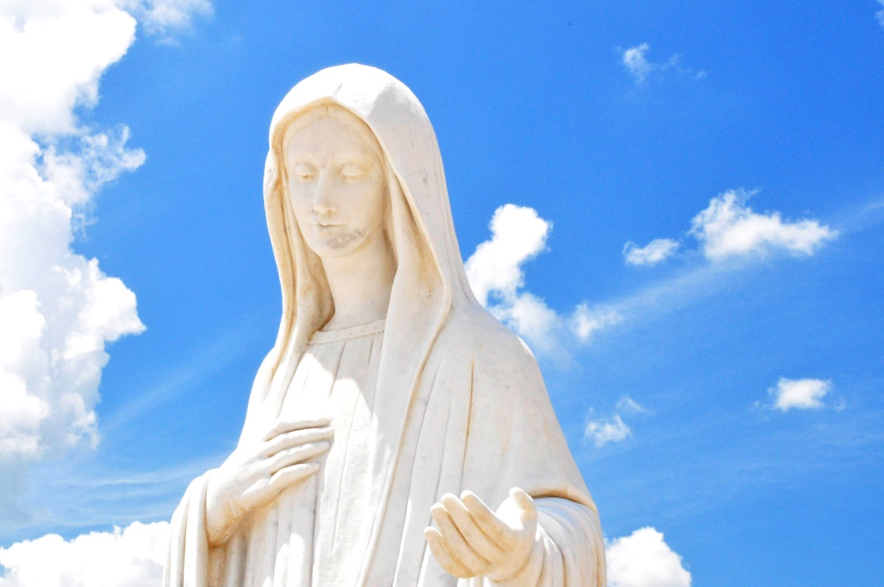
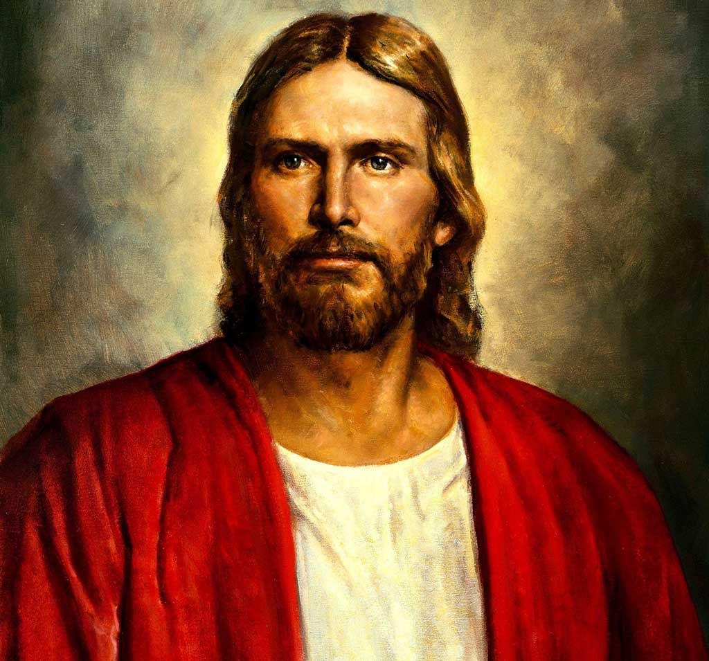

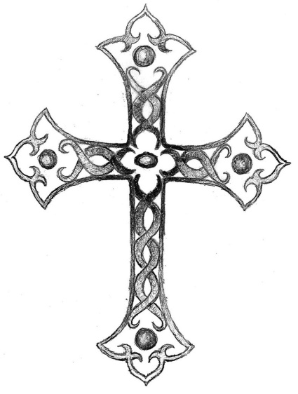



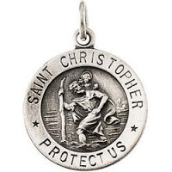
Indeed I will cast her into a sickbed, and those who commit adultery with her into great tribulation, unless they repent of their deeds.
We need to be careful not to harbor Jezebel in our churches today.
Idolatry is condemned on every level.
We do not need statues, pictures, crosses, symbols, etc. to pray to or for “charms” of protection, good luck, etc.
All of this is idolatry.

Slide 39





Christians collecting crosses or angels because “they make me feel good” can be or can easily slip into idolatry. When we make anything more important than our worship and service to God, it becomes an idol. Television has been a modern idol for many as it can take up much more of our time than the pursuit of knowing God. It might even be facebook, games, anything that gets in the way of our worship and service to God. Let’s be very careful not to become idolatrous.

Slide 40
I will kill her children with death, and all the churches shall know that I am He who searches the minds and hearts.
What is born from idolatry?
More idolatry!
Whatever comes from idolatry must be destroyed!
Allow God to search your heart to see if there is anything that hinders your worship and your service to Him.

Slide 41
Allow God to search your heart to see if there is anything that hinders your worship and your service to Him.
Ask Him to reveal it to you. Sometimes it isn’t easy to see our own idolatry, but if you are willing, God will show you.
What do you find easy to become idols in your life?

Slide 42
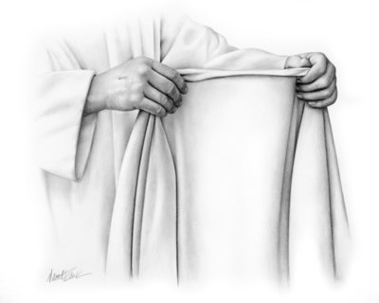
I will give to each one of you according to your works.
This is just and fair
but we don’t want justice or fairness from God – especially for our works!
Are you sure Christ has robed you in His righteousness?
All our works – our righteousness – are like filthy rags!!
We do not want God to give us anything according to our works! We want to repent of our works and for Christ to put His work upon us!!

Slide 43
Now to you I say, and to the rest in Thyatira, as many as do not have this doctrine, who have not known the depths of Satan, as they say, I will put on you no other burden. But hold fast what you have till I come.
Quote from InterVarsity Press:
He is not, like the angel at Pergamum, told to "repent," but simply to hold on to what you have until I come. Consequently, the "coming" of the risen one is not a threat, but a hope. This suggests that Jezebel and her clan may not have been an actual part of the congregation, but a separate community trying to entice away its members.
As for the angel (pastor), the words of praise at the beginning of the message (I know your deeds, your love and faith, your service and perseverance) are still in effect.
Quote from InterVarsity Press

Slide 44
Obviously, Jezebel only took over a part of the church, and the Lord is now speaking to the true church to hold on to the truth.
The true church always existed and stood against the Roman Catholic system.

Slide 45
For centuries the true church was underground as it was actively sought by the Roman Catholic hierarchy and when found, was utterly destroyed along with all records and teachings.
Very little evidence has survived of these flocks outside the true doctrines preserved by the Lord through salvations and oral teaching.

Slide 46
And he who overcomes, and keeps My works until the end, to him I will give power over the nations—‘He shall rule them with a rod of iron; They shall be dashed to pieces like the potter’s vessels—as I also have received from My Father; and I will give him the morning star.
God will one day rule with a rod of iron. This is a quote from Psalm 2:9. It hasn’t happened yet. We will rule with Him and have power over the nations!! Can you even fathom this!?

Slide 47
False Doctrines
There were two false doctrines that began to crop up in the church of Pergamos (and in the Church Age just before the Church Age of Thyatira):
1) the doctrine of Balaam &
2) the doctrine of the Nicolaitans.
These two teachings began to grow and spread throughout the churches.

Slide 48
False Doctrines - Balaam
Balaam went even further after he realized he could not do what Balak wanted – whether to save himself from Balak or what, he decided to reveal a plan to destroy the Israelites. He gave Balak the idea to entice the Israelite men with Moabite women, so they would commit fornication and then God would no longer bless them. Numbers 25:9 gives us the death results of God’s plague that came upon the Israelites because of Balaam’s compromise.
Compromising the faith for money
Disobeying God’s Instructions
The true gospel of the Lord Jesus Christ is not to be married into pagan beliefs or be compromised in any way!

Slide 49
False Doctrines – Nicolaitans
The Nicolaitans started a system of priestly confessions and hierarchy.
This system caught on and grew into what is now known as the Roman Catholic Church.

Slide 50
500 AD–1500 AD
The church of Thyatira represents the Church Age in the years 500 AD–1500 AD – the Church of the Dark Ages.
It is dark because of many reasons:

Slide 51
500 AD–1500 AD
The scarcity of the Word of God. Only the pope and papacy had a copy.
The oppression of the papacy upon the people. The people could only depend upon the papacy for guidance, and the papacy took huge advantages of their power.
Superstition prevailed.

Slide 52
500 AD–1500 AD
A religious system prevailed in the Roman Church that solidified the two false doctrines of Balaam and the papacy system of the Nicolaitans, and then added the idolatry (statue worship) of Jezebel. It provided a license to sin with a way of absolving those sins by the clergy – this became known as indulgencies.

Slide 53
500 AD–1500 AD
The rich could pay off the church so they could do something underhanded and not be held accountable. Roman Catholic priests were making continual sacrifices for forgiveness of sins.
(Remember Hebrews 9:28; 10:14? – only ONE SACRIFICE!)

Slide 54
500 AD–1500 AD
Popery was introduced during this time. The pope of Rome still today wears a sash that reads (in Latin) “In place of the Son of God.” Roman Catholics are taught that the pope is Jesus on this earth and has the power to introduce new doctrines, new truths, new practices, etc. in Jesus’ place.

Slide 55
500 AD–1500 AD
Last rites (words said by a priest to ensure the eternality of the soul), indulgencies, idolatry, transubstantiation (the belief that the bread and wine of communion actually becomes the flesh and blood of the Lord Jesus Christ when it is consumed)… were all introduced during this time period.

Slide 56
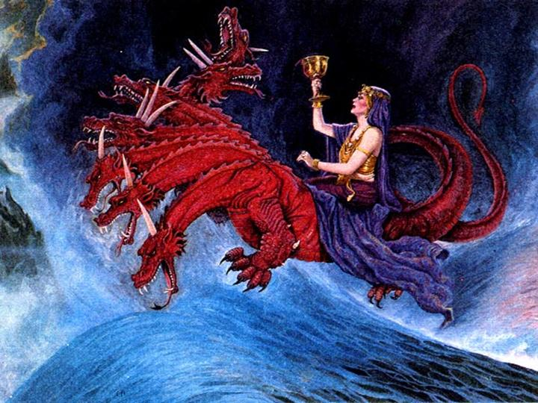
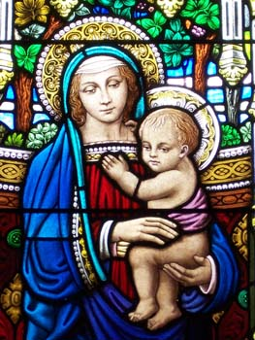
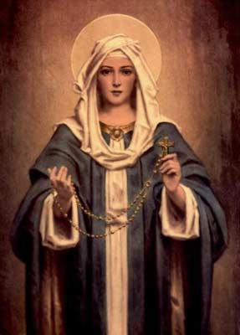
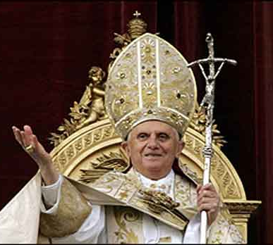
500 AD–1500 AD
This religious system is the Jezebel spoken of in the Lord’s letter to the church at Thyatira.

Slide 57
Matt. 16:5-12 – Now when His disciples had come to the other side, they had forgotten to take bread. Then Jesus said to them, “Take heed and beware of the leaven of the Pharisees and the Sadducees.”
And they reasoned among themselves, saying, “It is because we have taken no bread.”
But Jesus, being aware of it, said to them, “O you of little faith, why do you reason among yourselves because you have brought no bread?

Slide 58
Do you not yet understand, or remember the five loaves of the five thousand and how many baskets you took up? Nor the seven loaves of the four thousand and how many large baskets you took up?
How is it you do not understand that I did not speak to you concerning bread?—but to beware of the leaven of the Pharisees and Sadducees.”
Then they understood that He did not tell them to beware of the leaven of bread, but of the doctrine of the Pharisees and Sadducees.

Slide 59
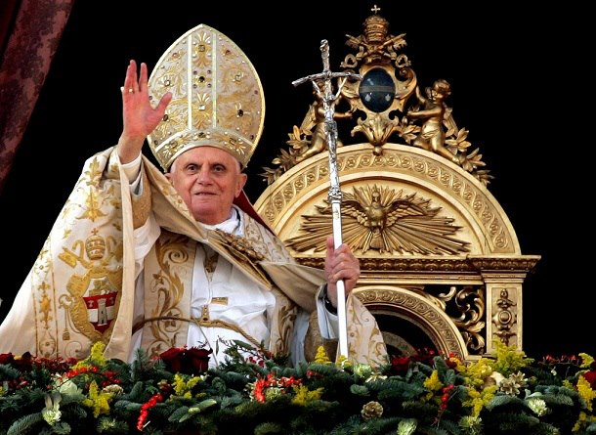
Beware the Leaven!!
It only takes a little yeast to permeate the whole loaf of bread. A little false doctrine will permeate the whole truth!

Slide 60

Jezebel
Behold I will cast her
(this Jezebel – this religious system)
into a bed…
And when He does, there will be many who want to commit adultery with her.

Slide 61
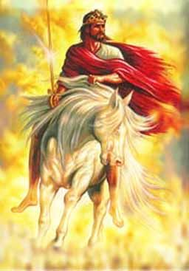
He will rule!
Rev. 12:5 – And she bore a male child who was to rule all nations with a rod of iron. And her Child was caught up to God and to His throne…
Israel gave birth to the Messiah and He was “caught up” when Jesus ascended back into the heavens – and has been there for the last 2,000 years.
Rev. 19:15 – …and
He Himself will
rule them with a
rod of iron…
This hasn’t
happened yet!

